Slide 1
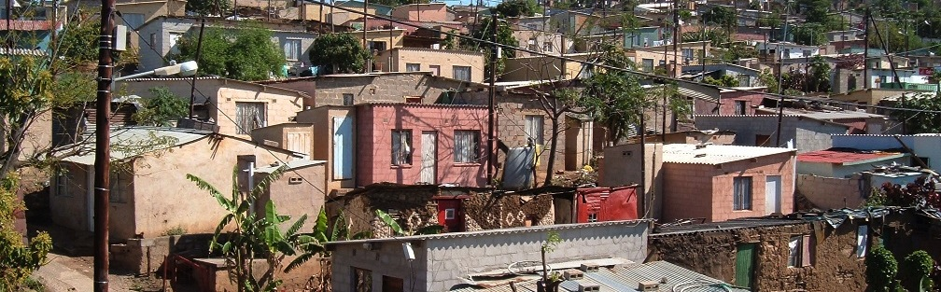


INTRODUCTION TO
INFORMAL SETTLEMENT
UPGRADING
MODULE 1: THE CASE FOR INCREMENTAL UPGRADING

Slide 2
Module purpose
To give you an understanding of the definitions and concepts of informal settlements and why they are an emergency in South Africa at present.
To explain what is meant by an incremental approach to upgrading informal settlements and why it is a relevant approach, so that you can promote incremental upgrading as an effective strategy to respond to the needs of the urban poor.

Slide 3
Learning outcomes
After participating in the module, you should be able to:
Explain the key criteria of an informal settlement.
Describe the main features of the informal settlement context in South Africa and why it is an emergency.
Explain the implications of the Constitutional rights of informal settlement residents.
Explain how informal settlements relate to towns and cities as a whole and the implications of this for municipalities.
Describe what incremental informal settlement upgrading is and discuss its advantages and limitations.

Slide 4
What the module covers
What are informal settlements?
Who lives in informal settlements?
Informal settlements are an emergency
What are the rights of people living in informal settlements?
Informal settlements and the town or city
The case for incremental upgrading of informal settlement
Informal settlements cannot be ignored

Slide 5
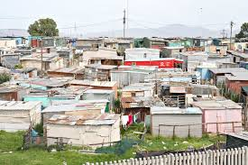
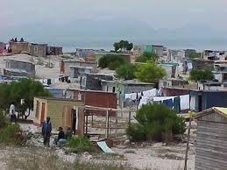
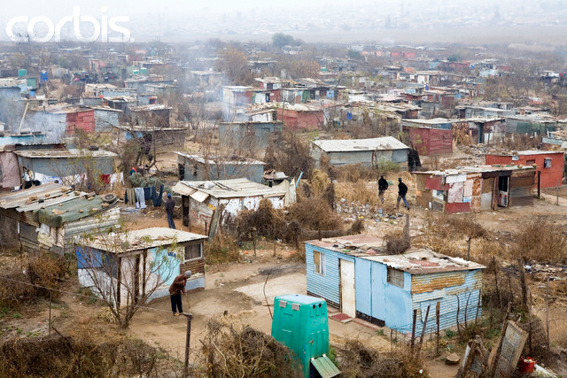
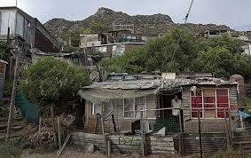
What are informal settlements?
Source: http://www.corbisimages.com/stock-photo/rights-managed/42-16943654/south-africa-soweto-chicken-farm-informal-settlement and http://www.bdlive.co.za/incoming/2013/04/24/240413bl-lead-.jpg/ALTERNATES/crop_638x402/240413BL+Lead+.jpg

Slide 6
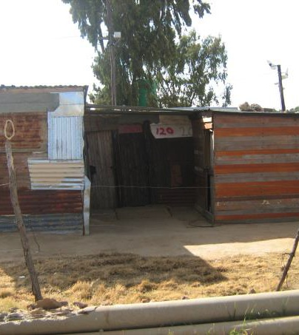
Informal settlements defined
Informal settlements are settlements which have not gone through the statutory approval processes and don’t comply with norms and standards.
This does not refer to the intentional bypassing of planning laws and regulations, but rather where poor households have occupied the land for a range of reasons including that affordable land and housing products are scarce and complying with planning regulations is expensive
An “Informal Settlement” exists where housing has been created in an urban or peri-urban location without official approval’ (NUSP)

Slide 7
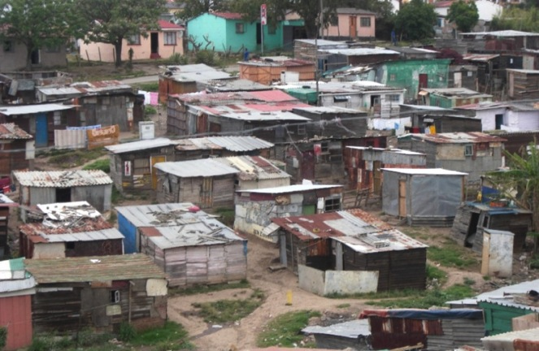
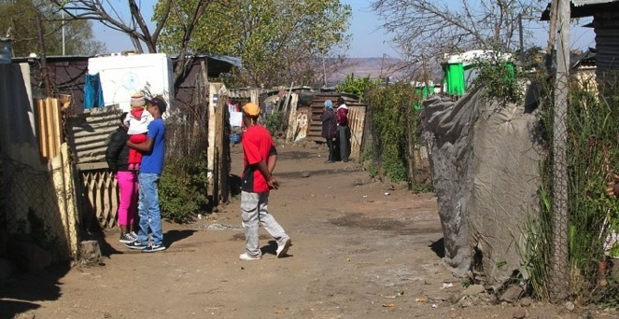
Activity 1.1 Know what you know
Type of activity: Individual work
Timing: 10 minutes
Purpose: To reflect on your own understanding of informal settlements.
Instruction: Consider the two photographs and answer the questions in the Participant Manual

Slide 8
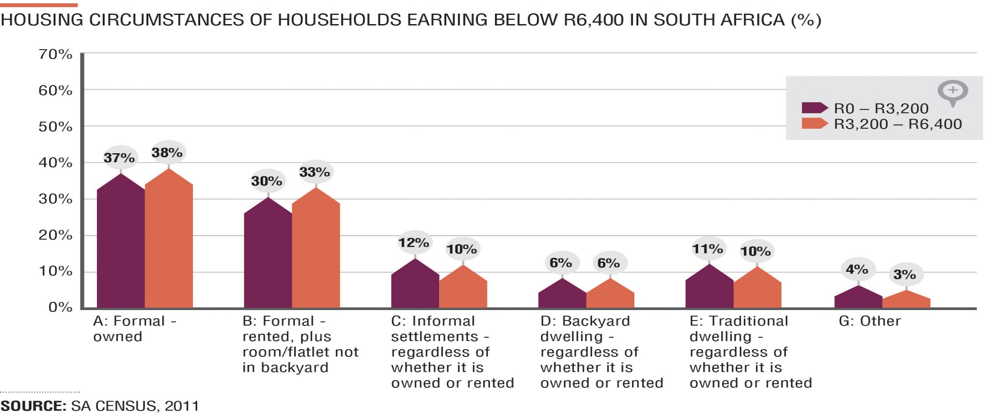
2.Who lives in informal settlements?
The 2011 Census indicates that there are approximately 1.25 million households or 8.6% of all households in South Africa living in an informal settlement
In 1994 there were about 300 settlements - today this number has grown to approximately 2700 settlements.
According to Census 2011, 12% of households earning below R3,200 and 10% of households earning between R3,200 to R6,400 live in informal settlements.

Slide 9
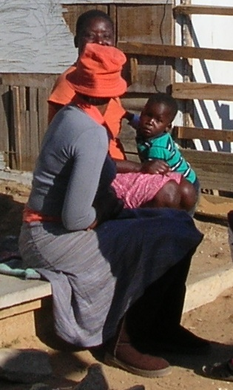
Households living in informal settlements
A very diverse range of households live in informal settlements
18% are nuclear families (mother, father, children)
11% are single parent (no spouse)
24% include extended family members (grandparents, grandchildren, relatives, in-laws or individuals who are not related)
The remainder (47%) are made up of single people, unrelated people sharing or households without children.

Slide 10
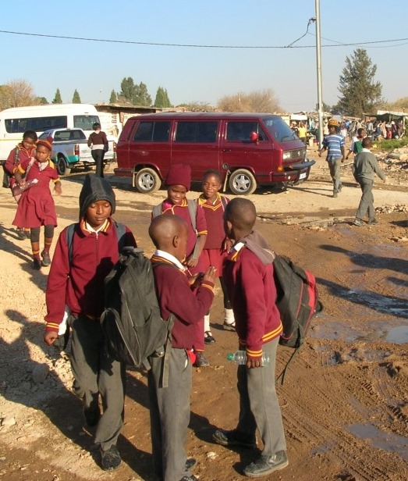
Children living in informal settlements
About 1 million children live in informal settlements.
81% have both parents alive (17% don’t)
2% are orphans
88% attend school
12% of children aged 7-17 don’t go to School
→ Parents in informal settlements are trying to ensure a future for their children

Slide 11
Where do residents come from?
While there is a belief that informal settlements are populated predominantly by foreign migrants, this is not the case - most migration is internal to South Africa
Migration of people under 35 years of age to urban areas from 2001 to 2011:
  6% moved from a different province in SA
  16 % moved within the same province in SA
  3% moved from across the border
Highest migration is
  out of the Eastern Cape
  Into Gauteng

Slide 12
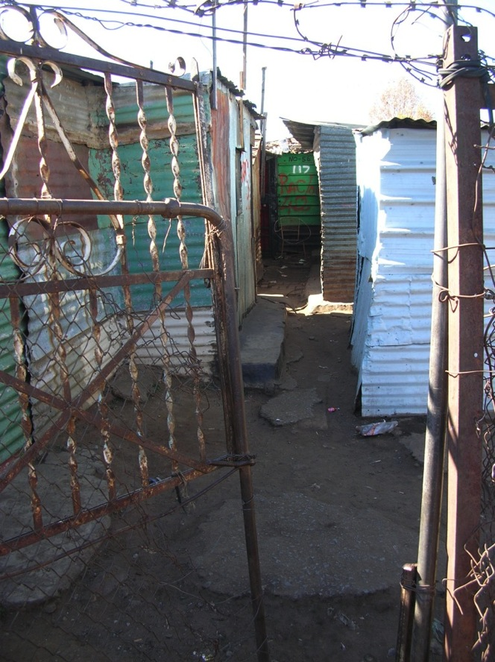
Migration and Rental
Migrating households maintain ties with their friends and relatives in the places they migrated from.
Some households will lock up their shacks and be absent for several months.
New migrants often become tenants in informal settlements - 17% of shacks not in backyards are rented

Slide 13
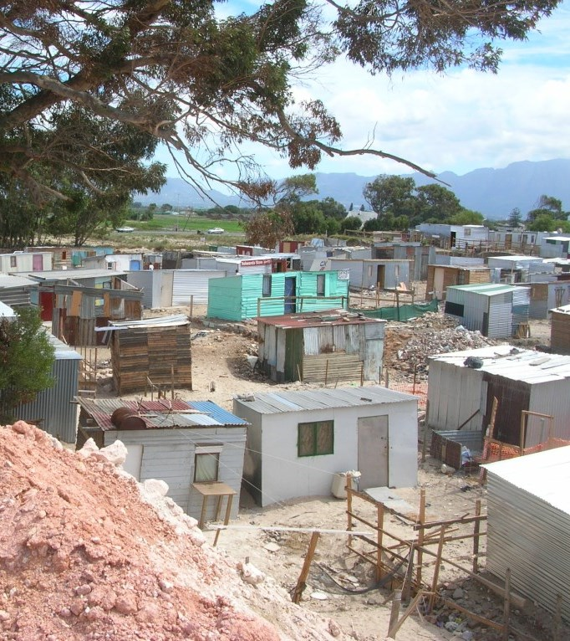
3. Informal settlements are an emergency
Living in an informal settlement is extremely hard and has many negative consequences
In the South African Housing Code, the Upgrading of Informal Settlements Programme (UISP) uses five criteria to identify informal settlements (known as the UISP criteria).
Notes:
10 min presentation that highlights key terms/criteria used to describe these settlements. Basic explanations are given. The definitions include UISP criteria but also point to the positive aspects. The implications of each criteria is included in red.

Slide 14
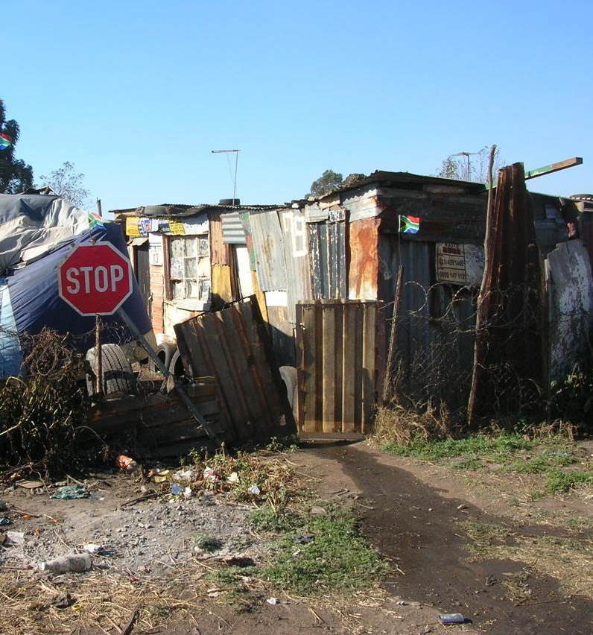
UISP Criterion 1: Illegality and informality
In law: ‘Unlawful occupation’
No formal planning
No permission to use
the land
No authorisation of the construction
→ No legal basis for the
household to invest in
home improvements
Notes:
Jill: good slide

Slide 15
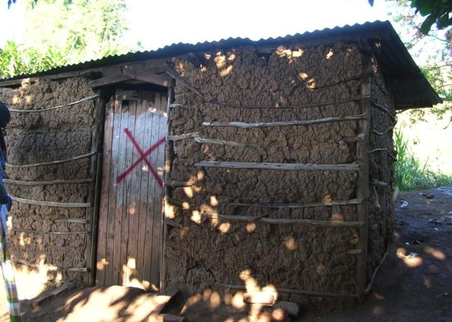
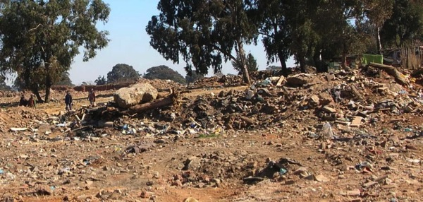
UISP Criterion 2: Insecure tenure
No formal guaranteed rights to continue living there
Uncertainty over the future
Possibility of being evicted in future
  → Not possible for the household to plan ahead

Slide 16
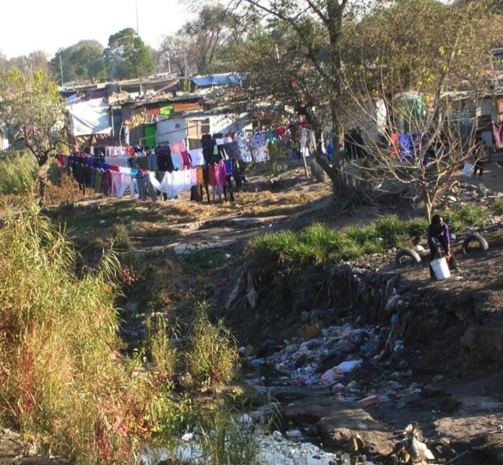
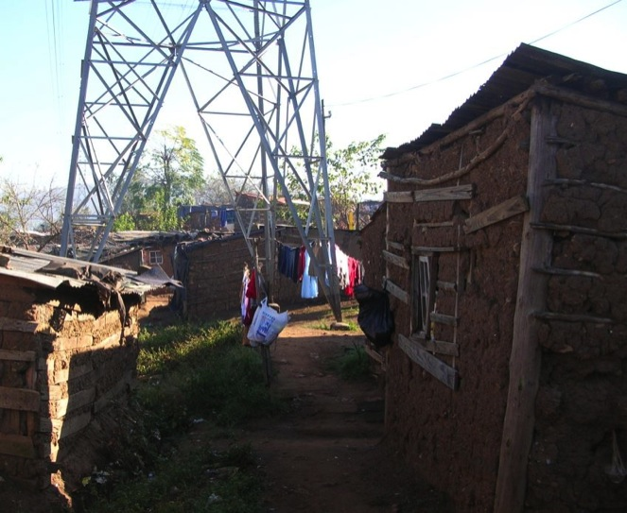
UISP Criterion 3: Inappropriate locations
  →Daily discomfort, inconvenience and fear of
  disaster

Slide 17
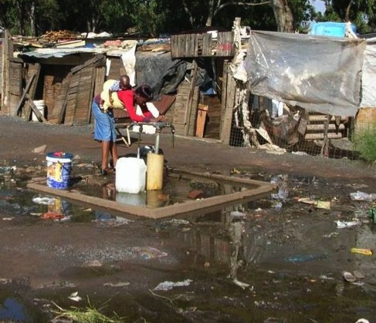
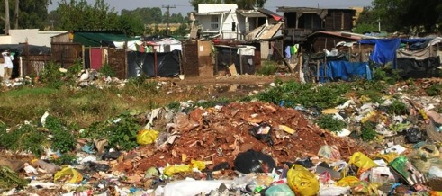
Criterion 4: Limited public sector investment
None or only very basic services
No street lights
Roads and paths not surfaced
Long distances to clinics, schools, post offices, police stations
No postal address/delivery
  → Much time spent walking,
  carrying, travelling, waiting

Slide 18
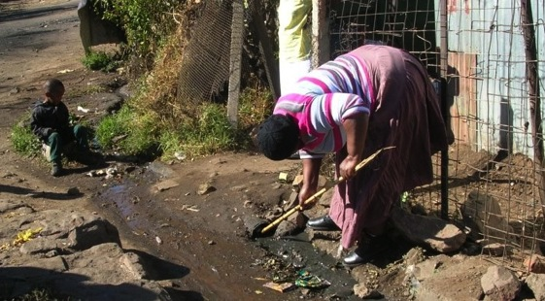
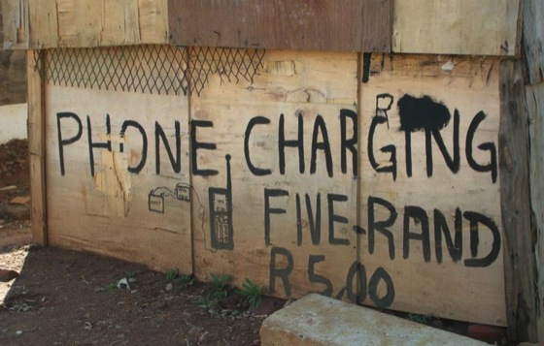
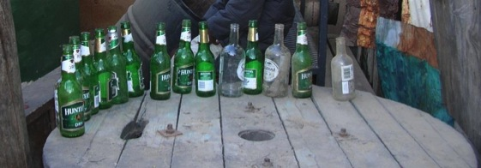
Criterion 5: Poverty, vulnerability and social stress
Low levels of education
Long periods of formal unemployment
Poorly paid and insecure informal jobs
Inadequate income for nutrition and basic home improvements
Vulnerable to exploitation
→ Prevalence of depression,
tensions, conflicts, dependencies, abuse
Notes:
Exploitation by loan sharks, unethical businesses, slum-/shack lords or ruthless politicians

Slide 19
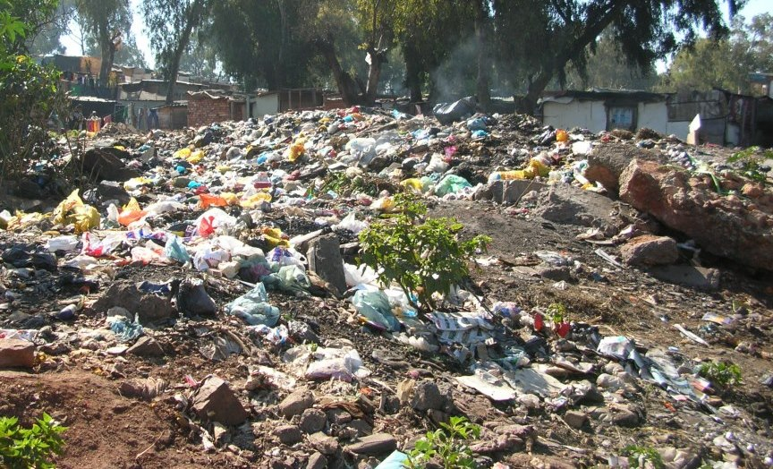
The negative consequences of living in informal settlements – refuse collection
Only 48% of households in informal settlements have their refuse removed at least once a week (52% don’t)
→
Many people in informal settlements are exposed to rats, cockroaches, smells and health threats caused by uncollected refuse.

Slide 20
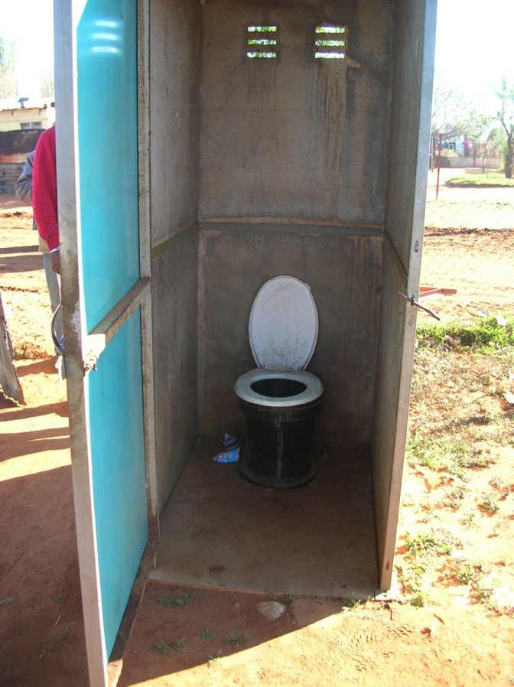
Sanitation
Only 32% of households in informal settlements have access at least to a pit latrine (68% don’t)
→ Many people in informal
settlements have to use
the open veld, bushes
or plastic bags and are
therefore exposed to
disease and abuse.

Slide 21
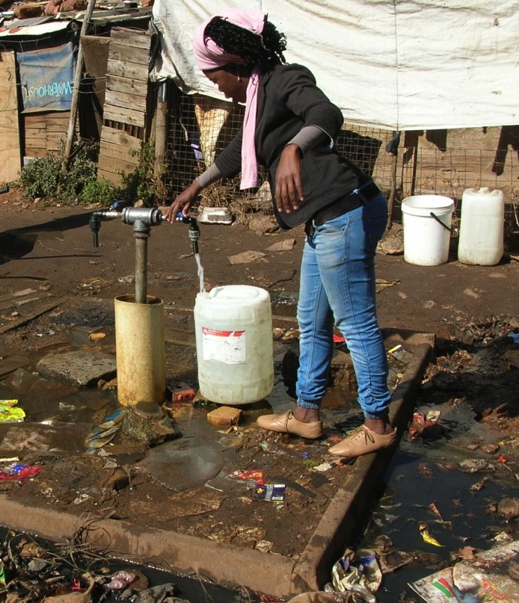
Water
72% have access to a water tap less than 200m from their shack (28% don’t)
→ Many people do not have access to enough water for basic hygiene and are therefore exposed to disease.

Slide 22
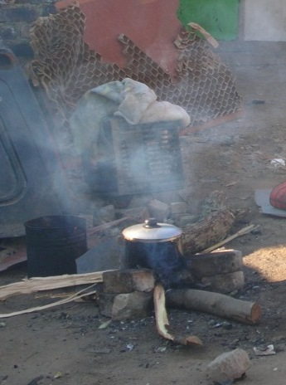
Electricity
Only 43% of households in informal settlements have access to electricity (57% don’t).
→ Most shack dwellers use alternative fuels (wood, coal, paraffin and candles) which can easily cause fires.

Slide 23
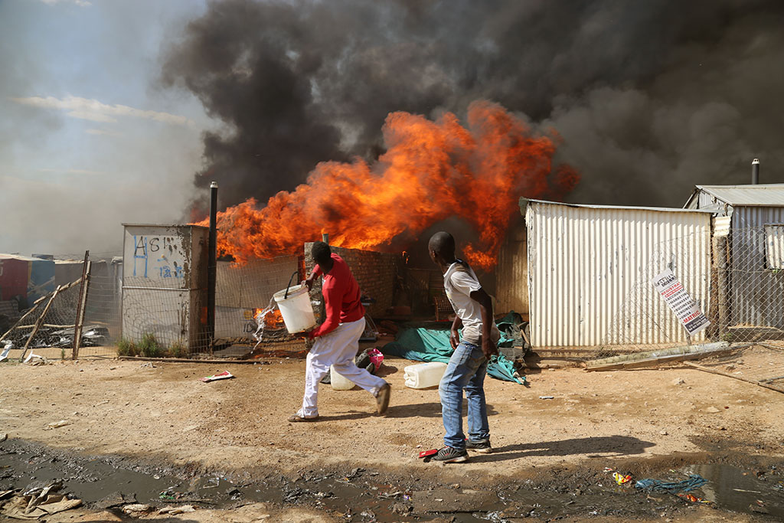
Fire
Nationally there are 10 shack fires each day, causing over 200 deaths per year.
→ Shack dwellers live in constant fear of losing belongings, loved ones or their own life.

Slide 24
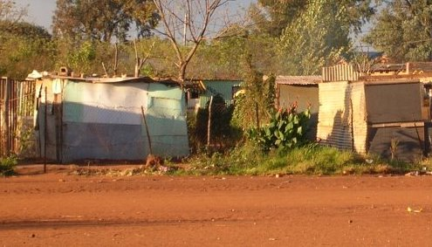
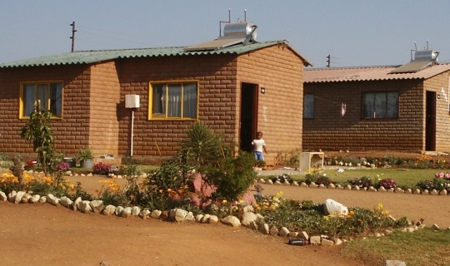
Health and Diseases
In urban informal settlements the HIV prevalence is 19.9%
In formal urban areas the annual HIV incidence rate is 10.1%
Ten times more infants die of diarrhoea in informal areas than in formal areas
→ It is hard to stay healthy if you live in an informal
settlement

Slide 25
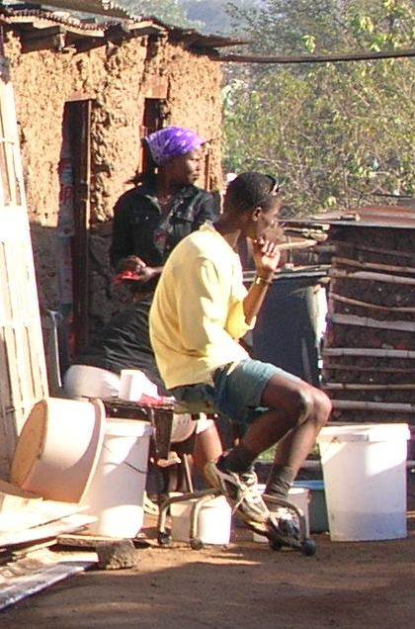
Limited opportunity for play, exercise and creativity, as well as local entrepreneurship
A lack of private and public space for different activities
A concentration of people with very low income levels, low levels of job security, and little money to spend
→ often results in insecurity and instability and limited opportunity for local entrepreneurship.

Slide 26
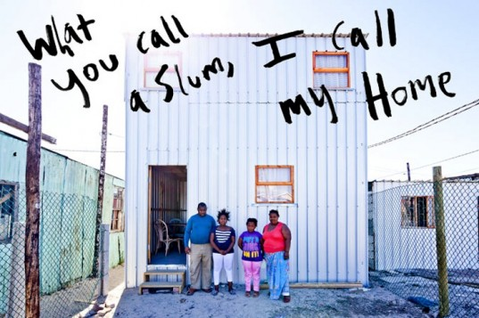
Positive aspects of informal settlements

Slide 27
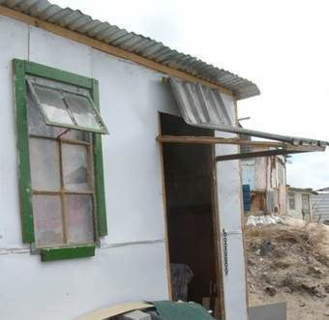
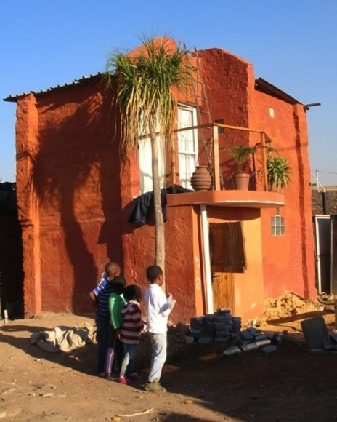
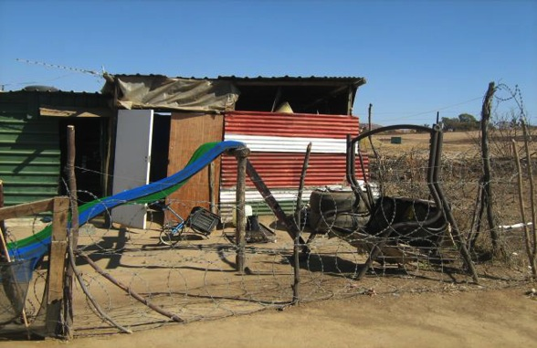
Positive aspects of informal settlements
Informal settlements are also places of
  Innovation & ingenuity
  Flexibility

Slide 28
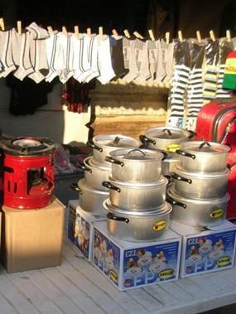
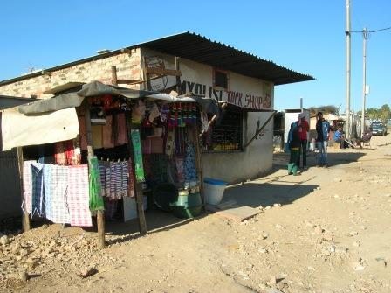
Positive aspects continued
  Opportunity and
  Affordability

Slide 29
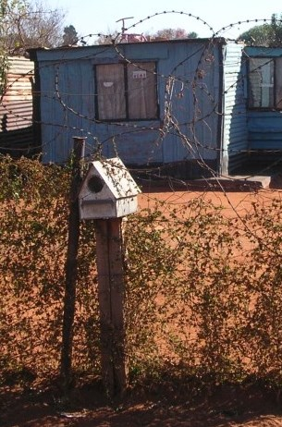
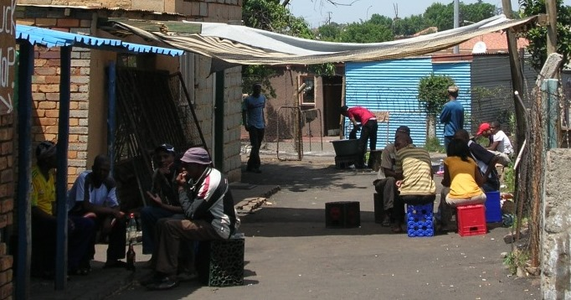
Positive aspects continued
  Hope
  High levels of social
  interaction
  Sharing among neighbours

Slide 30
Is informality chaos?
Informal settlements may seem disordered
But:
Note high level of order may exist
  Formal residents’ committees
  Rules and regulations on who may build where
  Networks and systems of support
  Community policing

Slide 31
Activity 1.2: Factors leading to informal settlements
Type of activity: Pair work
Timing: 10 minutes + 20 minutes de-brief
Purpose: To explain the scale of the informal settlement situation in South Africa.
Instruction: In pairs, discuss why we have so many informal settlements in South Africa. Write four reasons onto four cards. After five minutes these cards will be collected, read out and clustered into themes.
In the participant manual you may write down the reasons you identified, as well as any that were raised by the other participants

Slide 32
Factors Leading to Informal Settlement Situation
Apartheid legacy
Economy unable to create enough jobs
Land market has remained exclusionary
Cost of formal development
Skills deficit in the bureaucracy
Planning makes it too complicated to release land for poor people to settle on
Land is too expensive
Private property rights are protected

Slide 33
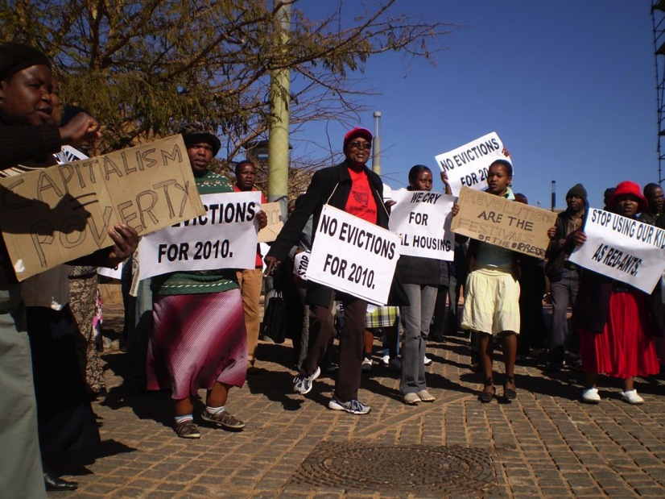
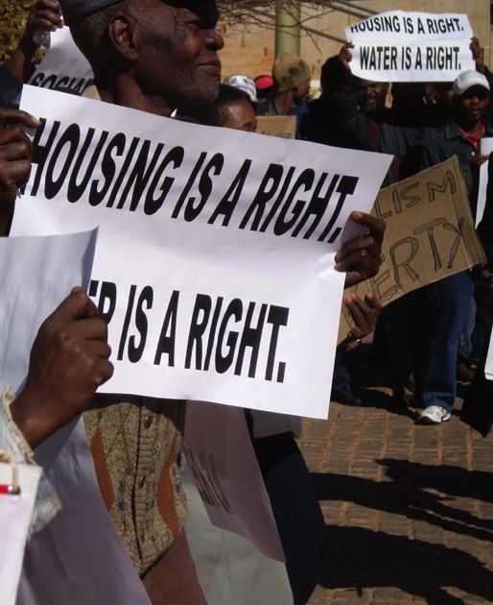
4. What are the rights of people living in informal settlements?

Slide 34
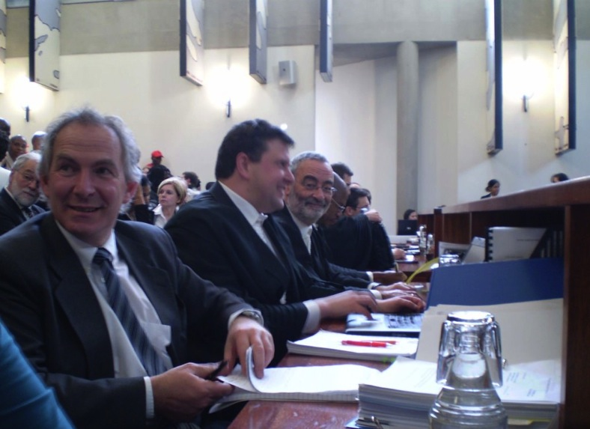
What this session covers
Rights in the Constitution
Constitutional Court cases: implications for
  the state

Slide 35
The Constitution, Section 26 (1): The Right to Housing
Everyone has the right to have access to adequate housing.
→ Most people in informal settlements do not
have this.
The state must take reasonable legislative and other measures, within its available resources, to achieve the progressive realisation of this right.
→ The state may not neglect the informal
settlement situation.

Slide 36
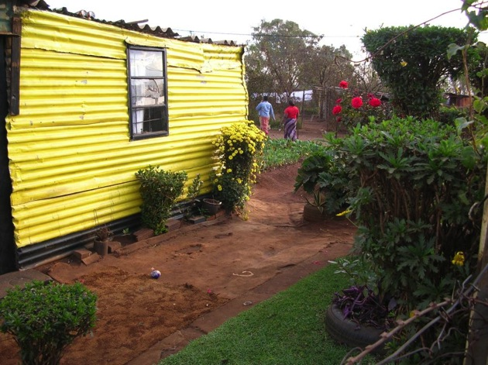
Section 26 (1): The Right to Housing
No one must be evicted from their home, or have their home demolished, without an order of the court made after considering the relevant circumstances. No legislation may permit arbitrary evictions.
→ Homes in informal
settlements are
protected from
un-procedural action.

Slide 37
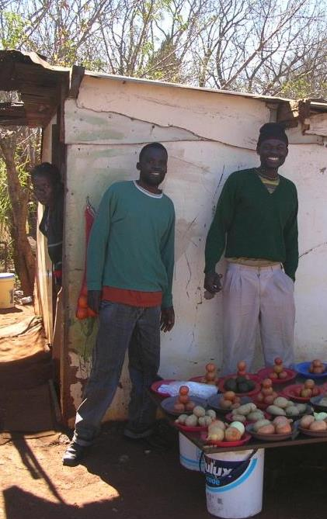
Section 9: The Right to Equality
Everyone is equal before the law and has the right to equal protection and benefit of the law.
→ Informal settlement
residents must be
treated like everyone else.

Slide 38
The Right to Equality cont.
Equality includes the full enjoyment of all rights and freedoms. To promote the achievement of equality, legislative and other measures designed to protect or advance persons, or categories of persons, disadvantaged by unfair discrimination may be taken.
→ Given the legacy of apartheid which disadvantaged those living in informal settlements today, measures have to be taken to redress this situation.

Slide 39
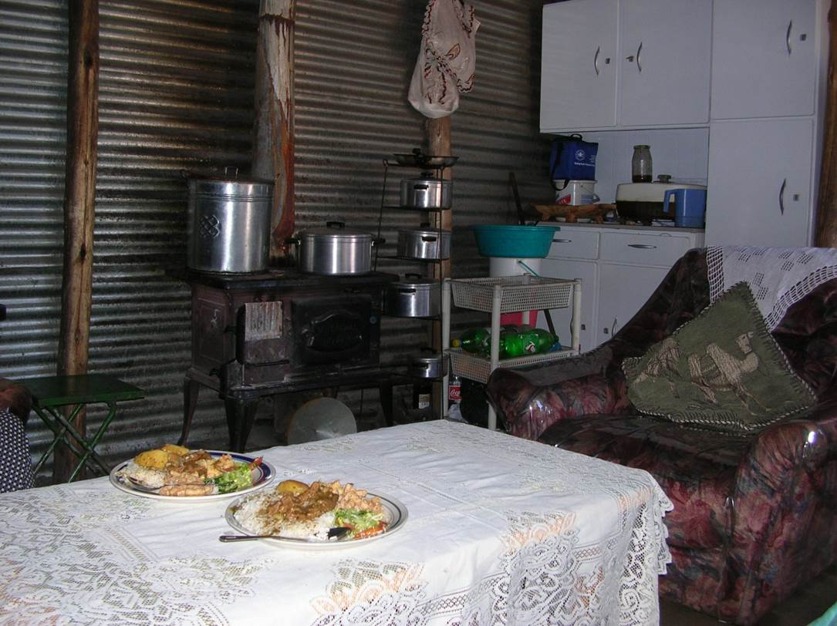
Section 10: The Right to Human Dignity
Everyone has inherent dignity and the right to have their dignity respected and protected.
→ A home in an informal settlement provides a level of dignity that may not be taken away.

Slide 40
Where to begin realising these rights?
Legislation has been designed to give meaning to these rights, e.g.:
Housing Act 107 of 1997
Prevention of Illegal Eviction from and Unlawful occupation of land Act 19 of 1998
→ But ‘mere legislation is not enough’. Policies and
programmes are required that are ‘reasonable
both in their conception and their implementation’
(Constitutional Judge Yacoob in the Grootboom ruling,
s42)

Slide 41
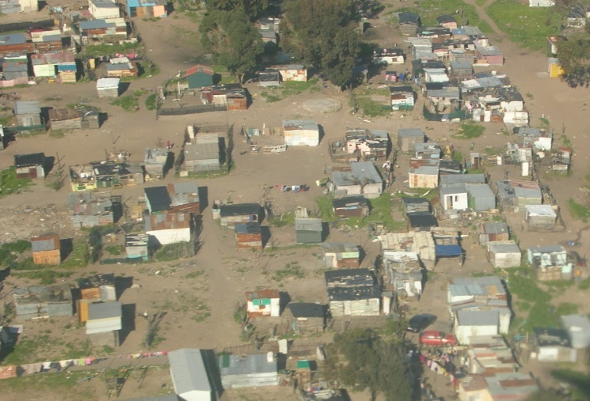
Constitutional Court cases: implications for the state

Slide 42
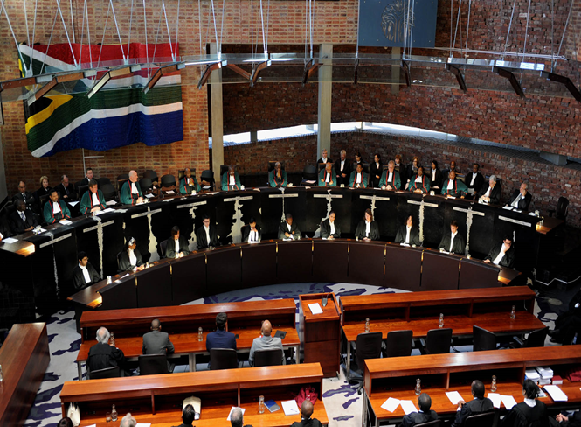
The role of the Constitutional Court
The Constitutional Court has had to consider mistakes made by the state.
The Court considers these mistakes carefully and its judgments become law (so-called ‘case law’). They bind the state.
Four clear principles have merged out of the informal settlement case law.

Slide 43
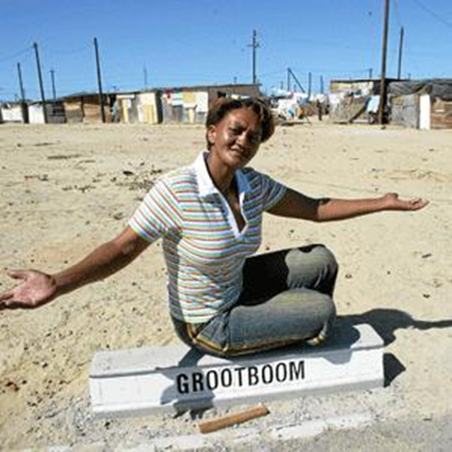
Grootboom (2000)
Government had no programme to assist households in intolerable conditions and emergency circumstance
→The judgment: The state’s housing programme must ‘provide relief for people who have no access to land, no roof over their heads, and who are living in intolerable conditions or crisis situations’
CARE!
Notes:
This slide has too many words on it. How about:
CARE!
The Grootboom case: government had no programme to assist households in intolerable conditions and emergency circumstances.
The judgement: The state’s housing programme must ‘provide
relief for people who have no access to land,
no roof over their heads, and who are living
in intolerable conditions or crisis situations’

Slide 44
The PE Municipality (2004)
The Municipality failed to listen and consider the problems of a community, which it planned to evict.
→ The judgment: Government must engage meaningfully with informal settlement residents and take their concerns seriously in planning for a way forward.
LISTEN!
Notes:
The PE Municipality case: the municipality failed to listen to and consider the problems of a community which it planned to evict.
The judgement: Government must engage meaningfully with
informal settlement residents and take their
concerns seriously in planning for a way
forward.

Slide 45
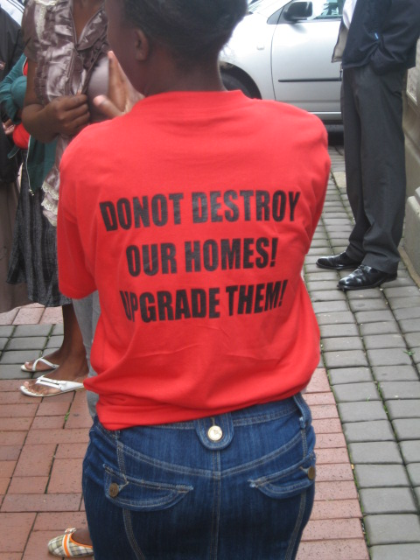
Abahlali (2009)
Provincial government enacted legislation that increased the state’s powers to evict – Abahlali (2009)
→ The judgment: The ‘dignified framework’ in existing legislation must be used.
‘the owner or municipality may only evict as a matter of last resort after having taken all possible steps to upgrade’
‘Proper engagement’ includes ‘taking into proper consideration … whether the areas where they live may be upgraded in situ’.
UPGRADE!
Notes:
Format as per previous slides

Slide 46
Nokotyana (2009)
Provincial government delayed decisions on the feasibility of upgrading – Nokotyana (2009)
→ The judgment: Relevant decisions must be taken without delay. Constitution (s237):
  “All constitutional obligations must be performed diligently and without delay.”
  ACT SWIFTLY!

Slide 47
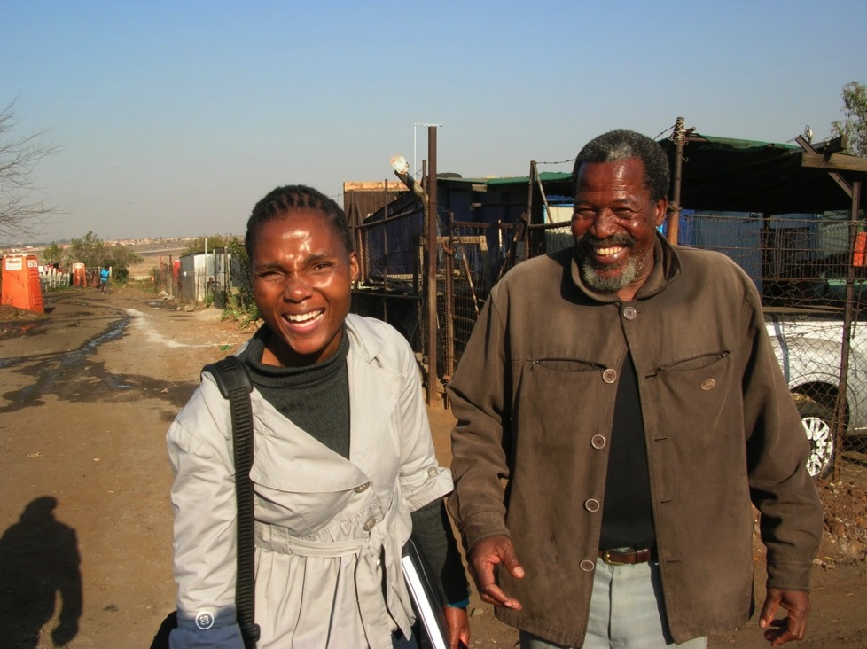
Ordinary informal settlement dwellers brought these cases to court
Johnston Nokotyana representing the Harry Gwala informal settlement in the Nokotyana case

Slide 48

Four Principles

Slide 49

5. Informal settlements and the town or city

Slide 50
Activity 1.3 Informal Settlements and the Town or City
Type of activity: Small groups (Triads)
Timing: 10 minutes + 20 minutes de-brief
Purpose: To describe the relationship between the town or city and the informal settlement.
Instruction: The facilitator will give each small group a question from the Participant Manual to discuss.
Each group should choose a spokesperson who will summarise the discussion in plenary.

Slide 51
Socio-economic
On the home front.
  Informal settlements function as reception areas for impoverished rural-urban migrants.
  This provides a chance to improve their situation and for society as a whole to progress.
  Informal settlements play an important role in this absorption.
On the work front.
  South African society and economy depends on casual and low paid labour.
  Wages, can only be low if it is possible for the workers to spend very little on their accommodation.
→ By accommodating the town and city’s lowest paid workers, informal settlements allow the town or city’s economy to function as it does. Informal settlements are therefore tied into a larger problem of the society and the economy

Slide 52

Environmental
Informal settlements depend on the environment, have implications for the environment, and are in turn impacted upon by the environment

Slide 53
Political
Informal settlements enable poor households to access the amenities offered by cities and towns and this helps to reduce or overcome the apartheid spatial pattern
Informal settlements accommodate an important voters’ base. Ward councilors formally represent informal settlement communities in municipal councils and have to ensure that councils hear the demands of these communities. Also that politicians do not make promises that cannot be kept.
→ Municipalities and councillors need to be aware that by law, informal settlement residents may approach the municipality directly and must be consulted and engaged with meaningfully. Section 16(1) of the Municipal Systems Act 32 of 2000 states that: A municipality must develop a culture of municipal governance that complements formal representative government with a system of participatory governance.

Slide 54

Legal
Informal settlements place legal obligations on the town or city, namely to listen, care, upgrade and act swiftly.
→ This means that state officials and politicians must always respect rights related to homes and occupation of land, meet minimum basic service standards as soon as possible (without unreasonable delay), prevent and respond to disasters as soon as possible, and work swiftly towards a permanent solution.

Slide 55
Budgetary
Indirect implications for the budget.
  Many informal settlements have existed for long periods with no direct claims on municipal budgets.
  However, the absence of critical basic services results in ill-health and burdens on the city’s health care infrastructure (clinics and hospitals)
Direct implications for the budget.
  Managing informal settlements on a temporary basis through interim services can be expensive.
  → Not budgeting for adequate basic services in informal settlements has cost implications. In the long run it would be better to spend funds on permanent solutions.

Slide 56
Turning problems into opportunities
"In the middle of difficulty," observed Albert Einstein, "lies opportunity."
The situation in South Africa with regard to meeting the need for housing is full of challenges and difficulties.
One of the key characteristics of a successful person is the ability to turn problems into opportunities.
But how do you do this? Problems have only the possibility, not the certainty, of becoming opportunities. Positively focused thoughts and actions are necessary to realize those opportunities.
  → Problems become opportunities through the way you approach them. You can allow them to drain you or to energize you. Seeing a problem or seeing an opportunity depends on your attitude. Your attitudes, or beliefs, come from your perceptions.

Slide 57
Activity 1.4 Perception
Type of activity: Individual
Timing: 5 minutes
Purpose: to experience perception
Instruction: The facilitator will give you a picture to look at. Tell your neighbour what you see in the picture.

Slide 58

Is the glass half full or half empty?
It is important to remember that our perceptions are not photographs of the reality outside of ourselves.
Each of us is unique so that even when two people look at the same thing or experience the same situation, the perceptions that are formed will not be the same.
Perception is unique to every individual and is simply one's interpretation of reality.
  → When we realize this and engage in dialogue with others, we can share our perceptions to arrive at a deeper understanding of reality.

Slide 59
Activity 1.5: Problems and Opportunities
Type of activity: Group work
Timing: 30 minutes
Purpose: To identify opportunities within informal settlement upgrading
Instruction: Your municipality is developing an informal settlement upgrading strategy. A number of problems are presenting a challenge to this process of developing a strategy. As set out in the Participant Manual, each group will be given two of these problems and will be required to review them so as to identify opportunities

Slide 60
6. The case for incremental upgrading of informal settlements
The underlying philosophy :
Informal settlement residents have nowhere else to go and have found a way to make a living where they currently are.
It is best to incrementally build on what they have already done themselves.
By building on what people have done and listening to what they need, people’s lives can best be improved.
In this way, they can be integrated into the town or city.
This means residents are partners in the upgrading process and stakeholders in the town or city.

Slide 61

A programmatic approach
Historically most informal settlements received little or no developmental assistance, whilst a few received a high level of investment, usually in the form of conventional subsidised or RDP housing.
This meant that residents of some informal settlements got a lot and others got nothing, or very little.
It is necessary to adopt a radically different approach - a programme-wide municipal approach.
The new approach recognises that meaningful developmental improvements need to be provided to all informal settlements as rapidly as possible.
The intention of the programmatic approach is towards a more inclusive and incremental situation where all or most settlements benefit by means of meaningful quality-of-life improvements.
  → The programmatic approach requires that municipalities should develop an informal settlement upgrading strategy and programme at municipal level, as well as detailed plans for each individual settlement that responds to the unique circumstances and needs of that settlement

Slide 62

Two levels of upgrading
Municipalities should be undertaking informal settlement upgrading at two levels:
A programme level, which focuses on all of the informal settlements within its jurisdiction;
A settlement level, which focuses on a specific informal settlement.

Slide 63
Key elements of a programmatic approach
Services - Initially emergency or very basic services are provided and these are then upgraded (depending on budget availability) over time until such time as a full service level is achieved.
Tenure - Tenure commences with the recognition of the informal settlement and this is incrementally upgraded over time to interim tenure and then more formal tenure types such as leasehold and freehold
Social and community facilities - Initially very limited facilities are provided and these can be part time (such as mobile clinics or libraries). Over time these should be upgraded so that the settlement has full access to public facilities.
Human-centered and environmentally sustainable planning layout - As a settlement is upgraded over time the focus should be on creating safe, good quality neighbourhoods where the maximum use of renewable resources is made.
Top structures - Households are provided with a serviced site and should be supported to build formal structures over time in terms of their own resources.

Slide 64


Constraints of conventional housing delivery
The cost of providing a formal house with basic services is very high - it would require R878bn to house everyone on the current backlog; the 2014/15 budget was R30.5bn.
It is expensive to install conventional services and results in high maintenance costs to the municipality.
Many households are unable to pay for services – the cost of providing these services falls on the municipality.
In smaller municipalities there are limited resources and capacity that undermines the delivery of formal housing developments.
The housing backlog increases annually as people migrate to the cities and the population grows.
In 2008 there were an average of 2 service delivery protests a month; in 2013 there was an average of 18 per month. Rising levels of frustration become a security risk to the country
The developments are low density and the designs of the houses are uniform and standardized, based on one-size-fits-all

Slide 65



Informal settlements cannot be ignored

Slide 66
Activity 1.6: Making the Case for Upgrading
Type of activity: Facilitated group discussion
Timing: 45 minutes
Purpose: To respond to common objections that people make to incremental informal settlement upgrading
Instruction: Answer the questions set out in the Participation Manual

Slide 67
Government’s current approach
The National Development Plan (NDP) of 2012 and the Medium Term Strategic Framework (MTSF) list governments commitments to 2019 including:
  Radical economic transformation
  Rural development
  Access to adequate human settlements and quality basic services
  Education, healthcare, social security, corruption-fighting, social cohesion.
The relevant 2019 targets in the MTSF are:
  Approximately 1.4 million more households living in new or improved housing conditions.
  Informal settlement upgrading will be expanded to cover 750 000 households, ensuring basic services and infrastructure in some 2 200 informal settlements.
  1.4 million households connected to the electricity grid and 105 000 to receive non-grid connections.
  90% of households to have access to a functional water and sanitation service.
  Increase in the level of trust and confidence in government (pp 26-28).
  → This means that there is a recognition of urgency, and commitment to going to scale or reaching the large numbers of households living in informal settlements and that there is potential to make a huge difference to people living in informal settlements in the period up to 2019.

Slide 68
What more will it take to get ahead of the informal settlement problem?
There is a need for champions (rather than opportunists) among communities, officials, politicians, consultants, NGOs.
There is a need for a collective belief that the problem can be overcome.
There is a need for active participation by all.
There is a need for trust that the poor can play their part.
There is a need for trust in the upgrading process.
There is a need for commitment to push the boundaries of what is possible.

Slide 69
Activity 1.7 What Did You Gain?
Type of activity: Individual work
Timing: 10 minutes
Purpose: To become aware of new insights you have gained.
Instruction: Consider the two photographs above, from the beginning of this module, and respond to the same questions you answered before. Then compare your answers to the answers you gave before. Have your responses changed?

