Slide 1
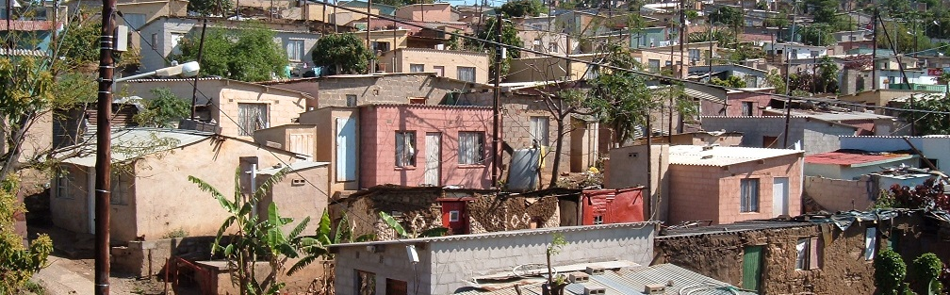


INTRODUCTION TO
INFORMAL SETTLEMENT
UPGRADING
MODULE 8: LAYOUT AND INFRASTRUCTURE

Slide 2
Module purpose
This module will help you to understand the principles, issues and trade-offs involved in designing incremental, in situ upgrading project layouts and providing services and infrastructure so that you can contribute to making appropriate choices within your own context.

Slide 3
Learning outcomes
Explain the principles and factors that influence an incremental approach to improving infrastructure and services in an upgrading project.
Provide examples of different approaches to layout and infrastructure that are being implemented in South Africa;
Explain the concept of trade-offs and give some examples;
Discuss different options available for layouts and servicing to ensure that services are sustainable;
Apply your knowledge of layouts and servicing options in the implementation of upgrading projects.

Slide 4
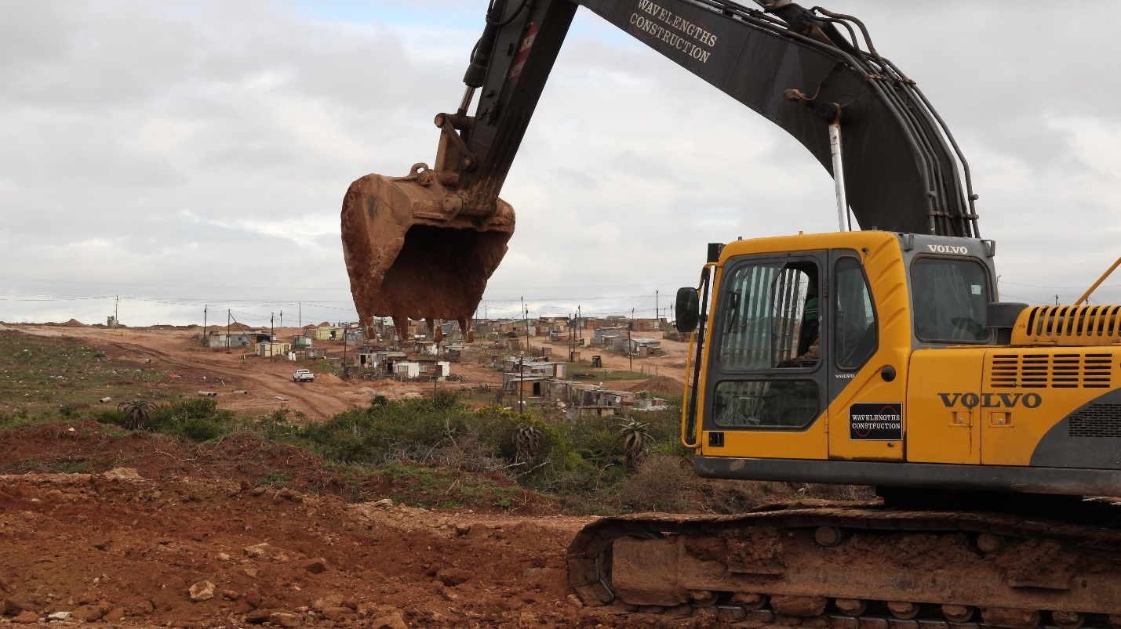
Module content
Layout approaches
Infrastructure approaches

Slide 5
Activity 8.1: Know what you know
Type of activity: Facilitated group discussion
Timing: 20 minutes
Purpose: To share existing knowledge about layout and services.
Instructions: Examine the aerial photo of the Monwabisi Park informal settlement on the screen and hand-out, and answer the following questions in the Participants Manual

Slide 6
1. Layout Approaches
The spatial layout is central to any in situ upgrade of an informal settlement.
An in situ layout involves creating spaces between existing top structures for the purposes of access and installing pipes and cables for infrastructure services.
The approaches to how these spaces are to be created, depends on a number of factors. These factors include:
  the planned nature of access — for example vehicles or pedestrians;
  the nature of the infrastructure to be provided, for example whether it is interim or permanent;
  whether the service level is low or full service.
The layout also has direct implications for the type of tenure planned for the settlement
  → Layouts should be designed in such a manner that the tenure and infrastructure services can be improved over time without the layout having to be redesigned.

Slide 7
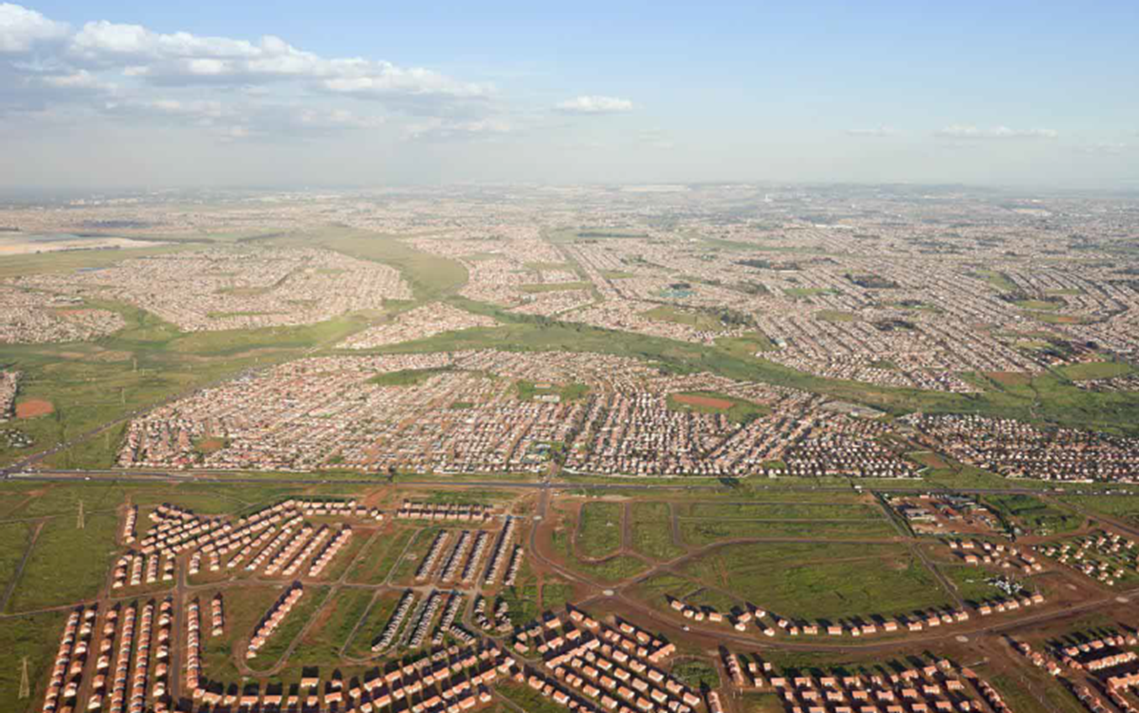
‘One size fits all’
“One size fits all approach”

Slide 8
‘One size fits all’ cont.
This approaches involves:
A once off capital intensive intervention
The complete redevelopment of the settlement in one project timeframe
Demolition of the existing settlement
Redesigning the layout according to set standards
In almost all cases it involves significant relocation of residents
The prescribed norms and standards are not possible to apply, in most cases, to informal settlements without demolishing them and redeveloping them.

Slide 9
‘One size fits all’ cont.
The package of standards for conventional full upgrading, with a top structure, includes:
  Freehold tenure in the form of registered ownership
  A minimum of a 250m² stand and 40m² top structure.
  A fully-subsidised top structure of a minimum of two bedrooms.
  A serviced stand, with water on the stand, and water-borne sewerage.
  A hierarchy of roads and road reserves which is a system of grades of roads ranked one above the other i.e. large roads to link the settlement to the outside and small roads within the settlement to access individual houses.
  Stormwater management and drainage.

Slide 10
‘One size fits all’ cont.
Some of the critiques of this approach include:
The monotonous grid-layout, with few stands per hectare.
Little attention given to affordability and operational costs to municipalities.
The slow rate of development, while residents are housed in temporary and often difficult conditions. Although an incremental in situ upgrade takes significantly longer the residents are not displaced and impacted upon less during the upgrade process.
The tendency to favour development of open land, rather than using places where people are already living, i.e. demolition and redevelopment.
Often the sites provided for education and social facilities are left empty for years and become places for waste dumping or further informal settlement.
Little attention is paid to top-structure orientation and greening.

Slide 11
UISP approach to layout and services
National Norms and Standards in respect of the creation of serviced plots do not apply to the UISP, but can serve as a guideline.
Plot sizes: The layout of informal settlements generally precludes the determination of uniform plot sizes
Service standards: The UISP provides funding for the installation of interim and permanent municipal engineering services.
Participation: The nature and level of permanent engineering infrastructure must be the subject of engagement between the local authority and residents.

Slide 12
Layout issues at the programme level
Planning for each settlement begins at the broader strategic or programmatic level;
Each informal settlement should be planned for at the strategic level within the broader context of the urban settlement they are located within;
Each settlement should be integrated into the municipal planning and budgeting process in terms of the local municipal IDP;
Once an informal settlement is assessed and categorised, the category of intervention will inform what the most appropriate layout approach to be applied is.

Slide 13
The layout plan at settlement level - guiding principles
Relocation i.e. who and how many people get relocated.
The extent to which there will be compensation
Levels of decision making and community involvement
Political will and agenda.

Slide 14
Factors that will influence the approach to the layout
Certain areas need immediate attention (e.g. precarious lands)
Certain services may need to be introduced incrementally
Some systems are best introduced simultaneously (e.g. pipes and water supply)
Community priorities regarding the approach and sequence of interventions
Budgetary constraints
Technical constraints such as geotechnical, bulk infrastructure or even human capacity constraints.

Slide 15
Technical issues that affect the layout plan
Land legal studies
Geotechnical studies
Topographical studies
A detailed map of existing top-structures mapped by the community or externally

Slide 16
Activity 8.2: Technical factors and the approach to layout and services
Type of activity: Pairs
Timing: 10 minutes
Purpose: To consider the factors that affect the approach to layout and services.
Instructions: Together with your partner, identify in what way the factors set out in the Participants Manual will affect the feasibility and the approach for developing the settlement.

Slide 17
The layout plan at settlement level
Key layout planning ‘fixes’:
  Number of households
  Types of tenure options;
  Developable area based on geotechnical studies;
  Developable area based on floodline studies;
  Developable area based on slope analysis;
  Direction of slopes;
  Availability and proximity to bulk infrastructure;
  Surrounding main transport routes

Slide 18
Trade-offs and layout planning
Some of these trade-offs amongst others include:
Plot sizes / densities
Plot orientation vs. house design
Pedestrian vs. vehicular access

Slide 19
Activity 8.3: Layouts and trade offs
Type of activity: Pairs
Timing: 20 minutes
Purpose: To consider the kind of trade-offs required by different layout options.
Instructions: Think about the two layout options in the diagrams in the Participants Manual (a. small plots and b. large plots) from the point of view of the municipality and of the residents. What are the advantages and the disadvantages of each option?

Slide 20
Small plots
Advantages:
  Reduced land costs which allows more money to be available for building and on-plot utilities.
  Reduced layout and infrastructure servicing costs.
  More households can be provided with a plot in any given area.
  Reduced risks of higher income groups benefiting from the project.
Disadvantages:
  More difficult and expensive to develop housing on the plot.
  Reduced possibilities of on-site sanitation options.
  Reduced opportunities for expanding the house.

Slide 21
Large plots
Advantages:
  Private open space for growing crops, keeping domestic animals and expanding the house.
  Space available for providing additional rooms for rental or commercial use.
  Greater opportunities for on-site sanitation disposal.
Disadvantages:
  Higher total land costs per plot.
  Higher layout and plot servicing costs.
  Reduced number of households can be accommodated in the settlement.
  Greater risk of attracting higher income groups not intended for the project.

Slide 22
Examples of approaches to layout - Superblock layout approaches
Firstly, identify and map the existing movement tracks, pathways and desired lines.
From the map, design a proposed movement network or public space structure.
This results in a system of large land parcels or blocks defined by the movement paths, containing multiple household top-structures.
Formally survey and “proclaim” these parcels or superblocks to create a street layout and new ‘addresses’ and street names. These superblocks then receive some form of collective / incremental tenure arrangement.
This recognition in turn enables funding.
At a later stage these blocks can be further sub-divided and individual title provided.

Slide 23
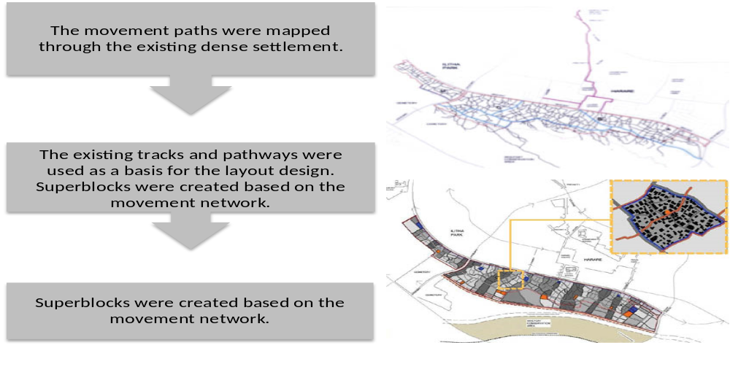
Superblock layout approaches cont.
Case Study : Superblock Layout: Monwabisi Park, Cape Town

Slide 24
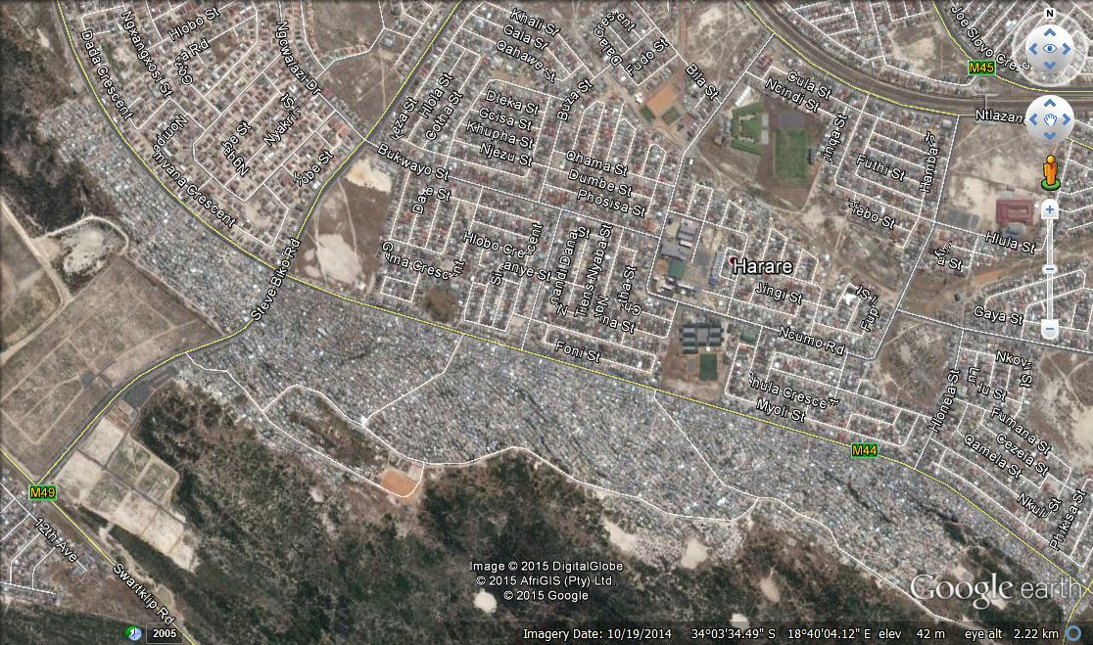

Slide 25
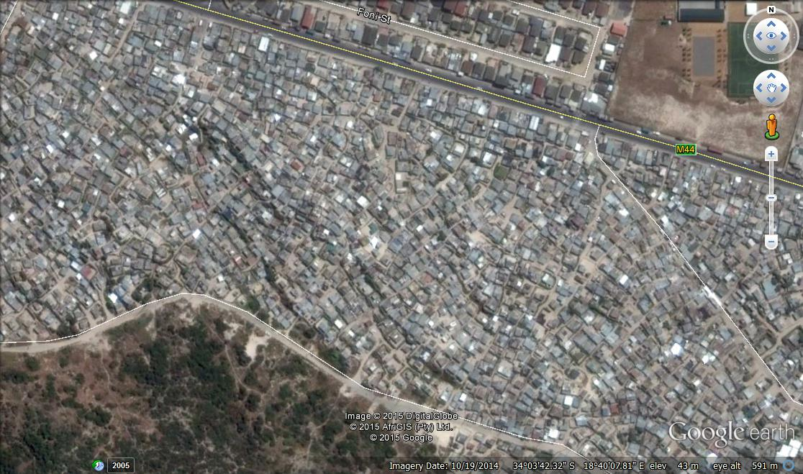

Slide 26
Superblock layout approaches cont.
Pros | Cons
Superblocks result in minimal displacement Layout can be undertaken quite quickly as one is not dealing with individual household boundaries, rather super blocks. Rapid legal recognition can be facilitated for the settlement to receive interim services. The approach provides a spatial pattern and spaces for short term / interim collective infrastructure provision. It is compatible with public finance requirements. It is ideal for incremental tenure arrangements in that the super block can provide communal land security in the short term. Thereafter they can be further subdivided to provide individual freehold tenure if required. | Superblocks may require some relocation of residents for public facilities such as parks, schools, public buildings. Inappropriate layout for immediate individual services installation and tenure arrangements as individual plot boundaries are not demarcated around each top-structure.

Slide 27
Examples of approaches to layout - De-Facto layouts
Undertake a survey of each household to determine the resident’s perceived land boundaries, using a GPS.
Convert the GPS points into lines on a map.
Through negotiation with the residents agree on how to adapt the existing lines.

Slide 28
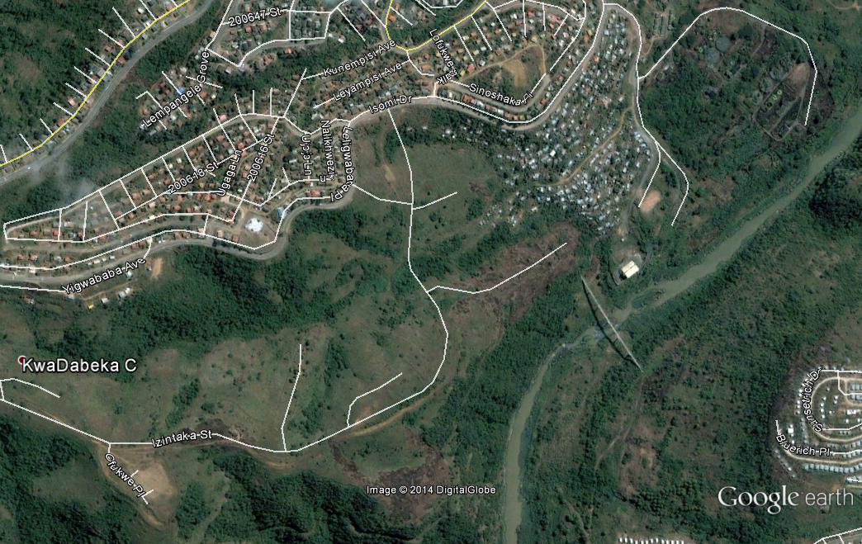
De - Facto layouts
Case Study : De-Facto Layout: Kwadabeka C - eThekwini

Slide 29
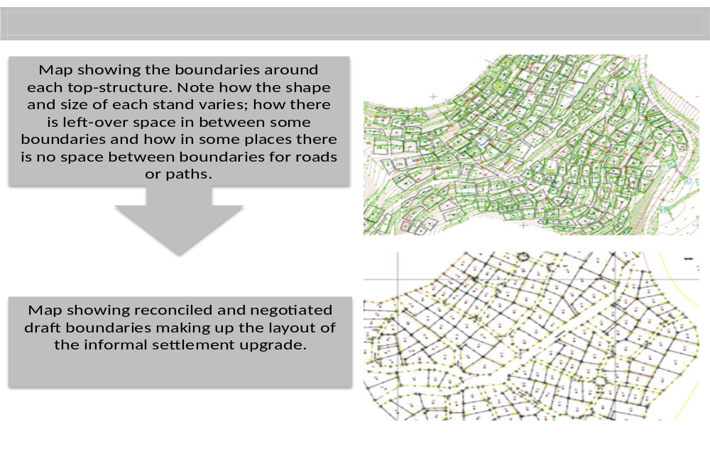
De - Facto layouts cont.

Slide 30
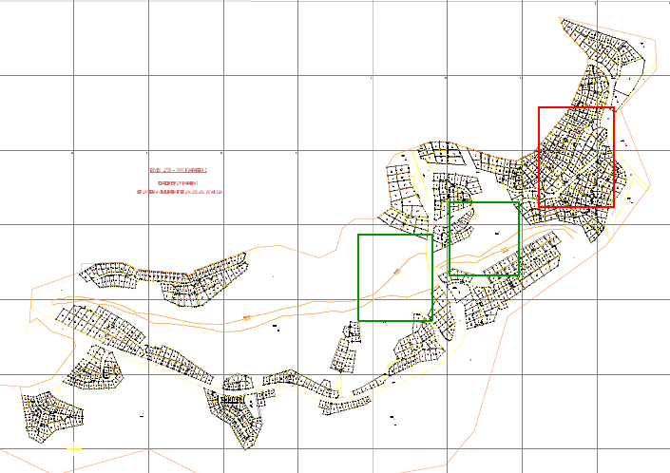
De - Facto layouts cont.

Slide 31
De - Facto layouts cont.
Pros | Cons
Minimal displacement of existing top-structures. During the planning process there is engagement with every household. Site by site engagement often results in greater transparency and support for the ultimate layout. Final negotiated layout can be used for final free-hold tenure acquisition. | Not applicable to high density settlements where top-structures are attached and individual boundaries cannot be demarcated around each top-structure. Could result in a variety of site sizes based on the size of the existing top-structure on the site, which might be an issue if community wants / expects equal sized sites. Irregular site boundaries can contribute to higher servicing costs, as it may result in more service pipe joints and man-holes.

Slide 32
Examples of approaches to layout - Re-blocking / blocking-out layouts
Refers to a rearrangement of shacks in an informal settlement with community consent.
Focuses on the larger concept of spatial reconfiguration versus the simple delineation of sites.
The spaces created through re-blocking are used for communal amenities, or to create lanes for installation of services such as water, sanitation and electricity.
There are variations in the re-blocking approach, from a comprehensive re-blocking to the partial re-blocking approach.

Slide 33
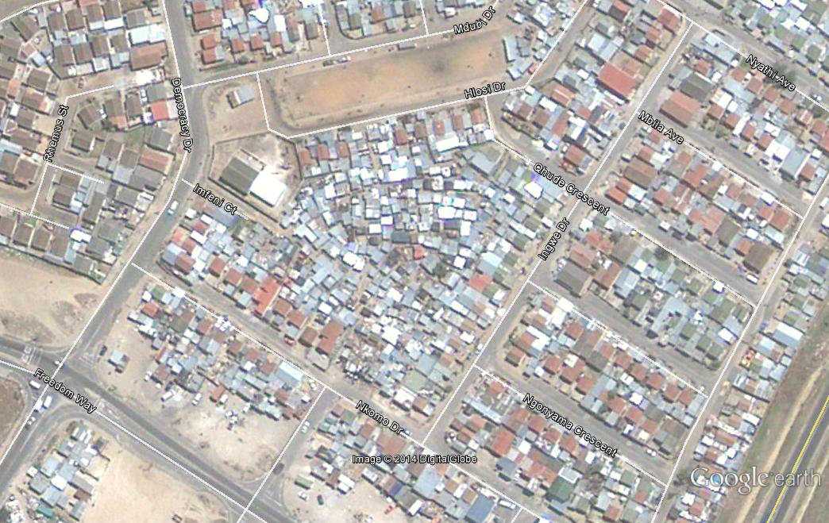
Reblocking
Case Study : Re-blocking: Mshini Wam – Joe Slovo Park

Slide 34
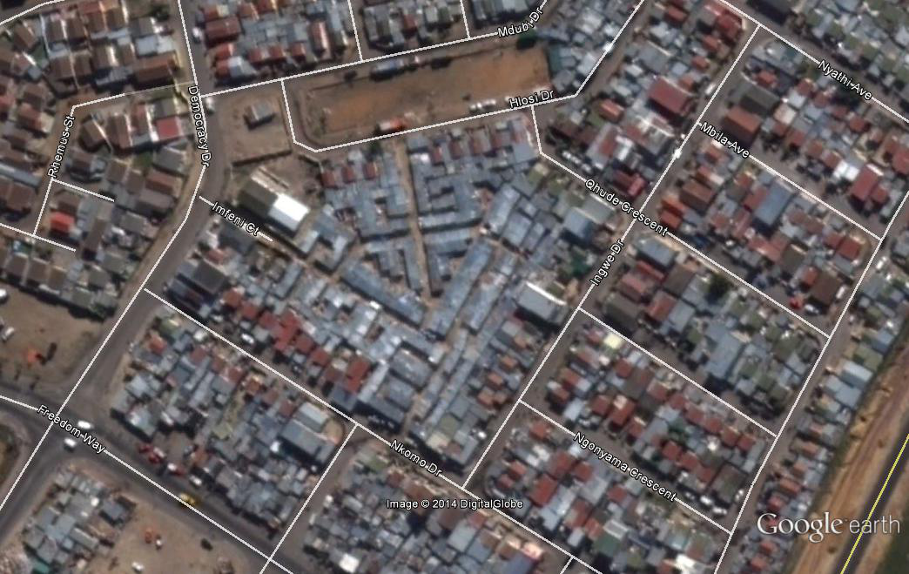
Re-blocking cont.

Slide 35
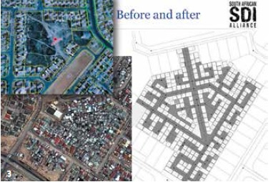
Re-blocking cont.

Slide 36
Case study video: Mshini Wam Re-blocking
Timing: 5 minutes
Purpose: To provide a South African case study to illustrate re-blocking.
Instruction: As you watch this video, take note of the advantages provided by the re-blocking approach to layout.
Note: This case study is used as an example for discussion purposes; it is not presented as a model.

Slide 37
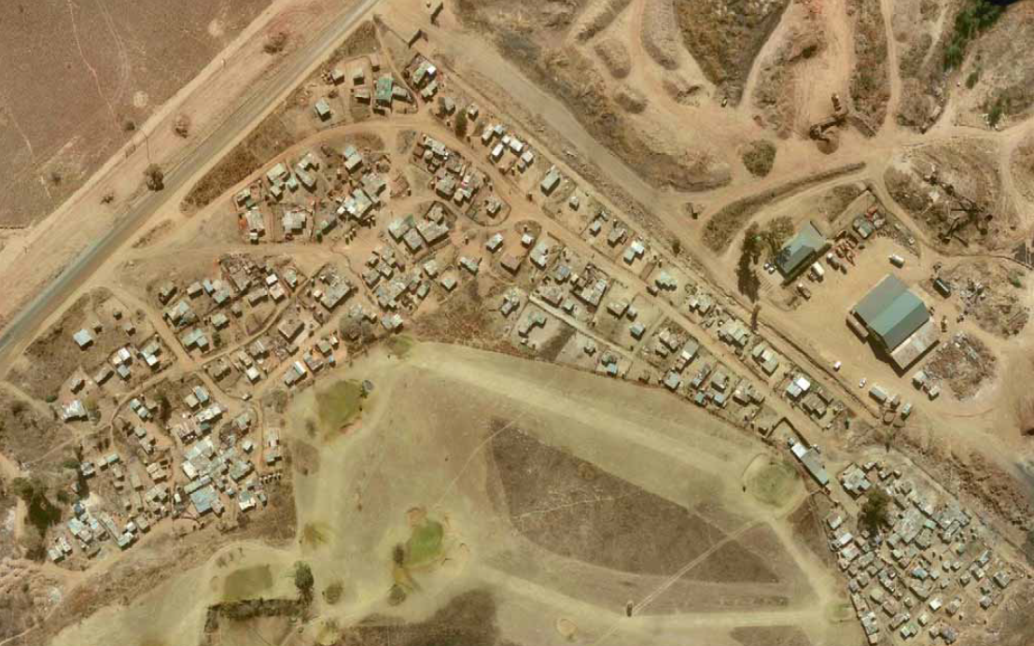
Case Study : Re-blocking : Ruimsig, NW Johannesburg

Slide 38

Relocate shacks from most congested areas…

Slide 39

… to better locations in the settlement
Relocate from dense, rental area to positions along main access road

Slide 40
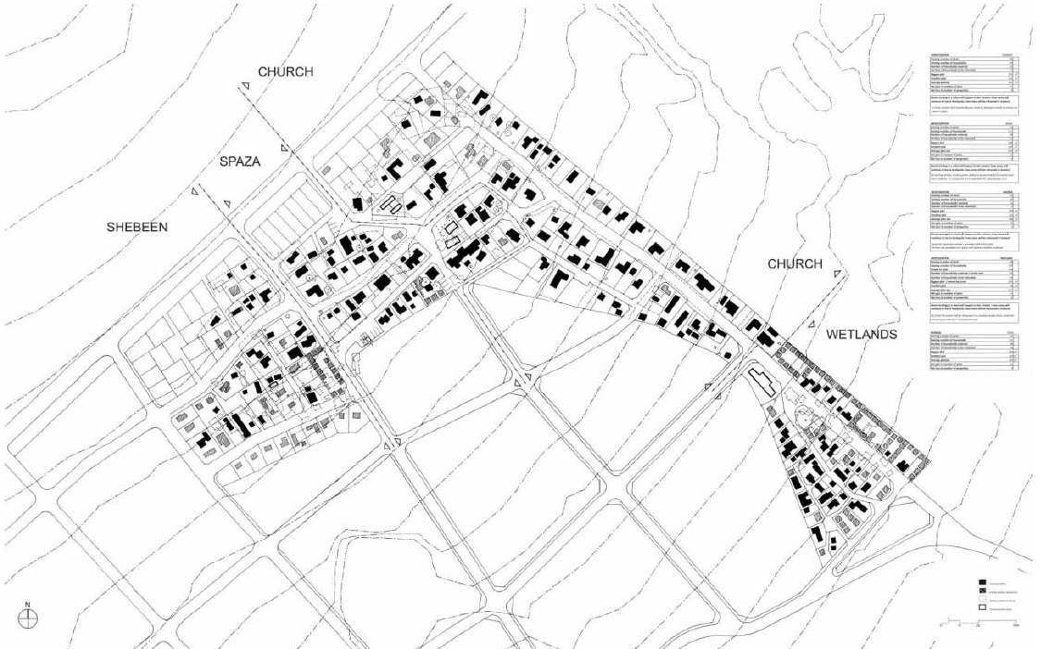
Final plan: developed by community with technical assistance, submitted to metro

Slide 41
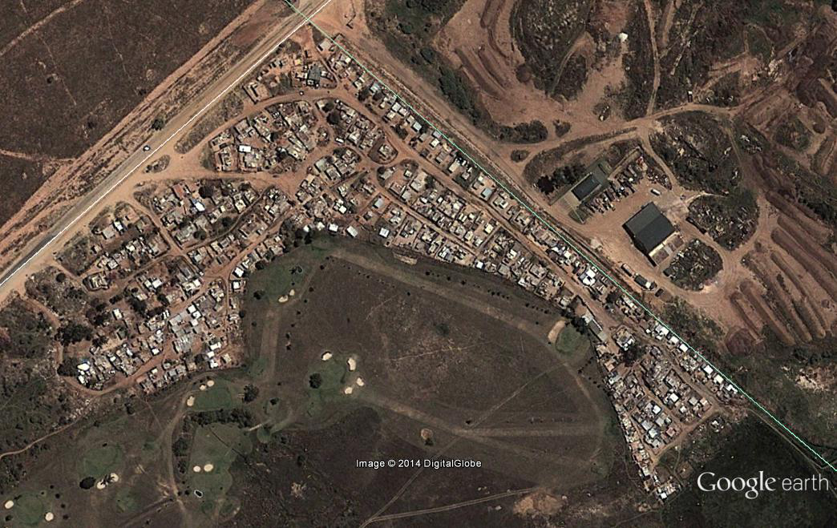
Re-blocking cont.

Slide 42
Re-blocking cont.
Pros | Cons
The re-block process involves intensive engagement with the existing residents, ensuring co-operation and buy in to the layout. Minimum displacement of residents from the settlement. Can quickly provide a spatial pattern and spaces for short term / interim collective infrastructure provision. Compatible with public finance requirements. New fire-resistant metal structures, coupled with the creation of space between rows of shacks, greatly reduce the risk of fire. Soil compacting techniques applied after re-blocking and introduction of grading reduces the amount of standing water after rainstorms. Large scope for local job opportunities to undertake the process | Moving of top-structures could result in damage and therefore a need for a replacement budget. A re-blocking layout may prove difficult to acquire freehold tenure, because no individual plots are demarcated, rather large superblocks facilitating an incremental tenure security approach.

Slide 43
Examples of approaches to layout - roll-over layouts
This approach entails the demolition of the entire informal settlement, either incrementally or in one timeframe.
The existing residents are relocated to transitional residential areas and the original site is redeveloped as a subsidised RDP project.
The intention is that, on completion, the original residents of the informal settlement move back into the newly developed area.

Slide 44
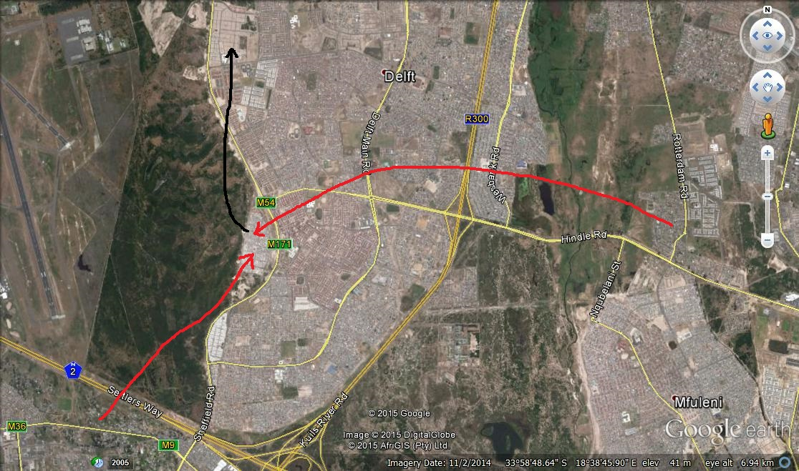
1
N2 Gateway Cape Town Rollover development showing relocations from informal settlements to the Transitional residential area (TRA) to the final project area.

Slide 45
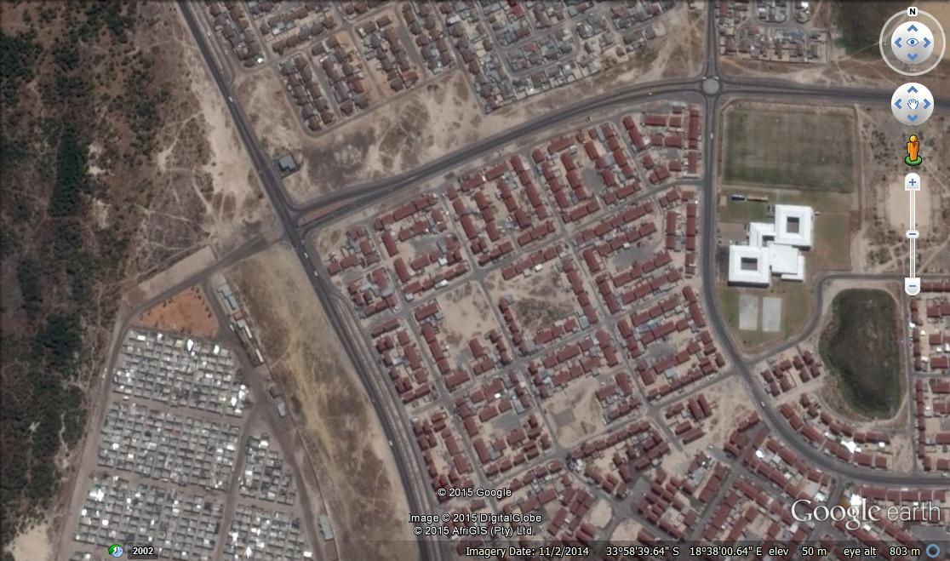
2
Detailed picture of TRA and final developed areas
TRA

Slide 46
Roll over layout cont.
Pros | Cons
Norms and standards can be adhered to in terms of minimum lot sizes and road dimensions and maximum efficiency of space can be achieved. Often results in the maximum efficient use of space and more uniform / equi-sized stands It is often more cost effective to install services due to straight service lines. Fits with public finance requirements. Provides space for education and social facilities. | Growing shortage of well-located land Vacant land often needs bulk infrastructure which is expensive. With accordance to minimum lot sizes these layouts are often very low density, thus contributing to urban sprawl. These layouts often result in significant levels of displacement of existing residents Often negate community participation because they are undertaken in areas removed from the community. Little attention is paid to top-structure orientation.

Slide 47
Activity 8.4: Re-blocking
Type of activity: Group
Timing: 30 minutes
Purpose: To learn about the re-blocking method, and how spaces can be created through the careful relocation of top-structures within the same settlement.
Instructions: In your groups, examine the hand-out consisting of an aerial photograph of the Ruimsig settlement, and three plans numbered 1, 2 and 3 showing the top-structures on the site. Using the tracing paper and koki pen issued to you, place the tracing paper over the photograph and complete the tasks set out in the Participants Manual.

Slide 48
2. Infrastructure Approaches
Infrastructure delivery approaches in South Africa
In South Africa, there are three broad approaches that have been used for service provision in urban areas:
A high level of services.
The progressive improvement model.
A demand-driven approach with variable levels of service.

Slide 49
Infrastructure delivery approaches in South Africa cont.
Case Study: eThekwini Interim Service Programme
Providing a range of basic interim services to 166 prioritised informal settlements within the Municipality with a view to addressing a range of basic health and safety issues.
    • Communal ablution blocks
    • A basic road network and footpaths
    • Electricity connections
    • Water stand pipes
    • Key social facilities such as fire and police stations,
    clinics, schools etc.

Slide 50
Project level infrastructure responses to informal settlements
According to the constitution, local authorities are responsible for local planning and service delivery.
Each individual local authority is required to provide services in terms of their existing delivery regime and mechanisms, procedures and capabilities.
Where the local municipality is not in a position to meet their obligation there is room for negotiation between affected community organisations and the local authorities

Slide 51
Project level infrastructure responses to informal settlements cont.
The settlement category will determine the service types and delivery options applicable.
Within each category a range of different servicing options and combinations appropriate for in-situ incremental informal settlement upgrading can be provided based on:
  the aims of the project;
  levels of service decided upon;
  affordability levels;
  environmental and resource issues amongst others.

Slide 52
Infrastructure Options Selection
Broad Types of Provision | Criteria for Selection (Agreed to between community and LA) | Examples of trade-offs to be considered
Accessibility (roads and pathways), mobility and transport Water and sanitation Drainage and erosion Control Community Facilities Bulk Earthworks | Aims of the project Levels of services Affordability Capital maintenance Budgets Capital Maintenance Environmental resource usage Local employment opportunities Construction Maintenance Local capacity building | Costs: Capital vs maintenance Levels of different services: selection based on budgetary constraints Timing of delivery: labour vs capital intensive construction Convenience: Ease of use vs environmental imperatives vs affordability Political Imperatives: Desired infrastructure vs technical practicalities

Slide 53
Infrastructure Options Selection
Service Category | Type | Characteristics | Application to informal settlement categories (Y: Yes/ N: No)
 |  |  | Conventional | Incremental | Interim arrangements | Deferred relocation
Accessibility Mobility & Transport | Pedestrian & cycle circulation | These are paved, or tarred narrow strips which can be constructed on steep gradients requiring limited cut and fill. In very steep areas stairs can even be provided. | Y | Y | Y | Y
 | Gravel/ unsurfaced road circulation | These are unpaved roads which require at least 6 metre widths and minimum radius curvatures on turns and minimum 1:5 gradients requiring cut and fill embankments in steep terrain. In very steep areas road access is not possible. | N | Y | Y | N
 | Surfaced roads | These are paved, or tarred roads which require at least 6 metre widths and minimum radius curvatures on turns and minimum 1:5 gradients requiring cut and fill embankments in steep terrain. In very steep areas road access is not possible. | Y | Y | N | N

Slide 54
Infrastructure Options Selection
Service Category | Type | Characteristics | Application to informal settlement categories (Y: Yes/ N: No)
 |  |  | Conventional | Incremental | Interim arrangements | Deferred relocation
Water | Use of piped system within the roadways and pedestrian paths as drainage channels | Stormwater pipes running below the road kerbs and where the water run-off from the road flows into a kerb inlet | Y | Y | N | N
 | Water tanker or vendor | Supply from tanker or from kiosks | N | N | Y | Y
 | Individual water butt | Water collected from roofs and stored on plot | Y | Y | Y | N
 | Individual well on each plot or bore hole with or without pump | Individual well on each plot or bore hole with or without pump | N | Y | N | N
 | Public stand pipes | Piped network throughout the settlement with standpipes at regular intervals (within 200m of each dwelling according to national regulations) and can be associated with an on-site storage facility | N | Y | Y | N
 | Yard tap | Piped water supply to a tap standing outside the house, metered supply. | Y | Y | N | N
 | House connection | Piped water supply to inside the house, metered water supply. | Y | Y | N | N

Slide 55
Infrastructure Options Selection
Service Category | Type | Characteristics | Application to informal settlement categories (Y: Yes/ N: No)
 |  |  | Conventional | Incremental | Interim arrangements | Deferred relocation
Sanitation | Communal system | A block of toilet facilities provided for communal use. A range of levels can be provided from flush latrine to piped network | N | Y | Y | Y
 | Night soil collection | Removable bucket provided by the local authority placed below a toilet seat, outside a house | N | N | N | Y
 | Chemical toilets | An off-site, non-reticulated sanitation service, normally used where temporary sanitation services are required for relatively short periods. | N | N | N | Y
 | Ventilated pit latrines | On-site sewage disposal system | N | Y | Y | N
 | Ventilated vault toilet | An on-site sewage disposal system with a sealed vault to avoid local water contamination. | N | Y | Y | N
 | Settled sewage system or soak pit system | Toilet connected to an on-site septic tank and either a soak-away or sewer. Toilet flushed by cistern using little water. | Y | Y | N | N
 | Composting toilet or urine diverting dry toilet | The composting and urine diverting dry toilet operates by separating the liquid and solid wastes. Produces usable humus fertiliser after several months to one year. | Y | Y | N | N
 | WC Waterborne sewage | An off-site sewage reticulation system. | Y | Y | N | N

Slide 56
Infrastructure Options Selection
Service Category | Type | Characteristics | Application to informal settlement categories (Y: Yes/ N: No)
 |  |  | Conventional | Incremental | Interim arrangements | Deferred relocation
Street lighting & household electivity supply | Street lights – below ground | Lamps and poles are provided along roads | Y | N | N | N
 | Street lights – above ground | Lamps and poles are provided along roads | Y | Y | N | N
 | Mast lights | Lamps and poles are provided along roads | Y | Y | Y | N
 | Photovoltaic street lights | Sun-energy is stored in a battery during the day and then used as electrical power for lighting at night. | Y | Y | N | N
Drainage & erosion control | Use of roadways & pedestrian paths as drainage channels | Surface of road used as a drainage channel to direct water run-off into soak-aways or retention dams. | Y | Y | Y | Y

Slide 57
How is layout and infrastructure funded?
UISP: Provides funding for land acquisition, pre-planning, detailed town planning, land surveying, interim basic services and permanent engineering services.
USDG: Provides funding principally for basic services (e.g. water supply, roads, sanitation etc.) for metropolitan municipalities.
IRDP: Provides funding for land acquisition, pre-planning, detailed town planning, land surveying, and infrastructure installation.
MIG: Provides funding principally for basic services (e.g. water supply, roads, sanitation etc.) for non-metropolitan municipalities and for bulk infrastructure.
Emergency housing: Provides funding for basic infrastructure where emergency housing is being provided.
Municipality: It is assumed that the municipality will need to cover the costs of the other initiatives if the above scenarios apply.

Slide 58
Activity 8.5: Pulling it all together
Type of activity: Group
Timing: 60 minutes
Purpose: To design the possible layout and service provision for an actual informal settlement
Instructions: In this exercise you will use an actual case study to examine the layout and service provision possibilities.
As a group examine the Langrug settlement aerial photo and map. Then develop a sketch layout (using the koki pens and tracing paper provided) to cover the aspects and requirements set out in the Participants Manual

Slide 59
Activity 8.6: What did you gain?
Type of activity: Individual
Timing: 5 minutes
What were the three most significant things you learnt in this module?
What will you do differently in your work as a result of what you learnt in this module?
Write your answers in the space provided in the Participants Manual

