Slide 1
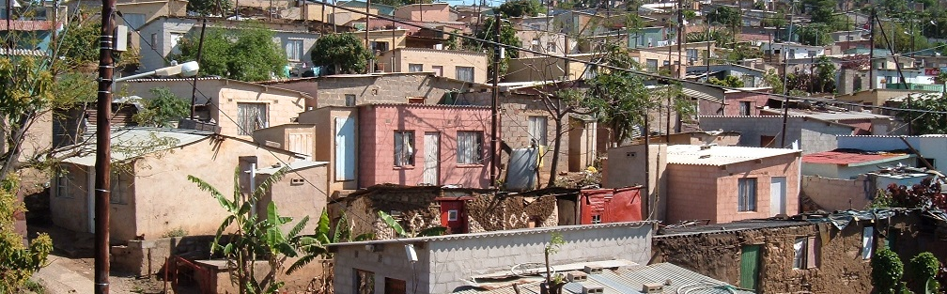


INTRODUCTION TO
INFORMAL SETTLEMENT
UPGRADING
MODULE 5: A PROGRAMMATIC APPROACH TO MUNICIPAL INFORMAL SETTLEMENT UPGRADING

Slide 2
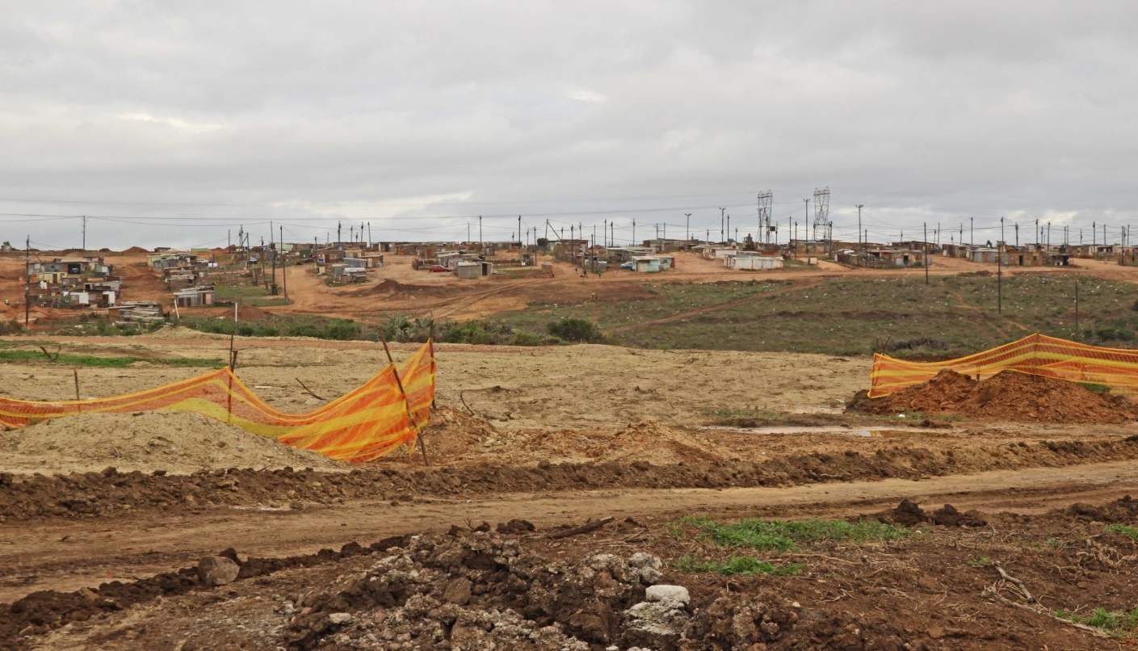
Module Purpose
The purpose of this module is to enable you to understand and apply the principles and processes necessary to develop an effective and systematic municipal-wide programme for upgrading informal settlements.

Slide 3
Learning outcomes
Describe the benefits of a systematic, programmatic approach to upgrading;
Identify the work streams that make up an informal settlement upgrading programme and the kinds of activities that happen at the programme and project levels;
Identify the main factors that determine whether or not informally settled land is suitable for permanent settlement;
Explain the assessment and categories of informal settlements, the rationale for each, and link the categories to developmental responses.

Slide 4
Module content
A programmatic approach to informal settlement upgrading
Work streams in upgrading programmes and projects
Assessment and categorisation
Developing an Informal Settlement Upgrading Strategy and Programme

Slide 5
Activity 5.1: Know What You Know
Type of activity: Facilitated group discussion
Timing: 5 minutes
Purpose: To reflect on the new approach to upgrading.
Instruction: With your partner, discuss the questions in the Participant Manual and write your responses in the space provided.

Slide 6
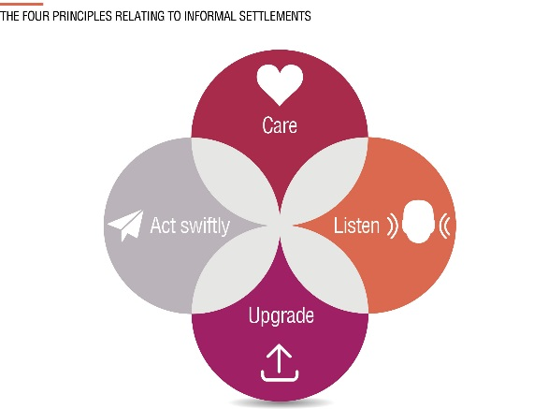
1 A programmatic approach to informal settlement upgrading
New approach to informal settlement upgrading
As discussed in Module 1 a new approach to upgrading informal settlements is being undertaken which starts with formulating a programmatic approach within a municipality
  → The programmatic approach requires that municipalities should develop an informal settlement upgrading strategy and programme at municipal level, as well as detailed plans for each individual settlement that responds to the unique circumstances and needs of that settlement

Slide 7
What is a programmatic approach?
Focusses on a number of projects or upgrading initiatives usually within a specific geographic area (typically a municipality, district or province)
Ensures that:
The number, size and characteristics of every informal settlement in the area is understood
A range of achievable developmental responses are planned, implemented and sustained in an effective and coordinated manners for ALL settlements.
  → The aim is to rapidly deliver meaningful responses to all informal settlements and to avoid leaving certain settlements on a developmental back-burner.

Slide 8
Programmatic approach overview
An informal settlement upgrading strategy and programme is developed that sets out how every informal settlement in an area will be developed. This is aligned with the Spatial Development Framework, Integrated Development Plan and Annual Performance Plan of the area.
Every informal settlement receives interim services in the short-term as rapidly as possible.
An appropriate long-term development response per informal settlement is implemented on a prioritized basis.
A settlement upgrading plan for each informal settlement is developed that sets out the basis by which the settlement will initially receive interim services and be upgraded over time.

Slide 9
The benefits of a programmatic approach
All settlements are included and assisted
All receive a minimum level of assistance (interim arrangements)
A developmental pathway is formulated for every informal settlement
Proactive instead of reactive approach
Right kind of upgrading responses for different types of settlements (not ‘one-size-fits-all’)
The response is rapid
Relocations and livelihoods disruptions are minimised

Slide 10
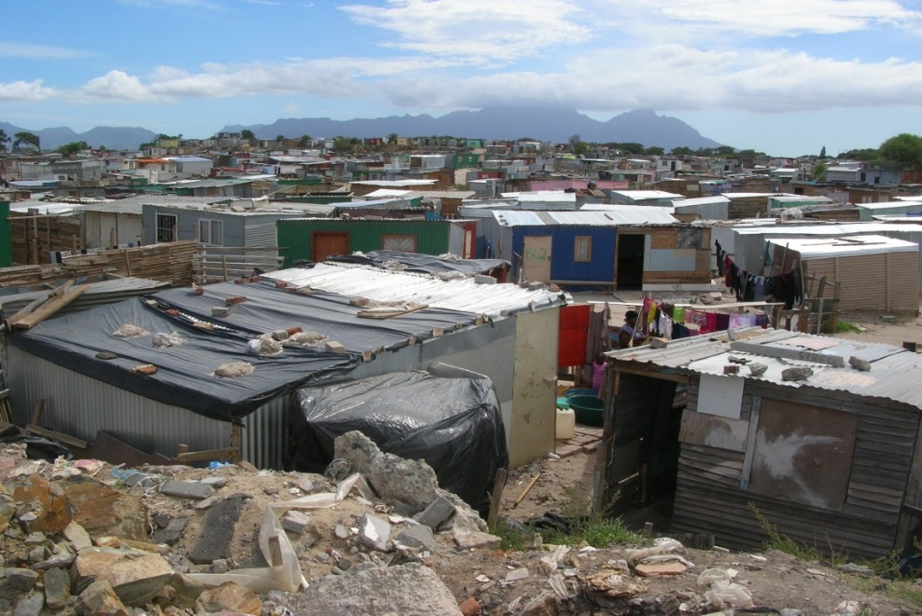
The benefits of a programmatic approach cont.
Effective multi-year budgeting is possible
Better institutional coordination and communication occurs.
Provides the information to know the total ‘demand’
An improved and more functional relationship between informal settlement residents and government occurs

Slide 11
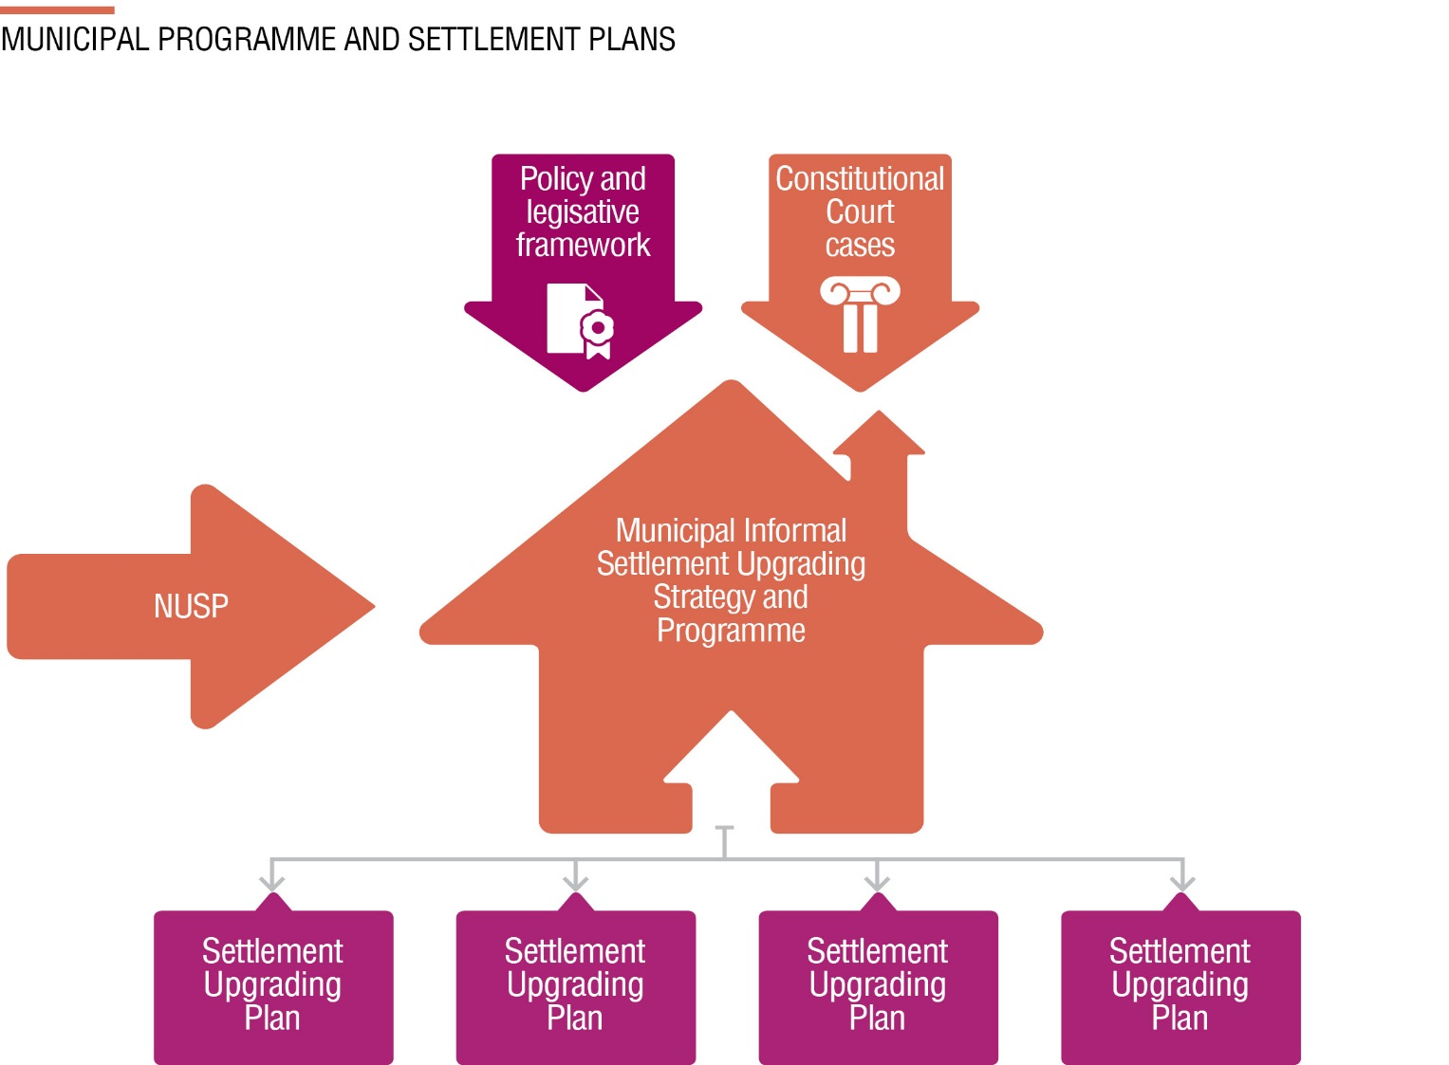


How does it fit into the policy framework?
Programme level
Settlement level

Slide 12
2. Work Streams in Upgrading programmes and Projects
There is a set of nine different work streams that make up an informal settlement upgrading programme:
Health and safety/emergency services
Tenure rights
Layout Planning/Settlement Planning
Relocations or reblocking
Urban services infrastructure installation
Public domain /social infrastructure
Housing consolidation support
Social development
Urban management

Slide 13
Activity 5.2: Activities at Programme Level and Project Level
Type of activity: Group work
Timing: 15 minutes
Purpose: To apply your understanding of the different work stream activities at the Programme level and the Settlement Project Level.
Instruction: Allocate the informal settlement upgrading activities set out in the Participant Manual to either the programme level or the project Level.

Slide 14
3. Assessment and Categorisation (AC)
Assessment and categorization (AC) is sometimes also called rapid assessment and categorisation (RAC).
It is the process of assessing and evaluating all informal settlements within a specific geographic area (municipality or province) in order to determine what categories of developmental responses are appropriate and achievable for each settlement

Slide 15
Assessment and Categorisation cont. (AC)?
Assessment and Categorisation is:
Distinct from full prefeasibility, feasibility and preliminary planning work which often follow.
Based on existing information
May need to be updated as additional information becomes available or as settlement conditions change.
Intended to be rapid so as not to delay municipalities in formulating effective upgrading strategies
Helps to design and structure an informal settlement project ‘pipeline’

Slide 16
What are the objectives of AC?
To obtain a rapid overview of the locality, scale and nature of the informal settlements in a municipality so as to better understand priority needs as well as site constraints
To determine suitability of informal settlement land for permanent settlement (formal or less formal)
To determine categorisation = developmental direction and key priority actions required
To enable strategic prioritisation for different developmental responses

Slide 17
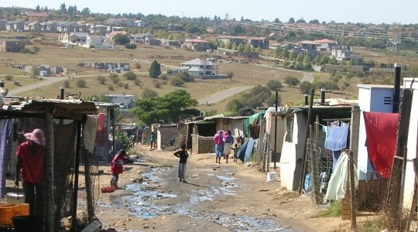
What are the objectives of AC cont.?
To enable the allocation of multi-year budgets for professional services and capital expenditure on MTEF
To provide input to strengthen and update the municipality’s Housing Sector Plan (HSP)
To ensure that ALL informal settlements are assisted.
To identify priority technical studies and work required to move projects forward

Slide 18
Activity 5.3: Suitable Land for Human Settlement
Type of activity: Pair work
Timing: 10 minutes
Purpose: To consider both the critical factors that determine if land is suitable for development, and the impacts of relocation on the lives of informal settlement residents.
Instructions: Answer the questions in the Participant Manual

Slide 19
Is the land suitable for permanent settlement?
A key determinant of categorisation is whether or not land is suitable for permanent settlement
This determines whether or not the settlement will be upgraded or relocated
The following are the key determining factors:
  Geotechnical conditions (e.g. slope instability, sinkholes)
  Environmental conditions (e.g. rare plant/animal species, toxic waste)
  Topography (e.g. very steep slopes or floodplains)
  Bulk services availability (e.g. water and sanitation supply)
  Locational suitability (e.g. access to jobs, schools, clinics)
  Land legal issues (e.g. power line servitudes, mineral rights, land claims)
  Land availability (can be acquired, not required for strategic purposes such as airport runway, Eskom powerstation etc.)

Slide 20
Assessment and categorisation - framework
Settlements are firstly separated into two categories:
Those that are suitable for permanent human settlements, either via conventional formalisation or via incremental, less formal type of permanent settlement solution. They are viable for upgrading.
Those that are not suitable and which will need to be relocated (either immediately or in the future). They are not viable for upgrading

Slide 21
Assessment and categorisation - framework
Settlements viable for upgrading
A - Conventional formal upgrading: Site is suitable for development and appropriate for permanent settlement and is implementation-ready. Formal full upgrading to be provided.
B1 - Interim arrangements (including basic services): Site is suitable for development and appropriate for permanent settlement. However it is not implementation ready and significant delays are anticipated. Basic services to be provided in the interim. Formal full upgrading to be provided in the long term.
B1 extended - Incremental full upgrading: Site is suitable for development and appropriate for permanent settlement. However it is not implementation ready (there may be insufficient funding, issues with the land etc.). Accordingly basic services should be provide. Incremental upgrading to be undertaken.

Slide 22
Assessment and categorisation - framework
Settlements not viable for upgrading
B2 - Deferred relocation with interim arrangements (including basic services): Site is not suitable for development and inappropriate for permeant settlement, but there is no urgent need for relocation. A more suitable site is not currently available so a delay is anticipated. Interim services to be provided
C - Immediate relocation : Site is not suitable for development and there is an urgent need to relocate due to serious health and safety threats. Rapid relocation to a site which is already available to be undertaken.

Slide 23
Activity 5.4: Categories of Informal Settlements
Type of Activity: Small groups (triads)
Timing: 15 minutes
Purpose: To reinforce what you have learnt about settlement categories.
Instructions: Match the criteria listed in the Participant Manual to the settlement types.

Slide 24
Assessment and categorisation - process
Collect and assess available base information
Undertake site assessment visits to settlements to identify key features and characteristics including constraints
Engage with communities, municipal officials, councilors
Develop a final and complete informal settlement list (none should be left out)
Develop preliminary site suitability assessments and base plans for each settlement
Identify key priorities (setting out what will be undertaken per settlement and the prioritization of these activities)
Develop cash flow projections (multi-year)

Slide 25
Activity 5.5: Assessment and Categorisation
Type of activity: Group work
Timing: 30 minutes
Purpose: To apply your understanding of assessment and categorisation.
Instructions: Your facilitator will give you case studies of four informal settlements within one municipality. Categorise each settlement. In each case provide the main reasons for your categorisation. Write your answers on the sheets provided in your Participation Manual

Slide 26
Assessment and Categorisation - Methodology outputs
List of all informal settlements showing broad categorisation of each one (A, B1, B1 expanded, B2, C)
Plan (map) showing locality of all settlements
Preliminary assessment for each settlement indicating key health and safety threats, site suitability, priority developmental actions and technical studies etc.
Multi year expenditure projections for informal settlement upgrading
Available vacant land (or buildings) for new settlement or relocations.

Slide 27
4. Developing an informal settlement upgrading strategy
What informs an upgrading strategy assessment and categorisation (AC)
Providing a minimum level of developmental assistance (interim arrangements) to ALL settlements as quickly as possible
Municipality’s IDP, housing sector plan and other spatial development frameworks and land use management plans
Any relevant provincial plans or strategies
Budget availability
Implementation timeframes
Nature of housing demand

Slide 28
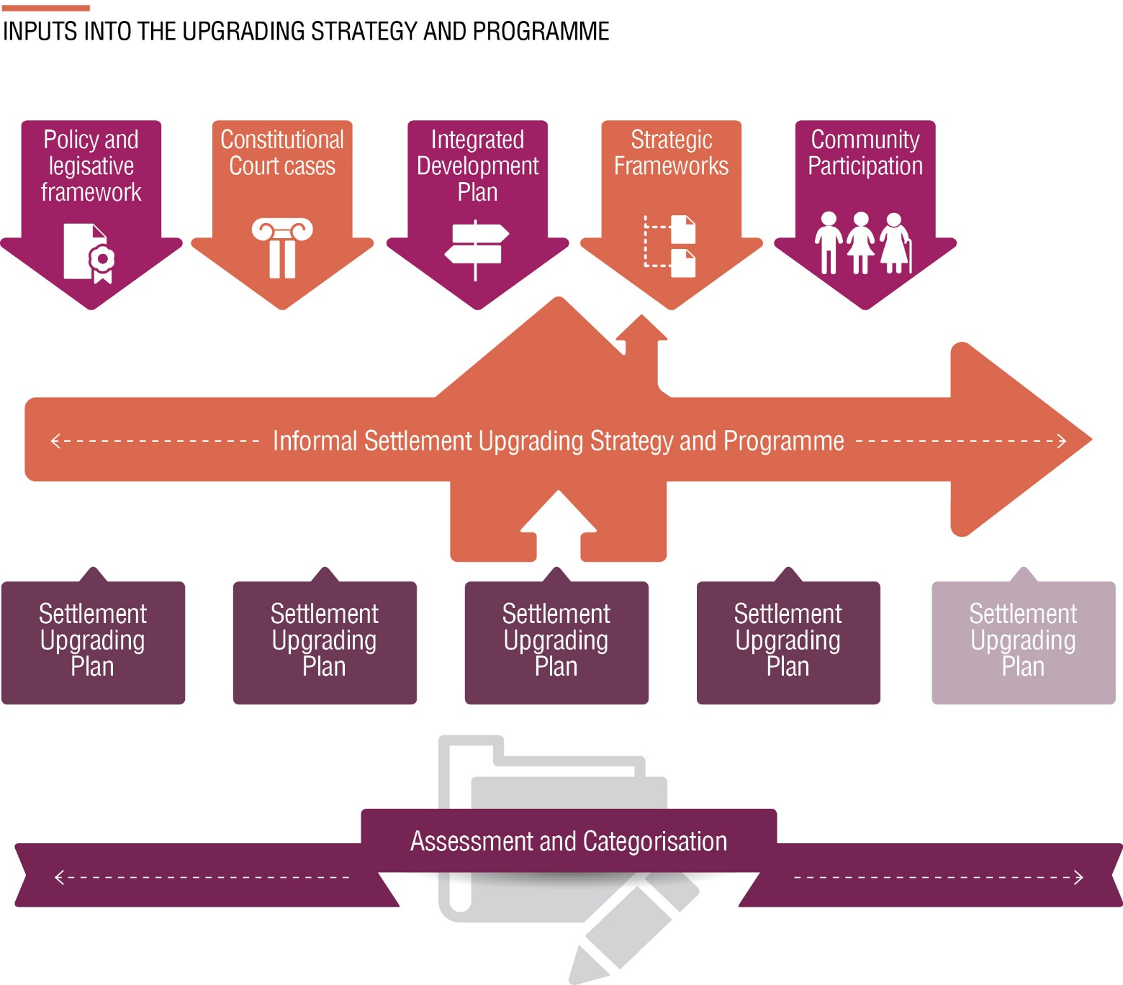
What informs an upgrading strategy
Programme level
Settlement level
Programme level

Slide 29
Activity 5.6: Developing a Response
Type of activity: Group work
Timing: 30 minutes
Purpose: To practice developing a response following the assessment and categorisation process.
Instructions: Use the case study and settlement profiles you used in Activity 5.5 on assessment and categorisation and complete the tasks below.
  For each settlement, identify the key vulnerabilities affecting the residents.
  Identify three priorities for development and possible responses.
  Are there any trends across the settlements regarding the developmental priorities?
  Answer on the sheets provided in the Participation Manual

Slide 30
Prioritising upgrading projects and responses
There are usually insufficient resources (human, financial, land) to upgrade all settlements simultaneously and to the same degree.
A critical part of developing an upgrading strategy is prioritising which settlements and activities should be undertaken first.
Prioritisation is a process of evaluating different options or alternatives in the light of specified criteria.
It is beneficial that this process is formal (documented) and as rational as possible.

Slide 31
Prioritising upgrading projects and responses cont….
    Every municipality will need to determine their own prioritisation criteria, however the following are suggested as being some of the key criteria in the context of informal settlement upgrading:
Available budget
The extent and severity of health and safety threats
The size of the affected population of an informal settlement
How well located the land is (in particular for full upgrading)
The state of readiness of a project

Slide 32
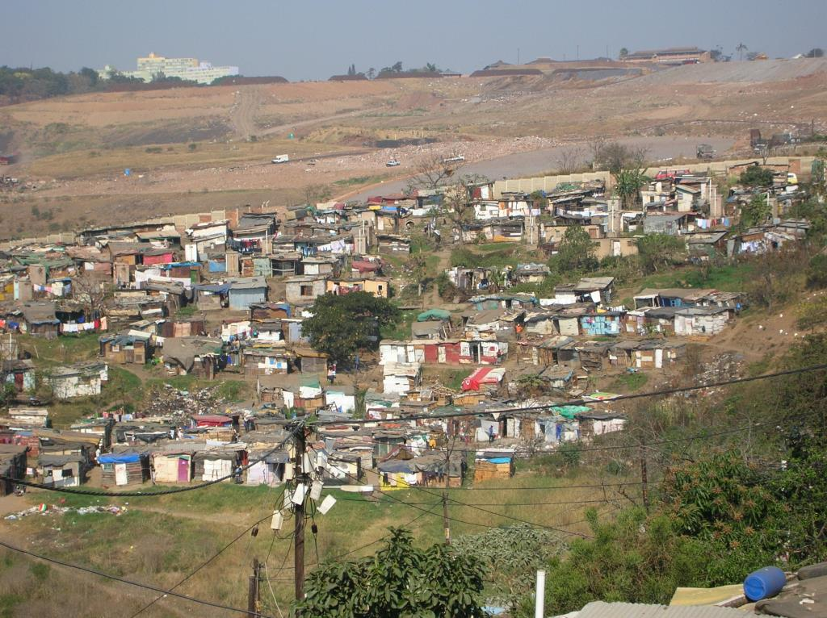
What Did You Gain?
Think back on the module you have just completed. Note down in the Participant Manual the key points that you found most useful.

