Slide 1
Advocacy Platforms that Promote Better Access to Land and Land Information

Slide 2
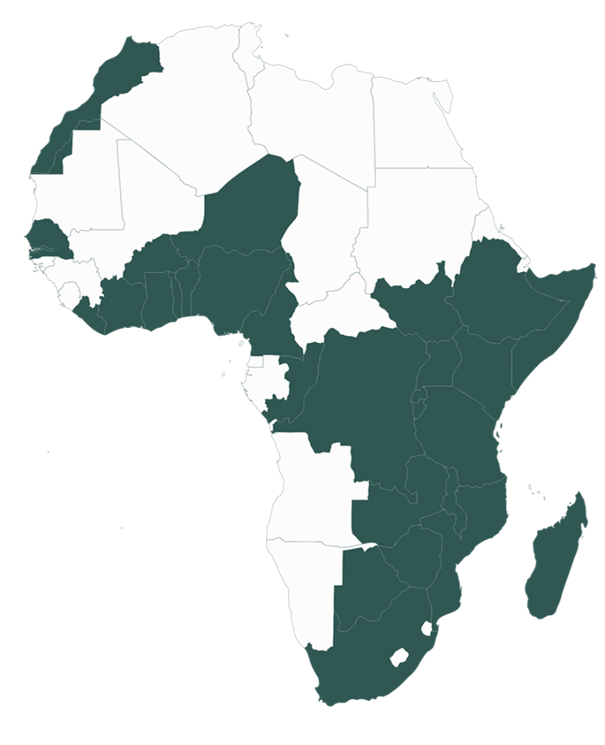
ILC representation in Africa
95 Members in 28 countries
EAST AFRICA REGION
1 | Kenya (11) | 5 | Burundi (3)
2 | Uganda (6) | 6 | Ethiopia (2)
3 | Tanzania (9) | 7 | South Sudan (1)
4 | Rwanda (2) | 8 | Somalia (1)
WEST AFRICA REGION
1 | Nigeria (3) | 6 | Niger (1)
2 | Togo (2) | 7 | Gambia (1)
3 | Liberia (3) | 8 | Ivory Coast (2)
4 | Senegal (5) | 9 | Burkina Faso (4)
5 | Ghana (2) | 10 | Benin (3)
CENTRAL AFRICA REGION
1 | DRC (5) | 2 | Congo (1)
3 | Cameroon (8)
SOUTHERN AFRICA REGION
1 | Zambia (2) | 5 | Madagascar (4)
2 | South Africa (5) | 6 | Zimbabwe (2)
3 | Mozambique (2) | 7 | Botswana (2)
4 | Malawi (3)

Slide 3
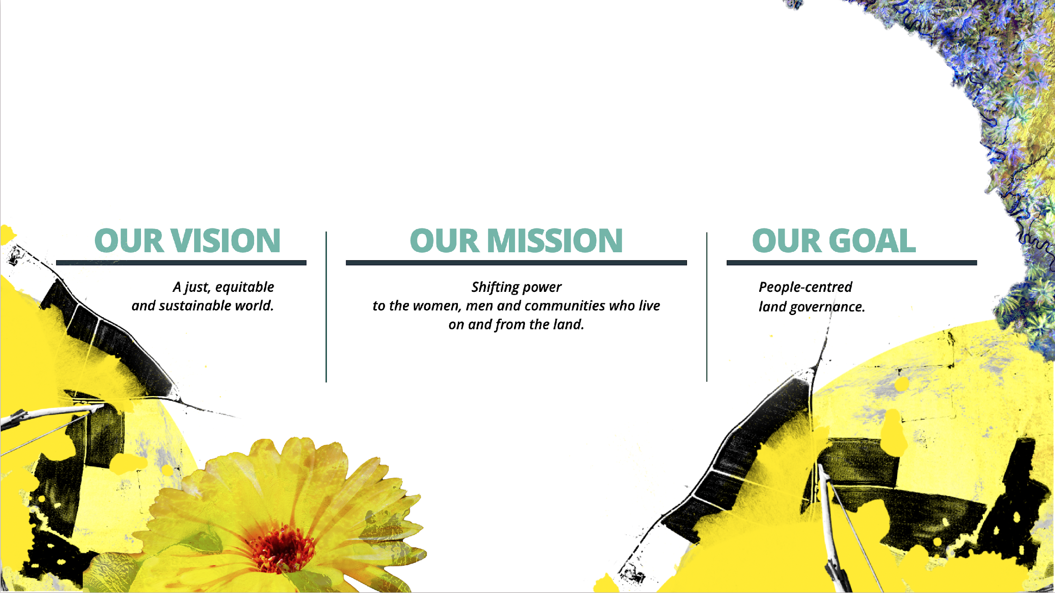
ILC AFRICA
AT
A GLANCE
OUR ASPIRATIONS

Slide 4
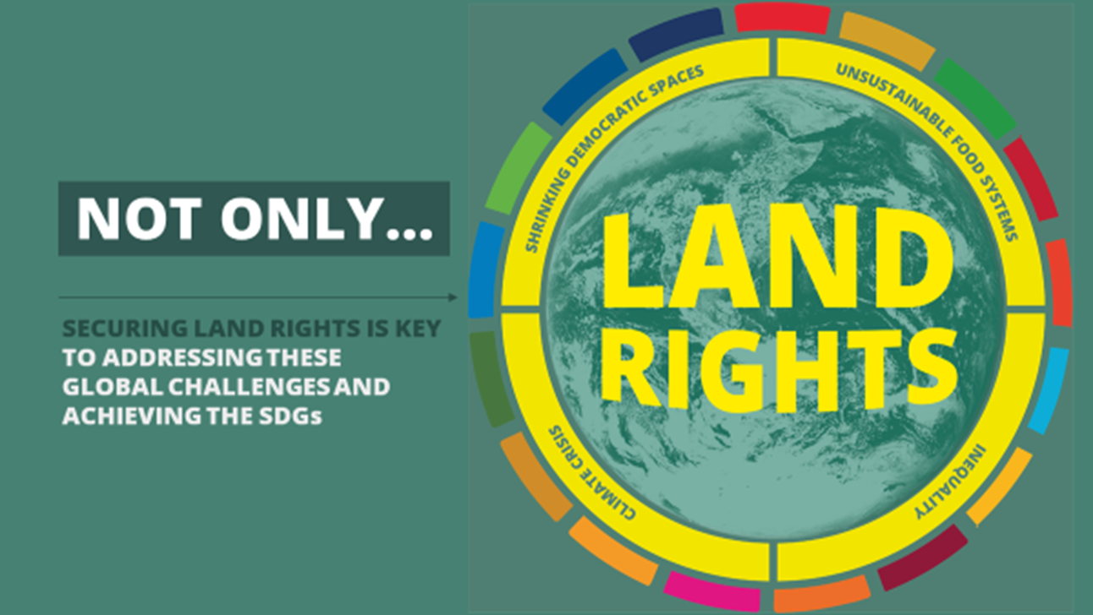
Land governance and Rights as a pathway to addressing global issues
#Shifting power back to the people

Slide 5
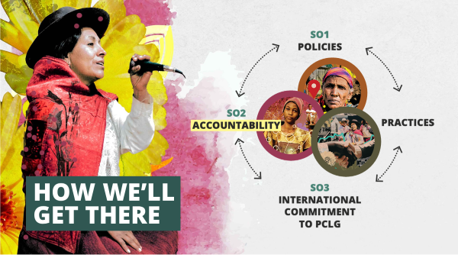
ILC STRATEGIC OBJECTIVES
National Land Coalitions (NLCs) influence policies & practices
People driven Land Data Production
Regional and global advocacies

Slide 6
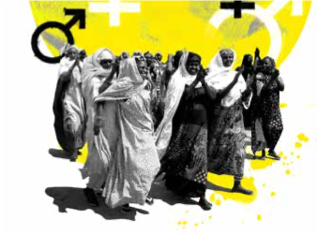
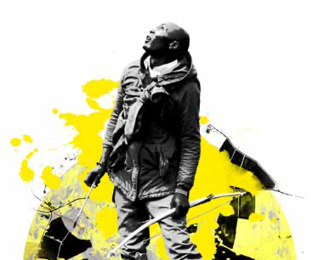
ILC PLEDGES:
GENDER JUSTICE:
ILC is committed to breaking cycles of gender injustice in its own coalition and partnerships.
In Africa we will strive to increase representation of women and women’s organizations in ILC Africa supported processes (50%)
NLCs and Africa Regional Platforms promote gender justice through the Global Gender Action Plan and ILC Africa Gender Charter
2. DEFENDING LAND DEFENDERS:
ILC is committed to support the members on the frontlines
of securing the land rights of their communities.
In Africa we are committed to build their capacity to protect themselves among other things

Slide 7







ILC AFRICA STRATEGY IMPLEMENTATION PLATFORMS/PROGRAMMATIC AREAS
1
2
3
NLC BUKINA FASO
NLC CAMEROON
NLC CONGO
12
RP 2
RP 6
4
Small-scale and family farming in Africa
Locally-managed ecosystems
NLC UGANDA
NLC DRC
RP 3
RP 7
11
Diverse tenure rights (rangelands initiative)
Inclusive decision-making
5
NLC TOGO
RP 4
RP 10
NLC KENYA
10
Equal women for land rights
Protect land rights defenders / Land grabbing
6
NLC TANZANIA
RP 5
Youth & Land
NLC LIBERIA
Secure territorial rights for indigenous peoples
Fellowship /internship scheme
9
8
7
NLC SOUTH AFRICA
NLC MALAWI
NLC MADAGASCAR

Slide 8
KEY RESULTS
14
11
8
POLICIES INFLUENCED
PRACTICES TRANSFORMED
AGENDAS SHAPED
By 12 platforms’ contributions
By 11 platforms’ contributions
By 6 platforms’ contributions
Policy Influenced: Promulgation by the President of the DRC on November 16, 2022 the Law no. 22/030 on the protection and promotion of the rights of Pygmy Indigenous Peoples (PAP)
Practice Transformed: Development of Land Booklet (Livret Froncier) in Togo to aid in the enactment of a law that recognizes customary land rights.
Agenda Shaped: Providing inputs to ensure the integration of land considerations into the amendment to the Climate Change Bill of South Africa
Notes:
Practice: The Plaform’s advocacy efforts aided the enactment of Law No. 2018-005, an important step in acknowledging the importance of customary land rights. One major challenge was the absence of rural land registers in town halls due to limited resources. To address this issue, the Platform engaged an expert land consultant who played a key role in the preparation of essential documents required by the land and property code, facilitating the recording of land ownership (Livret Foncier).
Agenda: LandNNES members’ advocated to fast-track the bill and address its shortcomings in addressing climate change impacts on land and agriculture. LandNNES facilitated a successful policy messaging workshop to identify the impacts of climate change on agricultural and land governance systems which went a long way in ensuring a comprehensive approach to climate change adaptation and mitigation.

Slide 9
Success Factors
Collective advocacy (there is power/strength in numbers) - synergizing efforts and complementarity
CSO-GOV Partnerships
Involvement of people’s organizations
Cross-country learning and exchange
Linking national advocacy to regional and global advocacy processes

Slide 10










The Global Land Governance Index
for People-Centred Data

Slide 11
THE GLOBAL
LAND GOVERNANCE INDEX
THAT PUTS
PEOPLE
AT THE CENTER OF LAND DATA
DEMOCRATIZING LAND MONITORING AND
BUILDING A DATA ECOSYSTEM WHERE
ALL VOICES CAN BE HEARD

Slide 12
LANDex AS CONCEPT
A TOOL THAT
RESPOND TO NEED FOR PEOPLE-CENTRED DATA
SHEDS LIGHT ON KEY ISSUES OF LAND GOVERNANCE
FOSTER INCLUSIVE DATA COLLECTION & ENGAGEMENT WITH UNDERREPRESENTED POPULATIONS
FILL EXISTING GAPS IN DATA & COMPLEMENT EXISTING DATA
FOSTER STANDARDIZED DATA ECOSYSTEM
MAKES DATA GENERATION AND USE ACCESSIBLE

Slide 13
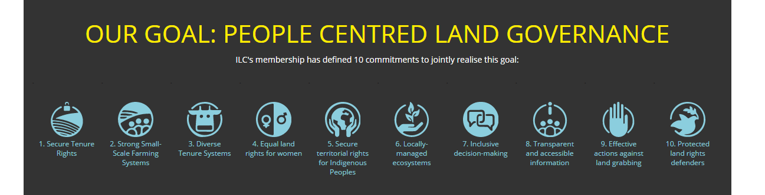
A BROAD APPROACH
COVERING ILC’S 10 COMMITMENTS

Slide 14
LEVELS OF INDICATORS
THREE INDICATOR LEVELS, PER 10 COMMITMENTS OF ILC
1 | 2 | 3 | 4 | 5 | 6 | 7 | 8 | 9 | 10
A | A | A | A | A | A | A | A | A | A
B | B.1 | B | B | B | B | B | B | B.1 | B
C | B.2 | C | C | C.1 | C | C | C | B.2 | C
 | C |  |  | C.2 |  |  |  | C
A = Legal
B = Implementation
C = Outcome, Results, Impact

Slide 15
THREE INDICATOR LEVELS
EXAMPLE: COMMITMENT 4
4
LEGAL
IMPLEMENTATION
RESULTS
COMMITMENT 4: EQUAL RIGHTS FOR WOMEN
LEGAL AND INSTITUTIONAL FRAMEWORK REGARDING LAND, IN PLACE AT NATIONAL LEVEL, IS GENDER RESPONSIVE
SHARE OF WOMEN OWNERS OR RIGHTS-BEARERS OF AGRICULTURAL LAND, BY TYPE OF TENURE
WOMEN WHO PERCEIVE THEIR RIGHTS TO LAND PROTECTED AGAINST DISPOSSESSION OR EVICTION, BY TYPE OF TENURE
Data in South Africa (2021)
4A
Score: 35
Moderate advances in the legal framework to secure women’s land rights
4B
Score: 33
33% of women in South Africa are owners and rights bearers of agricultural land
4C
Score: 70
70% of rural women in South Africa perceive their tenure rights to be secure
(PRINDEX)

Slide 16
LANDEX
TYPE OF METHODOLOGY
1 | 2 | 3 | 4 | 5 | 6 | 7 | 8 | 9 | 10
A | A | A | A | A | A | A | A | A | A
B | B.1 | B | B | B | B | B | B | B.1 | B
C | B.2 | C | C | C.1 | C | C | C | B.2 | C
 | C |  |  | C.2 |  |  |  | C
18 | People Based Indicators
7 | Calculation or Numerical Indicators
7 | Global Survey Indicators
1 | Crowd-sourced, integrated database indicator
A = Structural or Legal
B = Process or Implementation
C = Outcome, Results, Impact

Slide 17
Over 4 years of LANDex
What did we achieve?
Data sets in over 30 Countries
Full data sets for South Africa, Cameroon, Uganda, Kenya, Togo, Senegal, Liberia
Data for accountability
Legitimating people’s data
Translation of LANDex data to different international frameworks: SDG, VGGT, CEDAW
Using data for national and regional priorities: Countries Assessments and Analytical Reports
Improvement of the tool
Reducing data fragmentation by building partnerships
Regional Data Packages: Adjusting the tool to regional priorities
Expansion of indicators related to youth and climate

