Slide 1
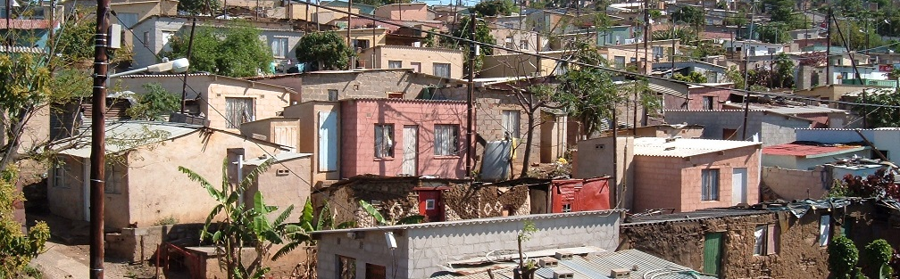


INTRODUCTION TO
INFORMAL SETTLEMENT
UPGRADING
MODULE 11: FINANCE FOR UPGRADING

Slide 2
Module purpose
The purpose of this module is to enable you to understand the approaches and instruments available for financing an informal settlement upgrading project or programme so that you can contribute to developing financial plans.

Slide 3
Learning outcomes
After participating in the module you should be able to:
Identify what needs to be funded as part of an upgrading project;
Explain the Division of Revenues Act and how the money is distributed amongst grants and subsidies;
Identify the different financial instruments that can be applied to upgrading projects;
Determine which types of finance are appropriate and relevant for different types (categories) of upgrading projects;
Read and understand a project budget.

Slide 4
Module content
Funding requirements for an upgrading project
Types of funding available
Preparing a financial plan for an upgrading project
Preparing a financial plan for an upgrading programme

Slide 5
1. Funding requirements for an upgrading project
Affordability Issues
Funding is a critical success factor for any project. Without the necessary funding a project cannot be implemented
Sources of funding must therefore be identified right at the start of any upgrading project (i.e. at the concept and early planning stages)
When the target market has very low incomes then the funding strategy will mainly be to access subsidies and grants to cover the full cost of the project
Incrementally improving infrastructure and services and creating more secure tenure can make upgrading more affordable to residents and to the municipality

Slide 6
Activity 11.1: Know what you know — Funding requirements
Activity type: Individual
Timing: 5 minutes
Purpose: To think about the funding requirements for upgrading activities.
Instruction: In the space provided in the Participants Manual, list as many items as you can think of that must be paid for in upgrading projects.

Slide 7
2. Types of funding Arrangements
Main types of Funding
Conditional grant/subsidy finance such as:
  Human Settlement Development Grant (SG): e.g. UISP, Provision of Social and Economic Amenities, Emergency Housing Programme (EH).
  Urban Settlement Development Grant (USDG).
  Municipal Infrastructure Grant (MIG).
Municipalities’ own financial resources. This is funding from the municipality’s capital or operation budget
Residents own money. This includes residents’ own investments in the top-structure, payment for rates and services etc.

Slide 8
Source of the Funding: the Division of Revenues Act (DORA)
The South African government raises funds through taxes and income earned, as well as borrowing.
Money may be withdrawn from the National Revenue Fund only in terms of an act of parliament
The funds raised by government are allocated to the national, provincial and local spheres of government in terms of the Division of Revenue Act (DoRA).
All budget schedules in the DoRA depict the financial allocation for any current year.
The recommended division of anticipated revenue for the subsequent two years is also included (MTEF)

Slide 9
Source of the Funding: the DORA cont.
The different types of funding allocations made in the DoRA are as follows:
The equitable share for local and provincial governments. The primary objective of the equitable share is to ensure that all South Africans have access to basic services. This is an unconditional transfer i.e. local government can decide how they want to use it. The equitable share is allocated on the basis of a formula.
Conditional grants:
    supplementary,
    specific purposes and
    in-kind-allocations. The funds must be used for the purpose for which they were allocated.

Slide 10
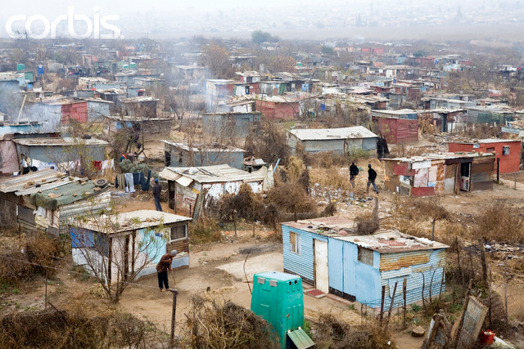
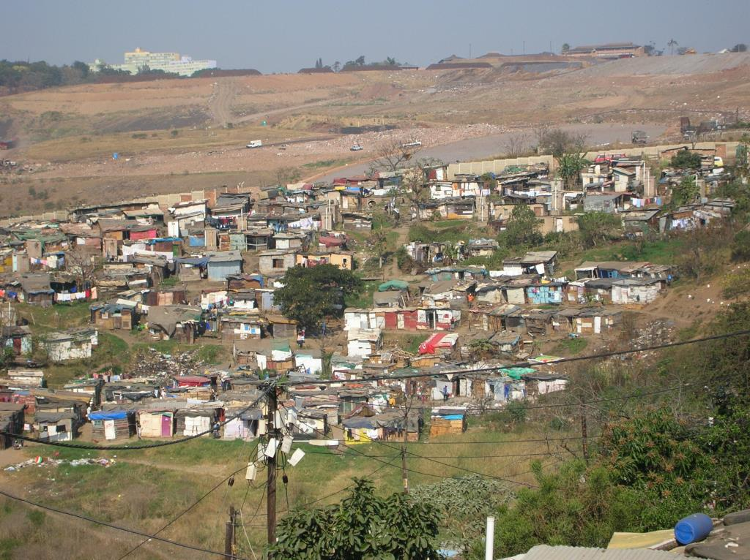
Factors affecting what funding is actually required or available
Settlement type
Municipal eligibility
Beneficiary eligibility
Municipal accreditation status and level
Settlement specific characteristics
Extent of in-house municipal capacity
Community participation

Slide 11
Grants available for informal settlement upgrading
A range of grant funding instruments are available for informal settlement upgrading.
Specific grants will be largely dictated by the category of the settlement arising from Assessment and Categorisation (AC), as well as the other factors outlined above.
There are instances where policy and grant instruments necessary for incremental upgrading are not in place
There are also grant instruments which would benefit from refinement
Sometimes required grant funding may be provided or co-funded by non-housing sources

Slide 12
Grants available for informal settlement upgrading cont.
Type of Settlement | Type of grant and source
Conventional formal full upgrading (Category A) | UISP: This is the best suited housing subsidy mechanism for immediate and full upgrading/formalisation, with no interim services phase.
 | IRDP: The IRDP could be utilised in particular where there is no interim services phase and no temporary engineering services and where A grade instead of B grade engineering services are intended.
 | EPHP can potentially be utilised for the top-structure phase although the new EPHP is not yet fully activated and guidelines are not yet available.

Slide 13
Grants available for informal settlement upgrading cont.
Type of Settlement | Type of grant and source
Incremental full upgrading (Category B1 extended) | UISP: This is the best suited mechanism for incremental formal upgrading although there are limitations such as the limited amount available for interim engineering services (R3.6k per site).
 | EPHP is relevant for formal incremental upgrading, but less suitable for less-formal incremental upgrading.
 | USDG and MIG: These are very relevant for less-formal incremental upgrading projects because there are likely to be limitations in terms of the extent to which the USDG and EPHP can be utilised.
 | Community savings: This will be especially relevant for less-formal incremental upgrading projects for housing consolidation and housing improvements

Slide 14
Grants available for informal settlement upgrading cont.
Type of Settlement | Type of grant and source
Interim arrangements including basic services (Category B1) | USDG: This is very suitable for Metros wanting to respond quickly and programmatically across many different informal settlements.
 | MIG: For non-Metros wanting to respond quickly and programmatically across many, different informal settlements.
 | UISP Phase 1: For projects where land is relatively easily available and only a small investment in interim services is required (less than R3.6k per site).

Slide 15
Grants available for informal settlement upgrading cont.
Type of Settlement | Type of grant and source
Deferred relocation with interim arrangements (Category B2) | USDG: For Metros wanting to respond quickly and programmatically across many, different informal settlements
 | MIG: For non-Metros wanting to respond quickly and programmatically across many, different informal settlements.
 | EH: For settlements with severe health and safety threats and in particular where it is not only emergency basic services that are required, but also temporary top-structures.

Slide 16
Grants available for informal settlement upgrading cont.
Type of Settlement | Type of grant and source
Immediate relocation (Category C) | EH: If the relocation is linked to the development of a temporary relocation area (TRA) already being funded, then funding for the actual relocation costs would potentially be available from the DHS under EH.
 | UISP: If the relocation is part and parcel of a UISP project then there is a relocations grant (R1.4k per site) available.
 | Municipality: It is assumed that the municipality will need to cover the costs of the relocation if neither of the above scenarios apply.

Slide 17
Grants available for informal settlement upgrading cont.
Specific Requirements | Type of grant and source
Temporary relocation area (TRA) | EH: A TRA often becomes a permanent or semi-permanent settlement in its own right. A TRA should therefore only be used as a last resort and with due regard to the suitability of the location. For example, it should provide easy access to education and health care for the short- to medium-term.
Land acquisition | Land acquisition typically occurs as part and parcel of full housing delivery (e.g. UISP/IRDP) and funding is provided for this in the housing subsidy formula (e.g. R3.24k per site for UISP).
 | It is unclear how land is funded outside of full housing delivery, possibly HAD.

Slide 18
Grants available for informal settlement upgrading cont.
Specific Requirements | Type of grant and source
Key social facilities: | DHS Social and Economic Facilities grant
 | Department of Education and Health
Community participation and facilitation: | The budgetary provisions within the housing subsidy formula for participation and facilitation are limited.
Project preparation and feasibility | There is no up-front funding available for the all-important preparation and feasibility stages of upgrading projects (leading up to the point of applying for subsidy or other capital funding).

Slide 19
Funding limitations and gaps
Community participation and facilitation
Basic (interim) engineering services: The UISP funding provision of R3.6k will often be insufficient for these purposes.
Less-formal incremental upgrading: In general, the existing Human Settlements grants assume that there will be formalisation.
Permanent engineering services: e.g. where retaining walls and water-borne sanitation are necessary

Slide 20
Funding limitations and gaps
Project preparation and feasibilities: Funding for this all-important project phase is not readily available.
EPHP: The new EPHP is not yet fully activated and is limited to the top-structure phase
Land acquisition: Funding for land acquisition and related professional services is not always sufficiently provided for

Slide 21
Activity 11.2: Applying the grant instruments
Activity type: Group work
Timing: 40 minutes
Purpose: To identify suitable funding instruments for different developments.
Instructions: Refer to the handout Grant Instruments for Informal Settlement Upgrading. For each of the cases in the table below:
  1. Indicate the most suitable funding source or sources.
  2. Explain your reasons for selecting the funding source.
  Write your answers on the table in the Participants Manual.

Slide 22
Activity 11.3: What can go wrong in financial planning?
Activity type: Facilitated group discussion
Timing: 15 minutes
Purpose: To identify what can go wrong in preparing a financial plan for an upgrading project, and what you can do to avoid or mitigate that.
Instructions: You will discuss the question: “What can go wrong with a budget for an informal settlement upgrading plan?”
  You can make notes in the space provided in the Participants Manual.

Slide 23
3. Preparing a financial plan/budget for an upgrading project
The basis for the financial plan
A financial plan is a critical part of an informal settlement upgrading plan.
It is informed by other parts of the upgrading plan especially those relating to the project concept and scope.
The project scope includes all the intended activities that need to be funded to make the project succeed.
The project concept, in turn, is heavily informed by the AC process and in particular the categorisation of the specific settlement.

Slide 24
Principles for financial planning for an upgrading project
Long-term operating and maintenance costs need to be taken into consideration
Cost estimates form the basis of all financial plans. The accuracy of such cost estimates increases as the project moves through its various phases.
Cost estimates need to take into account the project schedule (timetable), and the cash flow needs to be calculated accordingly
Often it takes many months to get a human settlements project approved and then often many years for it to be fully implemented. If you fail to provide for inflationary escalations the project may run out of budget before it is completed.
To a significant extent (and in particular in the case of human settlement grants) the budget available for certain project components is fixed and projects need to be budgeted accordingly.

Slide 25
Impact of project scale on costs and cost efficiency
The costs of professional work and related technical studies, e.g. geotechnical and land legal investigations, and environmental impact assessments are only slightly greater for a project of 1 000 sites compared to project of 500 sites.
Yet the project budget available is double because the funding formula provides a set amount per household or per site.
So, a 500 site project is much less cost-efficient than a bigger project. Very small projects (e.g. less than 250 sites) often become difficult to achieve due to these non-economies of scale, unless they are batched together with other projects to achieve better economies of scale.

Slide 26
Impact of project locality on actual costs
The costs of land are far higher in the centre of Metros and large towns than in small towns and peri-urban areas;
The costs of construction may rise in areas located far from centres of materials supply;
The costs of construction skills and professional services may rise in areas where such skills are not locally available;
Costs are higher in areas which are very hilly and steep or where settlement densities are very high.

Slide 27
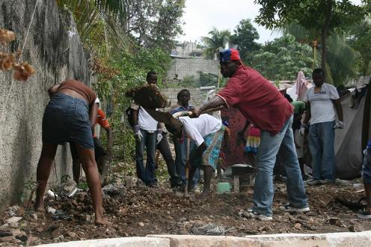
Making sufficient provision in an upgrading project financial plan
The following key items are often not adequately identified and provided for in the financial plan for an upgrading project:
Facilitation and community participation
Bulk services provision
Land acquisition and related technical work
Top up costs of internal services
Top up for top-structure costs

Slide 28
Budgeting using the UISP
A financial plan using the UISP will comprise the phases of the UISP.
There are fixed amounts provided for in the UISP policy, but actual costs are likely to vary from the amounts provided. In that case additional funding sources (e.g. municipal reserves) will be required.
Overall the budgetary provision of the UISP up until the interim services stage may be insufficient for many situations, except where some basic interim services have already been provided and significant community participation and planning work has already been completed using other budgetary sources.

Slide 29
Budgeting using the UISP cont.
The provision for the construction of interim (temporary) engineering services is small:
  Opt to provide only a minimal level of service,
  Utilise MIG/USDG funding,
  Motivate to the provincial MEC for special flexibility, or
  Defer the provision of services until the next phase although this will only be effective where land has already been acquired or can be rapidly acquired.
The permanent engineering services budget may also require a top up. On projects located on challenging sites
In the event that some bulk services are required (e.g. water or sewer connectors), a separate funding source such as MIG or USDG will need to be accessed

Slide 30
Activity 11.4: Estimating a budget using the UISP
Activity type: Group work
Timing: 40 minutes
Purpose: To draw up a budget for a UISP project, using the typical activities in the work package, and the items and amounts available from the UISP.
Instructions: Calculate an estimated budget for Settlement A. Complete the table that the facilitator will give you.
  Most of the settlement consists of 723 households. Most of the site has been identified for conventional formal full upgrading, but there is a section that requires immediate relocation. There are 81 households that will need to relocate. They will go to an existing TRA, from where they will relocate to a new development close by.

Slide 31

Project Cash Flow
A critical part of managing and planning project finances is determining how the funding will be spent over time, i.e. the projected cash-flow.
To do this, a realistic project schedule (timetable) must be developed.

Slide 32
4. Preparing a financial plan for an upgrading programme
Principles:
  MTEF is initially informed by estimates at assessment and categorisation level
  As further preparation and feasibility work is completed updated figures are inserted into the MTEF
  The municipality’s MTEF needs to be aligned with that of funders
Budgeting via MTEF
  The MTEF responds directly to the summary upgrading plans and ensures that the necessary financial resources are put in place over a multi-year period and across different funders and grant mechanisms so that the plans can be realised

Slide 33
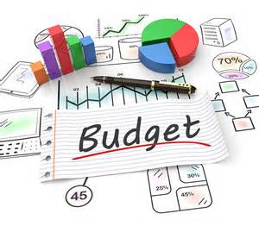
What Did You Gain?
Write down five useful things you learnt in this module in the Participants Manual.

