Slide 1
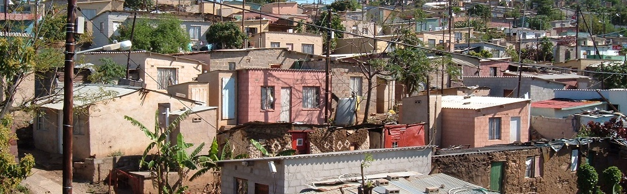


INTRODUCTION TO
INFORMAL SETTLEMENT
UPGRADING
MODULE 6: INTERIM ARRANGEMENTS AND RELOCATIONS

Slide 2
Module purpose
The purpose of this module is to provide an understanding of the planning involved in providing interim services and relocations. This will enable you to factor these requirements into settlement response plans, so that interim services and relocations are properly planned and humanely managed.

Slide 3
Learning outcomes
Explain the policy requirements for interim services in informal settlements that will not be upgraded in the short-term;
Describe appropriate interim arrangements for different settlement categories;
Identify who needs to participate in the implementation of interim arrangements;
Explain why and when relocations are necessary in informal settlement planning;
Propose ways to limit the negative effects of relocations on households;
Describe different types of relocation interventions;
Contribute to the planning and humane management of relocations.

Slide 4

Module content
Introduction
Interim arrangements
Relocations

Slide 5
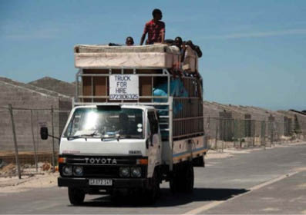
1. Introduction
This module covers two related topics — the provision of basic services to all residents of informal settlements (interim services) and relocations.
Interim services - regardless of an informal settlement’s category, legal and moral imperatives mean that a municipality is bound to attend to living conditions immediately in all informal settlements.
Relocation - affects people directly and frequently results in loss of income, increased cost of living and disruption of social links that provide insurance and support for livelihoods where incomes are low or irregular.
  Relocations are sensitive within the informal settlement upgrading process and there is a risk of relocation protests being held to stop projects from being implemented.

Slide 6
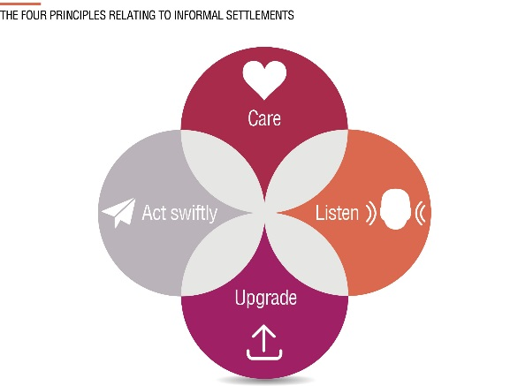
2. Interim arrangements
The obligation on the municipality to act and engage meaningfully
People living in informal settlements are subject to diseases and disasters
This creates a great urgency to do something to improve conditions for these people
From a humanitarian point of view it is intolerable
Legally municipalities bear responsibility
  → This means that no informal settlement may be left behind.

Slide 7
Activity 6.1: Know what you know
Activity type: Individual
Timing: 5 minutes
Purpose: To review the requirements for municipalities.
Instructions: Constitutional Court cases over the years have clearly established government’s responsibility with regard to citizens’ right to housing. What are the obligations of municipalities in this regard? Write down what you remember in your Participants Manual.

Slide 8
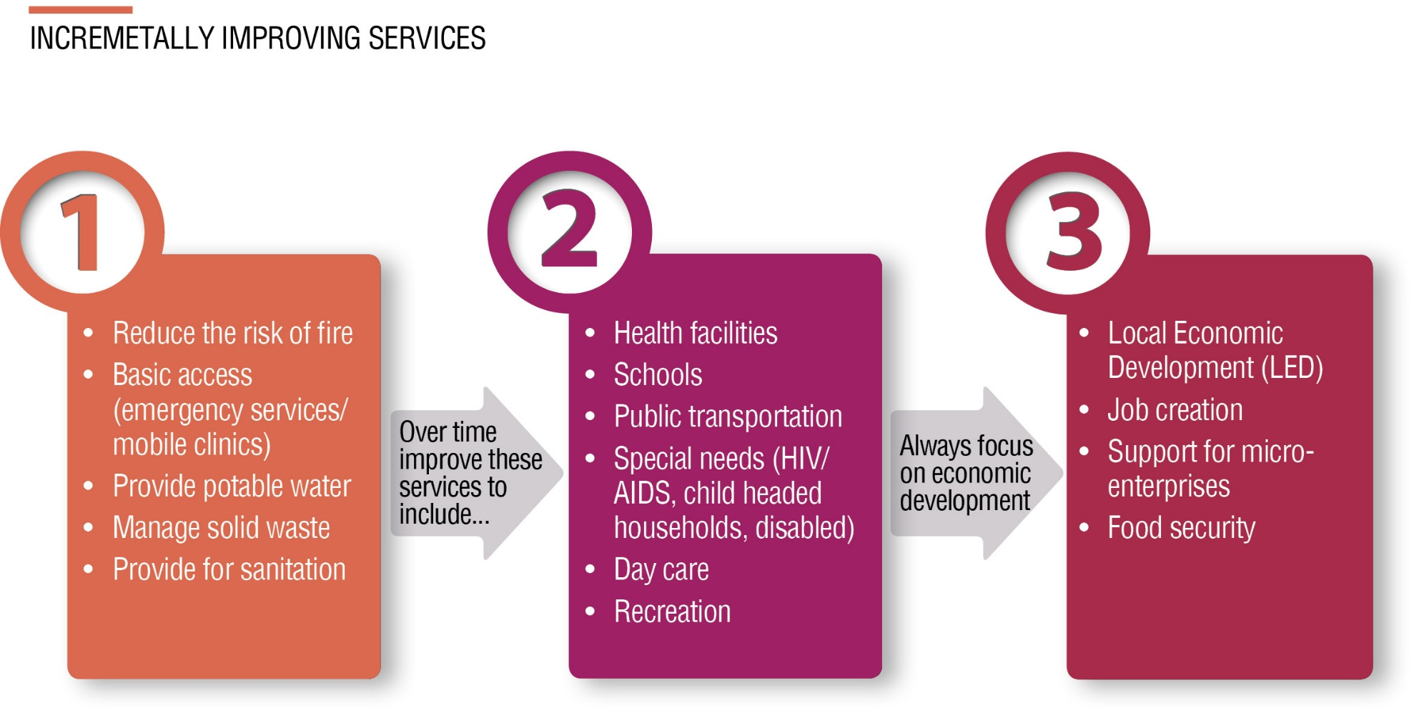
What are interim arrangements?

Slide 9
Definitions
Basic services focuses on health and safety and includes:
  reducing health and safety threats
  basic infrastructure
  broader socio-economic improvements
Interim services focuses on creating or extending both the range and quality of service provision on a basis where the installation will eventually form part of the settlement’s permanent service infrastructure.
Emergency services apply in cases of extreme threat where the installation of the services addresses an immediate need and is recognised as not forming part of any future service network.
Emergency housing refers to the provision of housing to a community after a disaster has occurred (such as fire or flooding). Note that emergency housing is not dealt with in this module.

Slide 10
Providing interim services to settlements viable for in situ upgrading
Conventional formal full upgrading settlements (Category A)
Basic services must be provided;
As the installation of full services is anticipated, it is undesirable/wasteful to invest in interim services.
Interim arrangements settlements (Category B1)
  Basic services should be provided.
  Interim services should be provided in a manner whereby they can easily be incorporated into the formalised development
Incremental full upgrading settlements (Category B1 extended)
Should be led by the provision of basic services (depending on timeframes);
followed by interim services, which will often consist of improved road and footpath access, standpipes, and some form of improved sanitation (e.g. VIPs or communal sanitation blocks);
sufficient preliminary planning is desirable to maximise the extent to which such interim services can be incorporated into an eventually formalised development

Slide 11
Providing interim services to settlements that are being relocated
Deferred relocation settlements (Category B2)
The provision of interim services should focus on health and safety:
Provision of water and sanitation
Refuse removal
Any risks faced by the residents
Emergency access for fire engines
Efforts to minimise wasteful expenditure must be balanced against plans to relocate the settlement.
Immediate relocation settlements (Category C)
If resettlement is imminent then no additional service infrastructure is warranted. Services to be provided could include:
Emergency services if resettlement is to be delayed.
A disaster response plan

Slide 12
Activity 6.2: Assessing service levels
Activity type: Groups
Timing: 15 min
Purpose: To assess the level of service provision in the settlements in your municipality.
Instruction: Choose two informal settlements in your municipality that you know (you may include the settlement you focused on in the work-integrated assignment). Using the information you have, answer the questions in the Participant Manual

Slide 13
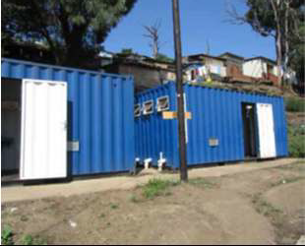
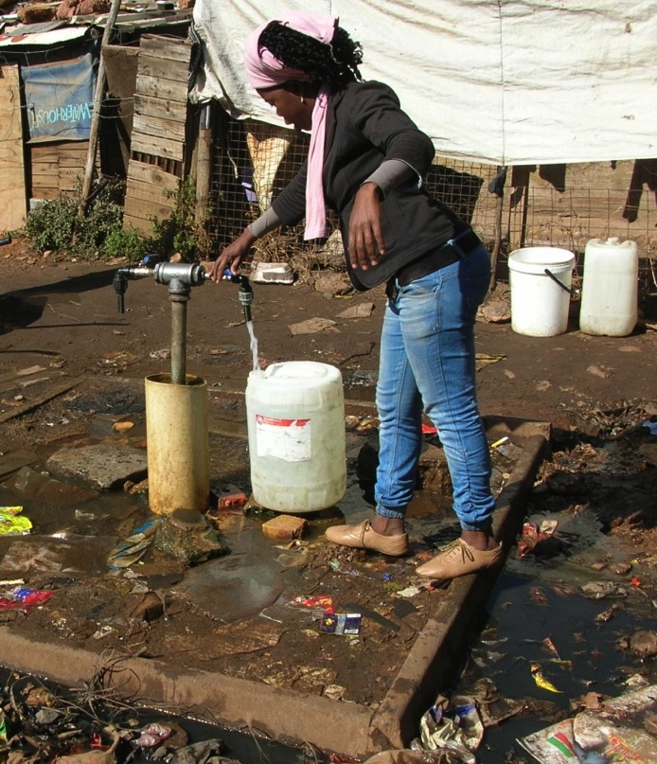
Case study: Ethekwini Municipality Interim Basic Services Programme
Ethekwini Municipality has developed an interim basic services programme which includes the following elements:
  Communal ablution blocks
  A basic road network and footpaths
  Electricity connections
  Standpipes
  Key social facilities
  Sustainable livelihoods

Slide 14
Activity 6.3: Interim services case study
Type of activity: Small groups (triads)
Timing: 10 minutes
Purpose: To apply planning for interim services.
Instruction: Imagine that you are going to implement the Ethekwini Interim Basic Services Programme in your municipality. Discuss and answer the questions in the Participant Manual.

Slide 15
Roles and Responsibilities
Providing interim services requires the involvement of technical departments and professionals:
  The main focus of interim arrangements is on the supply of engineering services
  The role of planning is to generate framework plans to reduce the potential for services to be abandoned

Slide 16
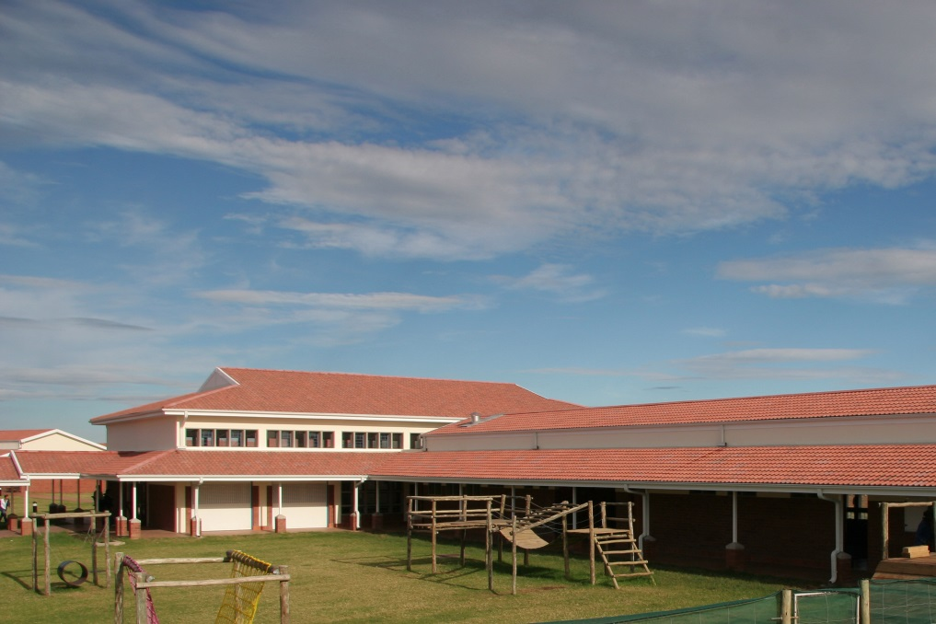
Access to social facilities
It is essential to plan for, and deliver, social facilities
This should be done bearing in mind the future plans for the settlement
Framework plans should be developed indicating land use, frame infrastructure and densities
Consideration should be given as to whether the service can be provided in other ways? For example are there mobile clinics and libraries or prefabricated structures that can be relocated to new sites?

Slide 17
How are interim arrangements funded?
Type of grant and source | What can be funded
Upgrading of Informal Settlements Programme (UISP) grant from the Department of Human Settlements. | Interim basic services.
Urban Settlements Development Grant (USDG) from Treasury | Principally for basic services (e.g. water supply, roads, sanitation etc.).
Municipal Infrastructure Grant (MIG) - from COGTA | Principally for basic services (e.g. water supply, roads, sanitation etc.).
Emergency Housing grant -from DHS | Emergency housing and basic infrastructure
Social & Economic Facilities – DHS | Medical care facilities, community halls, parks and playgrounds, sports facilities, taxi ranks and small business facilities.

Slide 18
3. Relocations
Activity 6.4: Know what you know
Type of activity: Individual reflection
Timing: 5 minutes
Purpose: To identify the challenges associated with relocations
Instructions: Note down the issues and challenges you have experienced with relocations in the Participant Manual?

Slide 19
The policy, legislation and social context
The Housing Code indicates the following in respect of how relocations should be undertaken:
  Where relocation is unavoidable, it should be based on the principle of minimal disruption to the affected persons and to relocating people to a site as close as possible to the existing settlement.
  A relocation strategy should be developed in collaboration with the community.
  Support should be provided to the households that are being relocated in respect of food grants and facilitating access to schools.

Slide 20
Legal imperatives relating to relocation
The legal imperatives, tested in court, indicate the following in respect of how relocations should be undertaken:
Relocation should only be considered as a last resort and
Relocation should be to destinations that are as close as possible to minimise social disruption.
No eviction or relocation may be conducted without the provision of alternate accommodation.
Accommodation provided must meet at least minimum standards and not constitute an affront to the dignity of the household being relocated.
Meaningful engagement with the affected community is mandatory.
  → Community participation around relocations is not only mandatory, but must be considered as a key success factor in an informal settlement project, and one of its greatest risks.

Slide 21
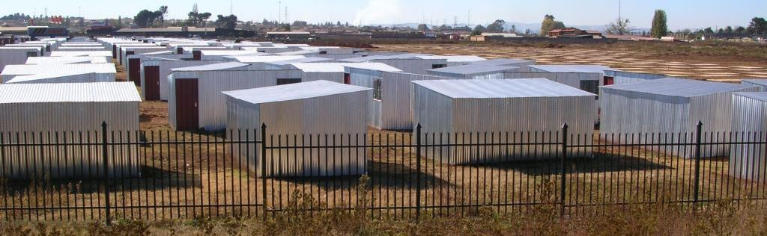
Types of relocation
Temporary relocation : involves moving a household while their site and top structure is redeveloped/developed and then moving them back to essentially the same location.
Permanent relocation : The household is moved away on a permanent basis. Permanent relocations require that even more effort needs to be made to make the relocation process acceptable to both the community and the affected households

Slide 22
Activity 6.5: Listen and care
Activity type: Role Play Simulation
Timing: 5 minutes to prepare; 30 minutes for simulations
Purpose: To identify the issues and concerns of people who may be relocated.
Instruction: You will be given a description of a person. Think about being that person: What are your main worries about being relocated? What will help you overcome those worries?
Introduce yourself to the group: tell them who you are, what your worries are and what will help you overcome those worries.

Slide 23
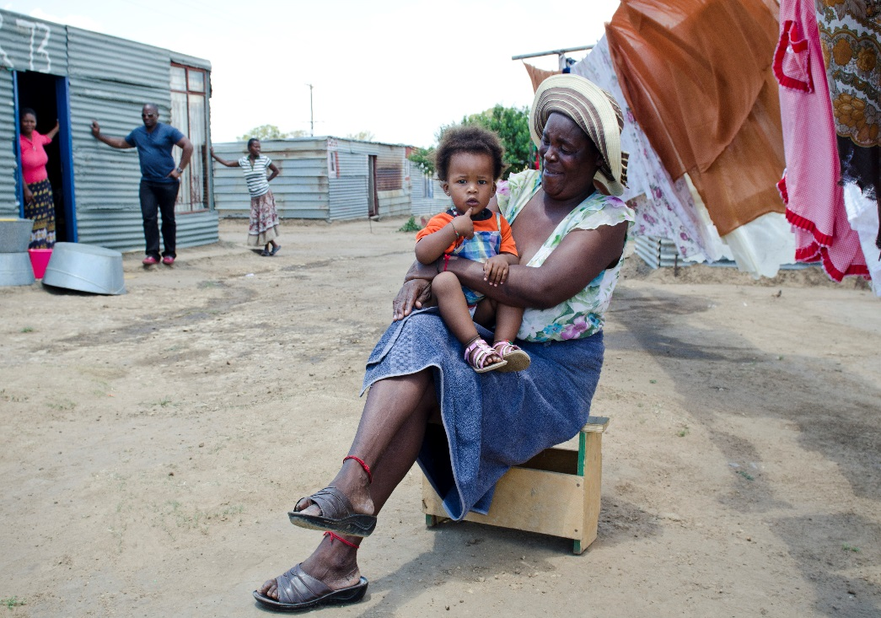
Key Aspects in relation to relocations
Residents of informal settlements are almost always amongst the poorest and most disadvantaged
A primary coping mechanism is the development of mutual support that takes a number of different forms from:
  Sociability/ friendship
  Sharing food
  Child care and security
  Financial support/borrowing.
  → Mutual support requires trust which develops slowly over time and is easily disturbed. The relocation of a household to a new setting destroys such support, making poverty much harder.

Slide 24
Key Aspects in relation to relocations
Relocations have the potential to disrupt living arrangements such as children’s access to school.
Planning relocations should consider gender roles and needs.
The relocation of households must aim to minimize disruption to social assets and livelihoods.
It is also important to factor in the cost of relocation to the individual households including:
  Cost of travel to work or source of livelihood;
  Cost of travel to school;
  Cost of travel to maintain social networks.
Many of these costs will affect the household over a long period.

Slide 25
The beneficiary status of relocates
The national status of those requiring to be relocated can be a problem as funding is not available for non-citizens who do not have a South African residence permit.
The Housing Code requires that the issue of aliens be referred to the Department of Home Affairs.
South African citizens who have previously received housing benefits, but are found in the informal settlement may also create problems. These residents should be reported to the Department of Human Settlements.
Options for resolving such matters include the sale of serviced sites under the upgrade programme. This requires departmental authorisation.

Slide 26
Activity 6.6: Reasons for relocations
Type of activity: Pairs
Timing: 5 minutes
Purpose: To reinforce what you have learnt about the reasons why relocation may be necessary.
Instructions: The reasons why a settlement may not be suitable for development are listed in the Participant Manual. For each reason, provide an example to illustrate what it means.

Slide 27
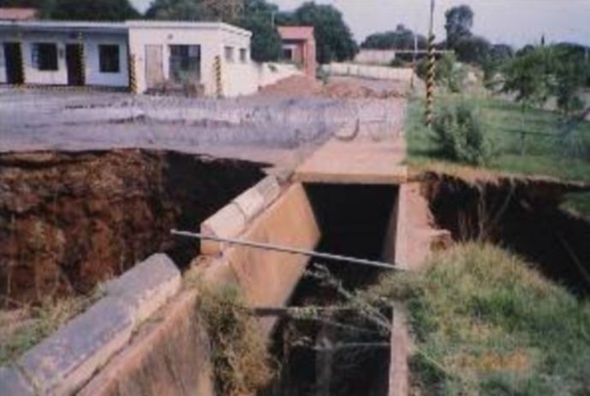
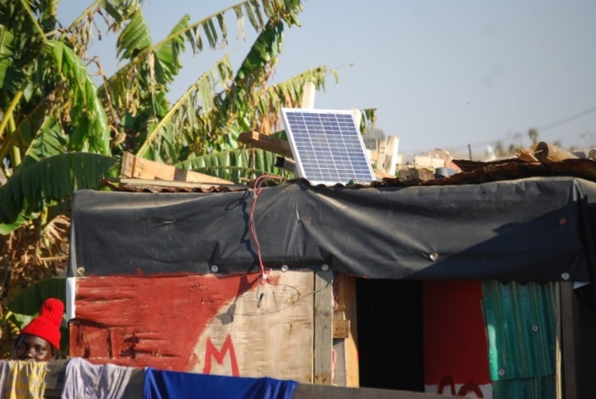
Minimising relocations
Where a settlement has been assessed and categorised as unsuitable for development, it should be investigated further, with the following in mind:
New planning legislation:
    SPLUMA
    NIMBY effect
New regulations for development on dolomite
New engineering technology

Slide 28
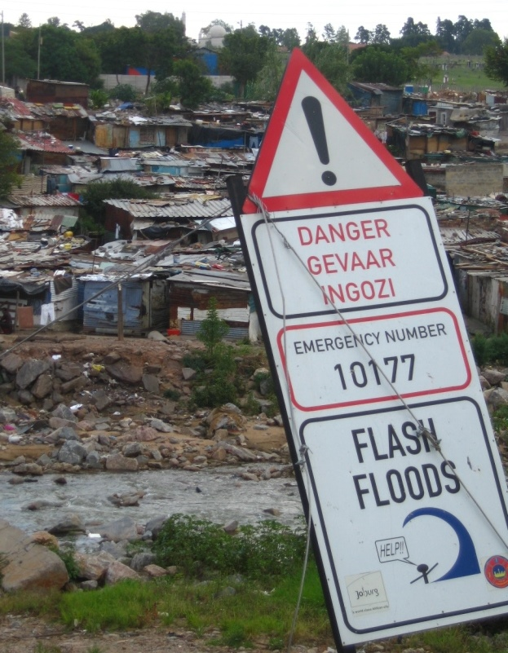
Looking for alternatives
The only legitimate grounds to relocate are proven hazards. But: There are engineering solutions to many hazards. Ask:
How severe are the hazards?
Do engineering solutions exist?
Can their cost be justified?

Slide 29
Looking for alternatives cont.
Longer term considerations: consider scarcity of land and the long term interests of the town/city, e.g.:
Can all dolomitic land be left undeveloped into the future?
Can flooding not be reduced through interventions upstream?

Slide 30
Looking for alternatives cont.
Possible engineering solutions to prevent relocation or to minimise relocation only to parts of the settlement:
Proximity to dangerous traffic – can a wall be constructed?
Proximity to a pipeline – can the pipeline be moved?
Proximity to power lines – can partial relocation be coupled with a suitable land use near the power lines (urban agriculture)?

Slide 31

Looking for alternatives cont.
Flooding – can surface water be better managed, or ground level be raised (e.g. through incremental roll-over upgrading)?
Unstable ground – can the ground be stabilised (terracing, gabions, retaining walls, raft foundations)?

Slide 32
Relocation in the context of an in-situ upgrade project
The implementation of an insitu upgrading process occurs with people on site and thus the relocation of households, be they temporary or permanent.
The scale of relocations depends upon the following factors:
  The size (scale) of the settlement
  The form of settlement
  Density of a settlement
  Infrastructure standards
  Top structure form

Slide 33
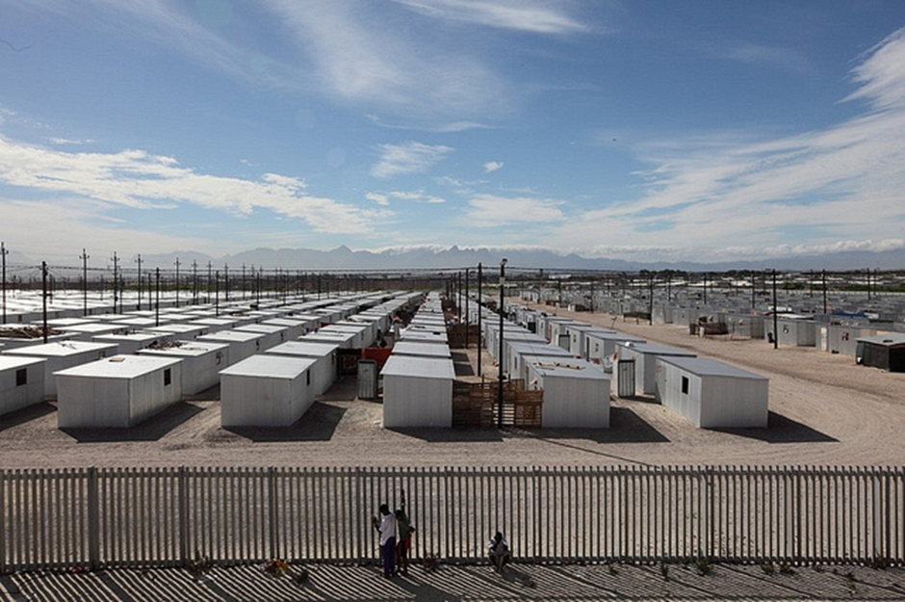
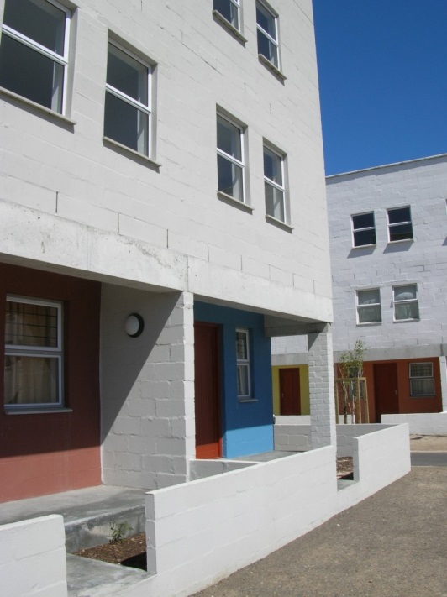
Methods of relocation - Roll over upgrading
Households are moved off the land, into a temporary relocation area (TRA) nearby
Shacks are dismantled and formal houses developed
The same households move back.

Slide 34
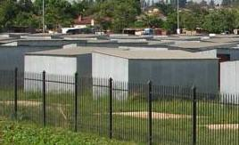
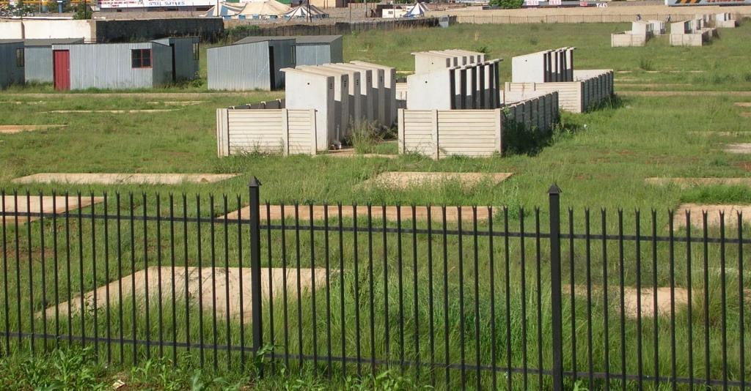
Roll over upgrading cont.
Disadvantages of roll over upgrading:
  it disrupts lives, and
  requires the establishment of a temporary relocation area (TRA). Its maintenance/management and later conversion or dismantling adds additional costs
  It is often difficult to get community buy-in due to fear of being displaced in the process.
But: this approach is required where land has to be rehabilitated. It is preferable to relocation.

Slide 35
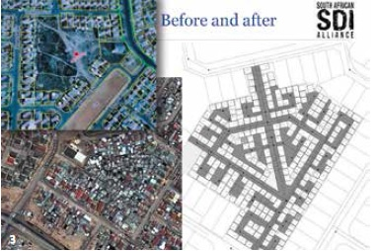
Re-blocking
Is a technique for re-ordering the settlement by moving and rebuilding shacks to free up space for infrastructure and facilities.

Slide 36

Relocations to greenfields sites
In a greenfields relocation, a whole community is moved to a new site.
A key issue with greenfield sites is their proximity to the site from which households are being moved.
The extent to which they are located within the vicinity of the existing site will reduce the social and economic disruption that households experience.

Slide 37
Planning for relocation
At the project preparation stage the following processes are involved:
  Registering all households in the informal settlement in order to establish the total number of households and (if possible) their beneficiary status.
  Determining the number of households that will have to be relocated as part of planning the settlement layout.
  Assessing the potential to accommodate relocation within the settlement or the availability of relocation sites outside of it.
  Arranging the relocation process — what needs to be done, when and by whom?
  Accommodating the relocation process in the plan including its timing, budgetary impact and management.

Slide 38
Post-relocation requirements
Aftercare in relocations is vital.
  Re-invasion of cleared sites defeats the object of the relocation
  Creating a clear demarcation between cleared sites and the rest of the settlement is essential to enable monitoring.
  Community buy-in to maintaining cleared areas is important.
  Regular monitoring is essential.
→ Most importantly: Caring for those who have been relocated needs to be an active process.

Slide 39
Funding for relocations
Emergency Housing grant: If the relocation is linked to the development of a temporary relocation area (TRA) already being funded, then funding for the actual relocation costs would potentially be available from the Department of Human Settlement under Emergency Housing. As the quantum for this is not specified in the housing subsidy formula it is granted at the MEC’s discretion.
UISP: If the relocation is part and parcel of a UISP project then there is a relocations grant (R1.4k per site) available.
Municipality own funds: It is assumed that the municipality will need to cover the costs of the relocation if neither of the above scenarios apply.

Slide 40
Activity 6.7: Managing relocations humanely
Activity type: Group work
Timing: 20 minutes
Purpose: To consider how to manage relocations humanely.
Instructions: Prepare a presentation to the Human Settlements Department called “Guide to Good Practice for Relocations”.

Slide 41
Summing Up
Managing relocations is a key success factor in informal settlement upgrading.
Careful planning and detailed community consultation at both community and individual level is both mandatory and essential.
Relocation planning must be included in the preparation of the informal settlement upgrading plan from the start.
In all cases never forget the severe impact that relocation can have on a poor household that is living in extremely marginal conditions- support during and after relocation process.
→ The emphasis should be on reducing the number of relocations and only undertaking them if they are absolutely necessary

