Slide 1
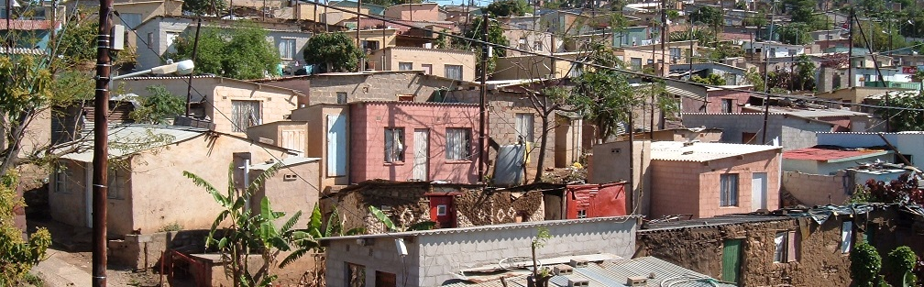


INTRODUCTION TO
INFORMAL SETTLEMENT
UPGRADING
MODULE 3: UPGRADING POLICIES, PROGRAMMES AND INSTRUMENTS

Slide 2
Module purpose
This module will give you an understanding of the South African policies, programmes and instruments relevant to informal settlement upgrading, so that you can make use of what is available.

Slide 3
Learning outcomes
Explain the links between the South African Constitution, the Housing Act of 1997 and the policies regarding upgrading of informal settlements.
Name the main instruments and financial subsidies that can be used in upgrading programmes and projects and explain the key features of each.
Describe the UISP phases and funding.
Link the instruments and financial subsidies to different development situations.

Slide 4
Module content
From the Constitution to the Upgrading of Informal Settlements Programme (UISP)
The Upgrading of Informal Settlements Programme (UISP)
National Upgrading Support Programme

Slide 5
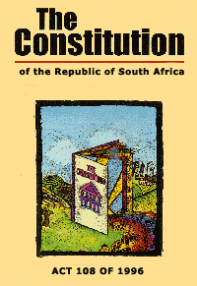
1. From the Constitution to the Upgrading of Informal Settlements Programme (UISP)
Constitution (1996): Chapter 2 - Bill of Rights
26. Housing
Everyone has the right to have access to adequate housing.
The state must take reasonable legislative and other measures, within its available resources, to achieve the progressive realisation of this right.
No one may be evicted from their home, or have their home demolished, without an order of court made after considering all the relevant circumstances. No legislation may permit arbitrary evictions.

Slide 6
Activity 3.1: The Constitution
Type of Activity: Group Work
Timing: 20 minutes
Purpose: To refresh what you learnt in Module 1.
Instruction: As a group discuss what you learnt about the Constitution and the right to housing in Module 1 and answer the questions in the participants manual.

Slide 7
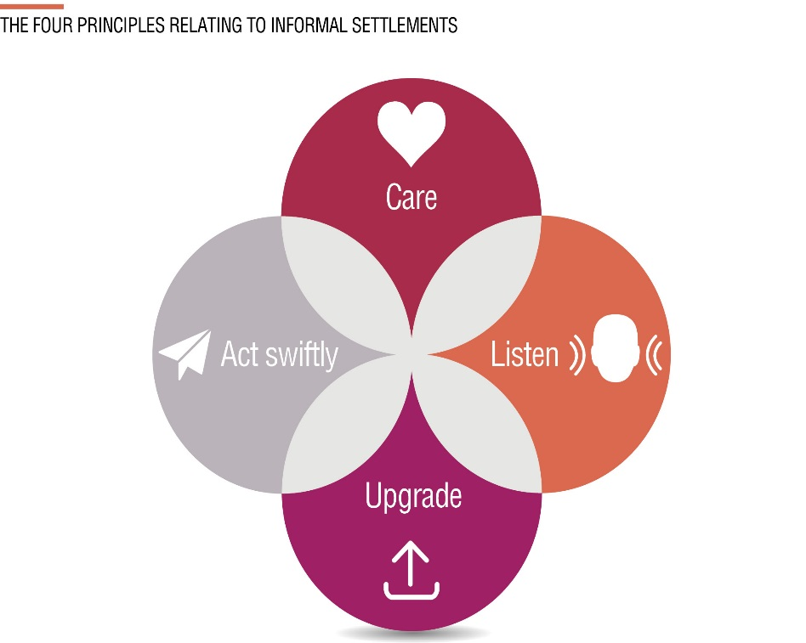
The Constitutional Court cases
The Constitutional Court cases show that the state may not neglect informal settlements.
The state is obliged to enact relevant laws, develop programmes and projects, and to make use of tax payers’ money to realise the right to adequate housing as quickly as possible for people living in informal settlements.

Slide 8
Housing Act, 1997
The Housing Act is split into seven parts. These are:
Part 1 – General principles.
Part 2 – National Government.
Part 3 – Provincial Government.
Part 4 – Municipalities.
Part 5 – Financing of housing development.
Part 6 – Termination of housing arrangements.
Part 7 – General provisions

Slide 9
Housing Act cont.
The Housing Act upholds Section 26 of the Constitution and recognises that housing:
Fulfils a basic human need
Is a product of human endeavour and enterprise
Is a vital part of integrated development planning
Is a key sector of the national economy
Is vital to the socio-economic well-being of the nation.

Slide 10
Housing Act- General Principles
The needs of the poor must be prioritised.
Need a wide choice of housing and tenure options
Housing development should occur in an integrated manner that creates socially and economically viable communities.
Government should encourage and support people to fulfil their own housing needs
Active participation should be facilitated.
Housing development requires meaningful consultation

Slide 11
Activity 3.2: The Principles of the Housing Act
Type of activity: Group work
Timing: 10 minutes
Purpose: To develop an understanding of the Housing Act.
Instruction:
  The facilitator will give each group two of the general principles from the Housing Act to which national and provincial government and municipalities must adhere.
  Put each of the two principles you are given into your own words.
  Give an example to illustrate how each of the principles can be put into practice in the upgrading of informal settlements.
  Select a group member who will report back on behalf of your team.

Slide 12
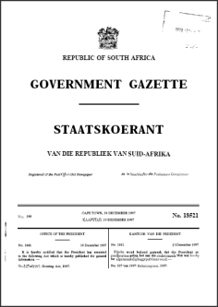
Housing Act – Role of National Government
The primary functions of national government are:
To develop national housing policy.
To establish a funding framework for housing development and negotiate and secure an allocation from the state budget for housing.
Allocate funds from the budget
Monitor the performance.

Slide 13
Housing Act - Role of Provincial Government
Housing is an area of concurrent competence for national and provincial government.
Provincial government can legislate in respect of housing matters that fall within its provincial boundaries, as long as such legislation does not undermine national legislation.
Develop provincial housing policy.
Support and strengthen the capacity of municipalities in respect of housing development.
Assess applications received from municipalities to administer national housing programmes and to monitor the performance of accredited municipalities.

Slide 14
Housing Act - Role of Municipalities
To facilitate the development and management of housing stock within their jurisdictional areas, as part of the process of integrated development planning.
Initiate, plan, co-ordinate and facilitate appropriate housing development on a progressive basis within its boundaries.
Prepare a local housing strategy and set housing delivery goals.
Set aside, plan and manage land for housing development.
Create a financial and socially viable environment conducive to housing development.

Slide 15
What does this mean for informal settlements?
The production of housing is a product of human endeavour and effort own imagination and effort, and this should be supported and reinforced by the government.
This implies that informal settlements should be upgraded where possible and build on what people have already developed.
There should be meaningful engagement with communities
The outcome of the housing or human settlements process should be socially and economically sustainable communities.
The responsibility for informal settlements, including municipal-wide strategic planning, as well as project planning and upgrading for a specific settlement, is with the local municipality.

Slide 16
Activity 3.3: Roles of the spheres of government
Type of activity: Group work
Timing: 20 minutes
Purpose: To clarify the roles of national, provincial and local government in sustainable human settlements
Instruction: You will be given a set of cards. Each card will have a role on it. Place the cards under the headings: national, provincial or local government.

Slide 17
Prevention of Illegal Evictions and Unlawful Occupation of Land Act (PIE) (1998)
The PIE Act came into effect to repeal and replace the 1951 Prevention of Illegal Squatting Act.
Its purpose is to ensure that no one is arbitrarily deprived of their home or property
No one can be removed from their homes without due process and the completion of full court proceedings.
It regulates the removal and eviction of people in a fair and just manner, whilst recognising that special consideration should be given to the rights of the elderly, women, children and the disabled.

Slide 18
PIE Procedure…
1. The community must be given notice of the land owner’s intention to get an eviction order.
2. The land owner must apply to the court to have a written notice served on the occupier/s stating the owner’s intention to evict the occupier/s.
3. No eviction may take place without a court order, which has taken into consideration the circumstances of the community in question.
4. Eviction may take place if meaningful engagement and alternative accommodation has been found

Slide 19
Activity 3.4: Applying the Prevention of Illegal Evictions (PIE) Act
Type of activity: Facilitated Group discussion
Timing: 15 minutes
Purpose: To confirm the rights of informal settlement residents.
Instruction:
  The Ruimsig Informal Settlement has existed for the past ten years; it has a number of very poor and vulnerable people who live in it such as child-headed households, the indigent and pensioners. The local authority would like to evict this community.
  What do they need to consider before an eviction can take place?
  What process must they follow in order for an eviction to be legal?

Slide 20
Spatial Planning and Land Use Management Act (2013)
Spatial Planning and Land Use Management Act (SPLUMA) is intended to:
Provide a national framework for land use and spatial planning to which all provinces and local authorities can abide by.
It is also intended to address previous spatial and regulatory imbalances
Clearly spell out the roles and responsibilities of the different spheres of government and other planning instruments.
→ What this means for informal settlements is that
Municipalities are required by law to know where the informal settlements are in their area of jurisdiction and should have a plan for upgrading each settlement.

Slide 21
Policy Documents: ‘Breaking New Ground’ (BNG) (2004)
Also called the ‘Comprehensive Plan for the development of sustainable human settlements’
BNG outlines a shift away from the provision of a house to providing sustainable neighbourhoods with access to social and economic facilities.
The plan introduces a number of new housing instruments
Supports the eradication of informal settlements through in-situ upgrading in desired locations, or the relocation of households ‘where development is not possible or desirable’.
→ During the initial years of the implementation of BNG it was misinterpreted to mean that informal settlements should be eradicated. Since then the intention of the policy has been clarified to focus on upgrading of informal settlements wherever possible.
This is recognised and reinforced in the policy documents and legislation that followed.

Slide 22
Housing Code (2009)
Part 3 of the Code promotes the progressive and incremental upgrading of informal settlements:
Favouring in situ upgrading over relocation and re-settlement
Securing tenure so that the tenure rights of informal settlement dwellers are recognised and formalised
Provide basic engineering services and infrastructure that is upgradeable, sustainable and affordable
Empowering communities, households and individuals by:
Addressing social and economic exclusion by focusing on community engagement
Building social capital through participative processes
Identifying and addressing broader social needs within communities
The Housing Code sets out a dedicated programme including a funding source under which informal settlement upgrading can be undertaken. In addition there are a number of programmes and grants that can be drawn on by municipalities to support and enhance this process.

Slide 23

National Housing Code - Emergency Housing Programme
  Provides assistance in emergency circumstances: grant to municipalities to allow them to respond rapidly to emergencies, can provide, land, services and temporary housing.

Slide 24
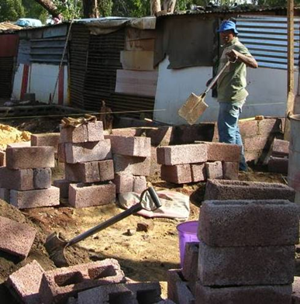
National Housing Code: more programmes
  Housing Chapters in an Integrated Development Plan: detailed guidelines for compiling the Housing Sections of the IDP by Municipalities.
  A grant to Municipalities to enable them to compile the Housing Chapter.
  Provision of social and economic facilities. The funds are for primary Municipalities to develop community facilities until other funding becomes available.
  Individual subsidy programme: …qualifying beneficiaries/households for a unit or serviced stand..

Slide 25
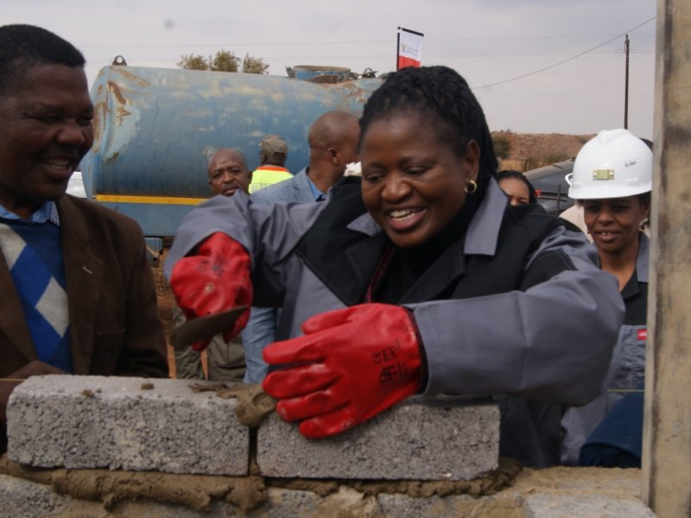
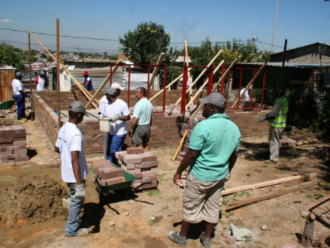
Enhanced People’s Housing Process (EPHP)
Aims to facilitate the a range of institutional, technical and logistical housing support mechanisms to enable communities to improve their housing circumstances

Slide 26
Accreditation of Municipalities
Accreditation Level One: Beneficiary management, subsidy budget planning and allocation, and priority programme management and administration
Accreditation Level Two: Full programme management and administration of all housing instruments/ programmes [in addition to Level One responsibilities]
“Assignment involves the shifting of planning, financial and legal accountability from the assigning to the receiving authority. Assuming financial accountability for a function includes the right to directly receive the funds and the assets necessary to perform the function”.

Slide 27
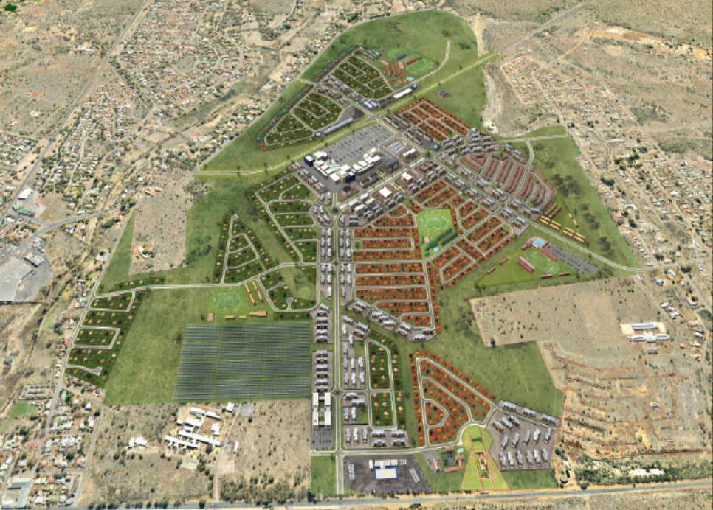
Integrated Residential Development Programmes (IRDP)
  Funds to undertake a large mixed use housing development.
  All types of housing, all types of land use – provides for acquisition of land, servicing of stands for all land use – sees Municipality as the developer.
Kuruman, IRDP Project

Slide 28
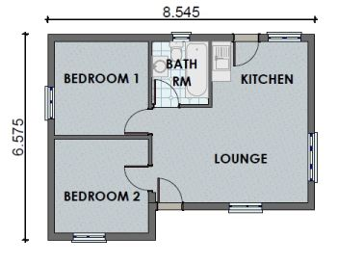
Norms and Standards – House/Unit
House/Unit
Minimum gross floor area of 40m2;
Two bedrooms;
Separate bathroom with a toilet, a shower and hand basin;
Combined living area and kitchen with wash basin;
Ready board electrical installation, if electricity is available.

Slide 29
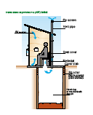

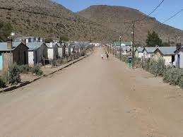
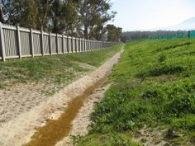
Norms and Standards - Services
VIP or agreed alternative
Metered stand pipe on stand
Services
Street lighting
Graded or gravel paved road
Storm water drainage

Slide 30
Service standards in informal settlement upgrades
“National Norms and Standards in respect of the creation of serviced stands shall not apply to this Programme but could serve as a guideline”.
The standard of permanent services must be negotiated between the local authority and residents.
Community needs and wants must be balanced against:
  short and long-term affordability,
  environmental sustainability,
  human dignity and
  sound engineering practice.

Slide 31

National Development Plan (2012)
Significantly expanding the national programme on informal settlement upgrading
Municipalities should introduce local level programmes
Rapid assessment and appraisal of all informal settlements
Legal mechanisms to recognise rights of residents and allow for incremental upgrading of tenure

Slide 32
National Development Plan cont.
Minimum health and safety standards which would be progressively upgraded as regularised informal settlements are brought into the mainstream urban fabric
Funding arrangements that would channel resources into community facilities, public infrastructure and public spaces; and not just housing
Dedicated capacity at local level for informal settlement upgrading
Developing community organisation to support participatory regularisation and upgrade programme.

Slide 33
National Development Plan cont.
Informal settlements must be addressed through spatial planning and land use instruments such as:
Land use management systems that must be flexible and appropriate
Spatial Development Frameworks (SDFs), must include previously disadvantaged areas such as informal settlements
Municipal SDFs must:
  Identify areas in the municipality where incremental upgrading approaches to development and regulation will be applicable
  Land use schemes must also include provisions for incremental introduction of land use management and regulation in areas such as informal settlements

Slide 34
What this means for informal settlements
The NDP promotes the need to address informal settlements both at a programmatic and project level.
In addition, it encourages a people-centred approach that is focused on understanding and responding to the needs of the community living in an informal settlement and creating integrated neighbourhoods.
A key element of the NDP is its acceptance of informality.

Slide 35
Activity 3.5: Accepting Informality
Type of activity: Small groups (triads)
Timing: 10 minutes
Purpose: To consider what it means to ‘accept informality’.
Instructions: In the presentation above, two key statements have been made:
  “A key element of the NDP is its acceptance of informality”.
  “According to the revised Housing Code, Part 3, section 3.13, the national norms and standards do not apply in the case of the upgrading of informal settlements. However, they are to be used as a guideline….”
  In your groups, discuss and provide examples of what it means to ‘accept informality’.

Slide 36
Performance instruments
Key performance documents in respect of informal settlements include:
Outcome 8 – Delivery Agreement (2010)
Medium Term Strategic Framework (2014 to 2019)

Slide 37
Outcome 8 – Delivery Agreement (2010-2014)
Outcome 8: Sustainable human settlements and improved quality of household life through the following outputs:
Output 1: Upgrading 400 000 households within informal settlements.
Output 2: Improving access to basic services.
Output 3: Facilitating the provision of 600 000 accommodation units within the gap market for people earning between R3 500 and R12 800.
Output 4: Mobilisation of 6 250 ha of well-located public land for low income and affordable housing with increased densities on this land and in general.

Slide 38
What this means for informal settlements
Outcome 8 is an extremely important document in that the targets set were a key driver for provinces and municipalities in addressing informal settlement upgrading between 2010 and 2014.
Even though the period for the targets has ended the document is still important in terms of its policy component.

Slide 39
Medium Term Strategic Framework: 2014-2019
Reflects the commitments made in the election manifesto of the governing party
Commitment to implement the National Development Plan.
Sets out the actions government will take and targets to be achieved.
Provides a framework for the other plans of national, provincial and local government.
With respect to informal settlements the MTSF sets the following target:
Informal settlement upgrading will be expanded to cover
750 000 households, ensuring basic services and infrastructure in some 2 200 informal settlements.

Slide 40
Activity 3.5: Reflection on Legislation and Policy for Informal Settlement Upgrading
Type of activity: Small groups (triads)
Timing: 10 minutes
Purpose: To reflect on how legislation and policies pertaining to informal settlements are being implemented.
Instruction: It is clear that we have many policies and programmes that support and promote incremental and in situ informal settlement upgrading. Yet informal settlements do not seem to be incrementally upgraded in accordance with policy. What do you think are the reasons for this?
Write down your key points in the Participants Manual

Slide 41
Summing up: Implications of legislation and policy
There has been a change in how informal settlements are viewed and should be addressed over time.
In the past the focus was on providing a formal subsidised house and the eradication through replacement of informal settlements.
Currently, the upgrading of such settlements is being specified.

Slide 42

Summing up… Care!
Work with and not against informality (and accepting that given our constrained economic future, it is likely to persist in the future).
Ensure that livelihoods and economic opportunities are afforded priority (protected or supported).
Integrate and include informal settlements into the planning of cities and towns.
Understand informal settlements in their spatial and socioeconomic context.

Slide 43

Summing up… Listen!... Upgrade!...Act Swiftly!
Ensure meaningful community participation, engagement and local ownership.
Prioritise in situ upgrades with relocations only being undertaken as a last resort.
Give priority to the provision of basic services and functional tenure
Maximize the use of scarce land.
Ensure that there is a rapid response at scale
Multi-pronged and flexible

Slide 44
2. Upgrading of Informal Settlements Programme - UISP
The UISP is an informal settlement upgrading funding mechanism introduced in the BNG in 2004, with the intention of:
supporting upgrading on an area-wide basis,
maintaining fragile community networks,
minimising disruption and
enhancing community participation through a phased process.

Slide 45
UISP: Four Phases
1.. Application
- Interim Business Plan
- Land Availability
2. Project initiation
- Land acquisition
- Installation of interim services
3. Implementation:
- Final Business Plan
- Formalisation of land rights
4. Consolidation

Slide 46
Phase 1: Application
Municipalities apply annually to provincial human settlements departments for funding for informal settlement upgrading.
Application must include:
  Interim business plans: the proposed projects fit into the local authority’s IDP and housing development plan.
  Pre-feasibility details of the proposed projects:
    A desk-top layout sketch of the informal settlement to quantify the number of sites required,
    A preliminary geotechnical assessment,
    A land availability agreement and
    Bulk engineering assessment.
The applications are evaluated against the criteria detailed in the guidelines and rules for implementation.

Slide 47
Phase 1: Application cont.
The types of activities undertaken during this phase include:
Survey of the informal settlement participation
Registration of households
A participation process (see Module 4)
Dispute resolution if required.

Slide 48
Phase 1: Application cont. - Funding
Phase 1 funding is provided for:
survey,
registration,
participation,
facilitation,
dispute resolution
geotechnical investigation,
land acquisition
pre-planning and
interim engineering services.

Slide 49
UISP Phase 2: Project Initiation
This phase is expected to take place over 8 to 12 months. The municipality is expected to undertake a range of activities including:
Acquiring land where required through negotiation or expropriation;
Providing a clear socio-economic and demographic profile of the settlement;
Installing interim services including basic water and sanitation;
Conducting pre-planning studies to determine geotechnical conditions and environmental impact.
Developing a business plan which is submitted to the MEC for approval.

Slide 50
Phase 2 and 3 - Funding
Funding for Phases 2 and 3 is for:
detailed town planning,
land surveying and pegging,
contour survey,
land survey examination fee,
civil engineering fees,
site supervision fees,
permanent engineering services provision and
project management.

Slide 51
Phase 3: Implementation
Phase 3 commences with the approval of the business plan. The municipality receives funding for the following activities:
Establishing project management capacity;
Establishing housing support services;
Undertaking the planning processes;
Formalising land occupational rights and the resolution of disputes;
Land surveying and pegging;
Relocation assistance;
Land rehabilitation;
Installing permanent municipal engineering infrastructure; and
Constructing social amenities, economic and community facilities.

Slide 52
Phase 4: Consolidation
Once the first three phases have been completed, township establishment finalisation, ownership registration (where appropriate) and house construction will take place.
Any outstanding social amenities, as agreed between the community and the municipality, will also be constructed during this final phase.

Slide 53
Funding Arrangements
Currently the funding arrangements are still top-down and flow from national to provincial and then to municipal authorities.
Province receives their funding allocation from national and in phases 1 to 3 of the UISP.
Municipalities apply for funding to be reserved for projects that are included in their IDPs and housing chapters.
The MEC conditionally approves funding and ensures that it falls within the Medium Term Expenditure Framework (MTEF)

Slide 54
Activity 3.7: Finding Information in the Housing Code
Type of activity: Small groups (triads)
Timing: 15 minutes
Purpose: To practice finding information in the Housing Code
Instructions:
  The facilitator will provide a number of copies of the Housing Code: Incremental Intervention.
  Use the Housing Code to find the answer to the following question: What criteria are used to evaluate applications for the UISP?

Slide 55
The UISP Subsidy amount
UISP Subsidy | Subsidy per site
Phase 1
Survey, registration, participation, facilitation, dispute resolution etc. - 3% of project cost | 240.63
Geotechnical investigation | 114.06
Land acquisition | 3 247.66
Pre-Planning | 978.64
Interim engineering services | 3 680.69
Total ph1> | 8 261.68
Phases 2 and 3
Detailed town planning | 513.22
Land surveying and pegging | 380.17
Contour survey | 76.04
Land survey examination fee | 117.85
Civil engineer's fee | 1 140.50
Site supervision fees | 288.90
Permanent engineering services provision | 23 513.38
Project management - 8% of total cost | 2 082.40
Total ph2&3> | 28 112.46
Relocation grants
Transportations and loading costs for people and household effects | 487.15
Social service support including support for the registration of social benefits, school registration and other welfare support | 368.07
Relocation food support to households | 606.24
Total max relocation grant per household> | 1 461.46

Slide 56
Additional fiscal instruments
 | Type of grant and source | What can be funded
Grants which are relevant for upgrading | Upgrading of Informal Settlements Programme (UISP) grant | Interim basic services. Land acquisition. Permanent engineering services. Top-structures (as a follow-up phase).
 | Urban Settlements Development Grant (USDG). (The USDG replaces the previous Municipal Infrastructure Grant (MIG) for metropolitan municipalities.) | Interim basic services. Emergency basic services.
 | Municipal Infrastructure Grant (MIG) | Interim or emergency and basic services
 | Individual subsidy | Top-structures and full tenure for those who qualify for the subsidy quantum.
 | Consolidation subsidy | Top-structures.
 | Integrated Residential Development Programme (IRDP) grant | Top-structures.
 | Emergency Housing grant | Emergency housing and basic infrastructure.
 | Social and Economic Facilities | Medical care facilities, community halls, parks and playgrounds, sports facilities, taxi ranks and small business facilities.
Grants which are potentially relevant | New Enhanced People’s Housing Process grant (EPHP) | Top-structures and associated PHP social, planning and capacitation processes.

Slide 57
Funding arrangements UISP
Relocation grants cover transportation and loading costs for people and household effects, social service support and relocation food support to households.
In terms of the construction of social and economic amenities e.g. sport fields, community centres, municipalities can apply though the Social and Economic Amenities Programme for funding

Slide 58
Activity 3.8: Using the Programmes and Instruments in an Upgrading Project
Type of activity: Group work
Timing: 30 minutes
Purpose: To become familiar with the different programmes and instruments that can be used in upgrading projects.
Instruction:
  Your facilitator will provide you with a profile of the Luthuli Park settlement that is due to be upgraded.
  Use the Handout: Grant Instruments for Informal Settlement Upgrading and identify which programmes and grants need to be applied for to fund the different development priorities.

Slide 59
Institutional Arrangements
Community participation is acknowledged as being critically important to the UISP and funding is made available to support social processes.
According to the UISP, this participation should be undertaken through Ward Committees with on-going effort in promoting and ensuring the inclusion of key stakeholders and vulnerable groups in the process.
The UISP notes that in certain circumstances the assistance of community development workers (CDWs) can be used in collaboration with the ward structures

Slide 60
Important Considerations
Relocations
Layouts and standards
Project performance
Institutional capacity and knowledge
Other key challenges (Difficulties in accessing land and putting land availability agreements in place, the funding amount for interim services, capacity to undertake participation and the phases of the UISP being too rigid and not sufficiently flexible)

Slide 61
3. National Upgrading Support Programme - Objectives
Promote incremental upgrading as a major complementary housing programme, in line with Part 3 of the National Housing Code (where possible, in-situ)
Improve programmatic approach to upgrading, strengthening coordination with other sectors and partners
Strengthen capacity of government and professional practitioners to implement community-based incremental upgrading

Slide 62
NUSP – Strategic areas of support
Provision of technical assistance to provinces and municipalities for the development and implementation of upgrading programmes and projects
Capacity building and training to practitioners, councillors and community members in the field of informal settlement upgrading
Knowledge services and information dissemination to the upgrading community of practice

Slide 63
Activity streams
Active engagements with municipalities around informal settlement upgrade plans and projects (45 municipalities including the Mining Towns in Distress Programme).
Rapid assessments, categorisation, and the development of settlement plans in over 600 settlements.
Introductory courses on UISP for municipalities.

Slide 64
What did you gain?
What were the three key aspects, relating to the new approach to the incremental upgrading of informal settlements, which you learnt from this module?
How will you apply them in your local upgrading programme?

