Slide 1
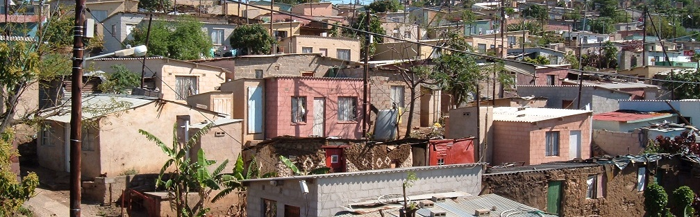


INTRODUCTION TO
INFORMAL SETTLEMENT
UPGRADING
MODULE 4: PARTICIPATORY APPROACHES

Slide 2
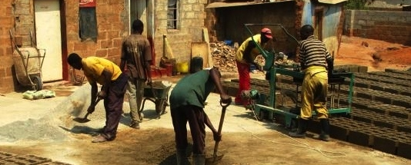
Module Purpose
The purpose of this module is to provide you with a basic understanding of the benefits, theory and practice of participation, including suitable tools and methods that can be applied, so that you can support genuine and meaningful participation in upgrading projects.

Slide 3
Learning Outcomes
Discuss the meaning and importance of a participatory approach to informal settlement upgrading;
Recognise that municipalities are mandated to empower communities through participation;
Describe different levels of participation and place your own participatory processes on the participation continuum;
Consider key issues when selecting stakeholders to be involved in a participatory process;
Identify different participatory processes that can be used at different phases of informal settlement upgrading;
Use some communication skills that encourage participation;
Suggest some responses to common issues you encounter with participation.

Slide 4
Module content
Why is participation important?
Good practice in participatory processes
When? Participation in the different stages of the upgrading process
Who? The stakeholders in Informal Settlement Upgrading initiatives
Participatory methods and techniques
Participation is challenging

Slide 5
Activity 4.1: Know what you Know
Type of activity: Facilitated group discussion
Timing: 15 minutes
Purpose: To identify the challenges of community participation.
Instruction: Discuss the questions in the Participation Manual with your partner.

Slide 6

1. Why is Participation important?
In informal settlement upgrading, participation is based on the acknowledgement that different parties bring different things to the upgrading process.
This process requires that participants develop respect for each other and the various strengths and contributions that each can bring.

Slide 7
What is meaningful participation?
Participation means some form of involvement of people with similar needs and goals, in decisions affecting their lives.
There is no single blue print as to how it should be undertaken.
It needs to be locally relevant considering that each community is characterised by different dynamics and demographics.

Slide 8
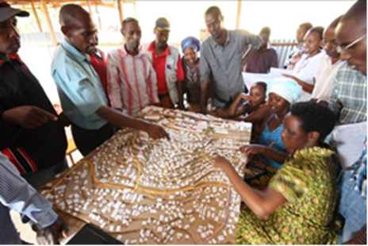
What is meaningful participation cont.?
Participation comprises building “common ground” between Institutions and Communities bringing together:
Internal knowledge: which is the knowledge, experiences and skills of the community,
External knowledge: which is technical, specialized knowledge brought into the process by specialists and municipalities

Slide 9
What is meaningful participation cont.?
The process of participation requires:
Reciprocal Trust
Collaboration to find solutions
Mutual Respect
Recognition of each others strengths
Harnessing creativity

Slide 10
Activity 4.2: The benefits of participation
Type of Activity: Pairs
Timing: 10 minutes
Purpose: To illustrate the benefits of participation
Instruction:
  You will watch a video that describes the participatory approach taken in the Mshini Wam re-blocking project.
  After you have watched, discuss with your partner and note down three advantages of participation and three things that can go wrong if there is no participation.

Slide 11
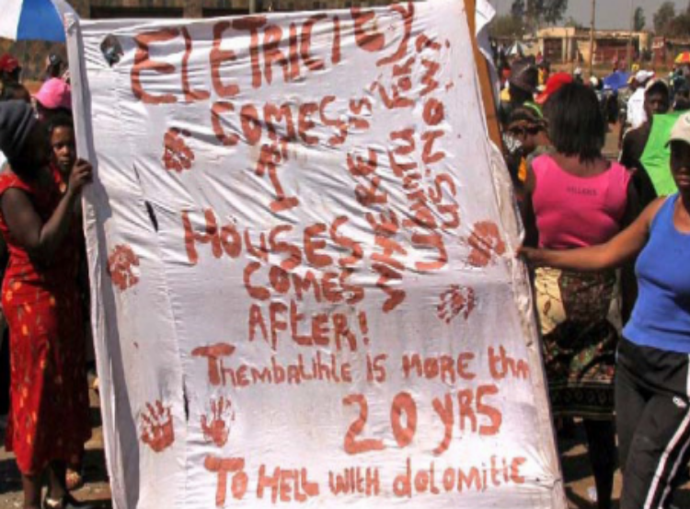
The benefits of participation
Without a meaningful, truthful and deep participation process, a series of substantial, problematic issues may arise during the upgrading of an informal settlement e.g.
Lack of alignment between institutional/governmental goals and community needs
Strong opposition/protest from the community concerning particular aspects of the upgrading process.

Slide 12
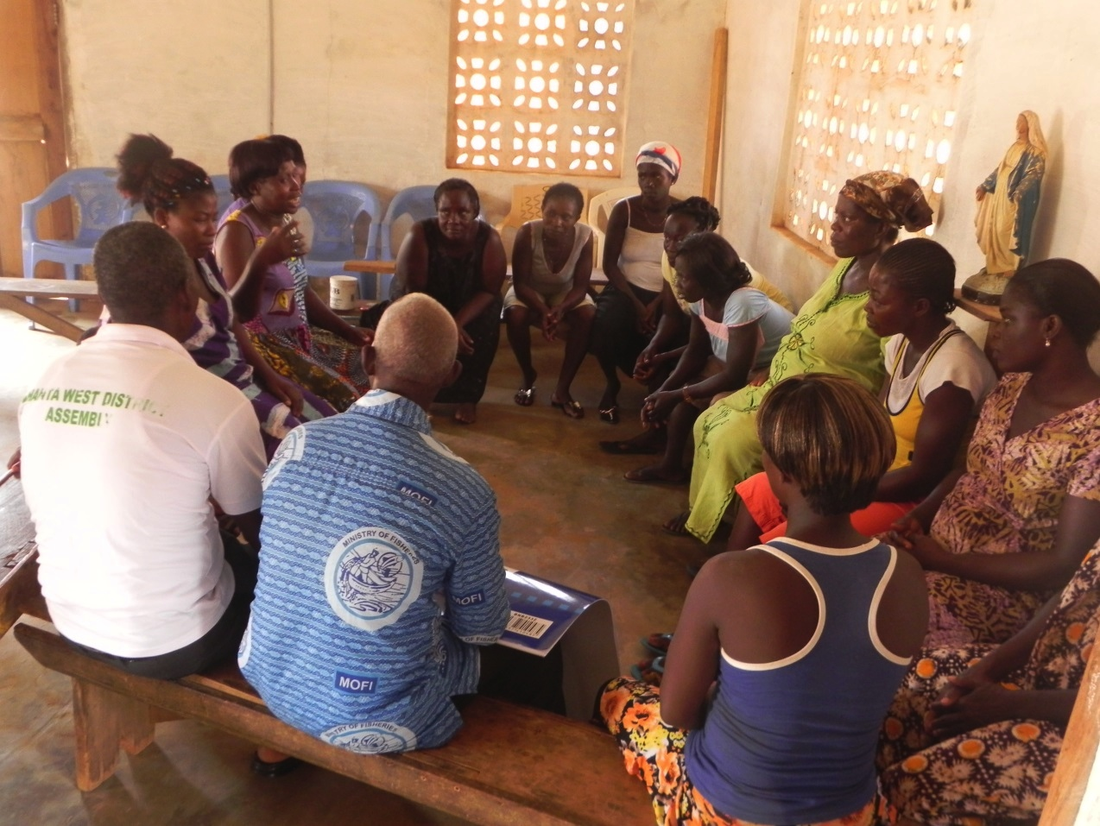
The benefits of participation
Community participation is crucial in developing good plans that:
- Ensure that communities own the process of development.
- Ensure that people can make a meaningful contribution to the
development of their own lives.

Slide 13
The benefits of participation
Greater acceptability and legitimacy of the process by local communities.
Effective utilisation of existing skills and resources.
Improved quality of information gathered
Fewer disputes among local residents and between communities and authorities.
Effective responses to local conditions and priorities.
Building trust and confidence by all parties.
Opportunities for further engagement between communities and authorities.

Slide 14
Is participation mandated?
YES!
Where? - Everywhere!
  The Constitution of the Republic of South Africa, 1996
  Municipal Structures Act, 1998
  Municipal Systems Act, 2000
  Municipal Planning and Performance Regulations, 2001
  Breaking New Ground, 2004
  Upgrading of Informal Settlements Programme (UISP), 2009

Slide 15
Is participation mandated?
Requires a municipality to develop mechanisms to consult with communities and community organisations
Municipal Structures Act
Municipal Systems Act
Breaking new Ground
UISP
A municipality must establish appropriate mechanisms, processes and procedures to enable the local community to participate in the affairs of the municipality
Specifies that informal settlement upgrades should be undertaken as community projects
The programme has three interrelated key focus areas: the provision of tenure security, addressing health and safety, and empowering residents through participatory
processes

Slide 16
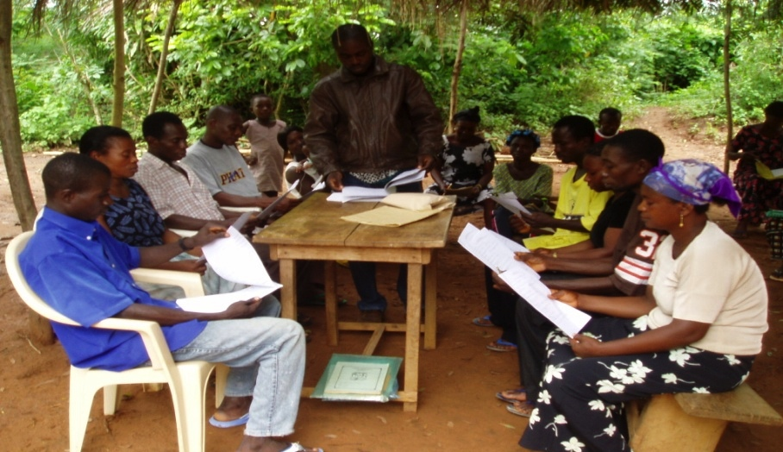
2. Good practice in participatory processes
Meaningful engagement is viewed as the core principle upon which the participatory process should be based.
Individuals or communities should be treated as partners in the decision making process.
Meaningful engagement should occur during all stages (decision-making, planning, implementation and evaluation)

Slide 17
Good practice in participatory processes – Court Cases
The important practices established in the court cases are as follows:
Meaningful engagement
Individual engagement
Respect and partnership
Mutual consensus
Adequate consultation
Active participation

Slide 18
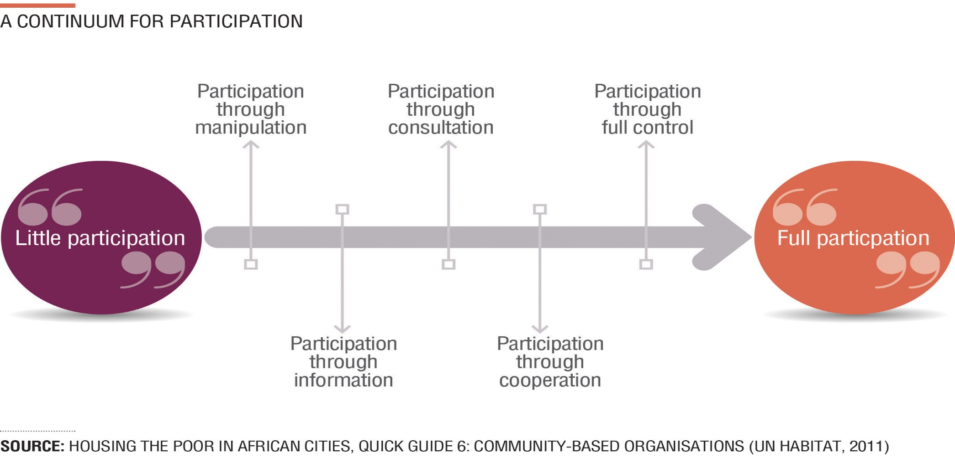
The Participation Continuum
In under taking a participatory process, genuine and meaningful engagement must be distinguished from superficial participatory forms.
There is a critical difference between going through an empty ritual to a process where the participants have real power that can affect the outcome of the process.

Slide 19
Activity 4.3: Participatory Continuum Examples
Type of activity: Small groups (triads)
Timing: 10 minutes
Purpose: To consolidate understanding of the participatory continuum.
Instructions: Read the examples in the Participation Manual and place them on the participatory model/continuum provided.

Slide 20
Activity 4.5: Reflecting on your Practice
Type of activity: Group
Timing: 10 minutes
Purpose: To reflect on the participatory processes you use in your municipality.
Instructions:
  In your group, discuss the participatory processes that have been, or are being, used in your informal settlement upgrading programme or project.
  Describe the participatory tools or activities that have been used and decide where on the participation continuum you fall.
  Complete the table in the Participation Manual

Slide 21
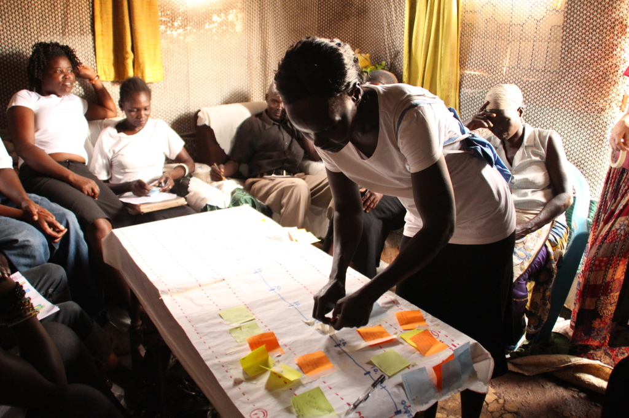
3. When? Participation in the different stages of the upgrading process
Participation is not a once-off event or even a series of events, but that it is an ongoing activity to be included in all phases of an upgrading process.
Participation becomes especially important at particular points of the upgrade

Slide 22
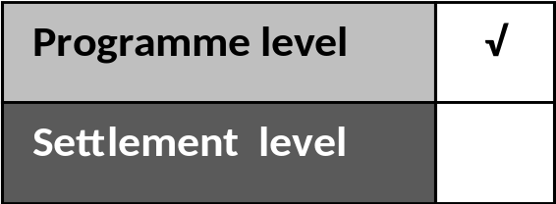
Participation at the programme level
At the programme level informal settlement upgrading is planned across many different settlements within the same municipality and requires a municipal-wide strategy.
The process of developing a municipal informal settlement strategy and programme requires information in order to assess and categorise informal settlements.
The process of gathering the information, as well as the process of categorising the settlements, are both opportunities for involving community representatives in programme level activities.

Slide 23
Activity 4.5: Video: Thandi and the IDP
Timing: 15 minutes
Purpose: This video describes how community engagement is built into the IDP process at a programmatic or municipal level.
Instruction: As you watch think about the impact this process can have on the relationship between the community and the municipality.

Slide 24
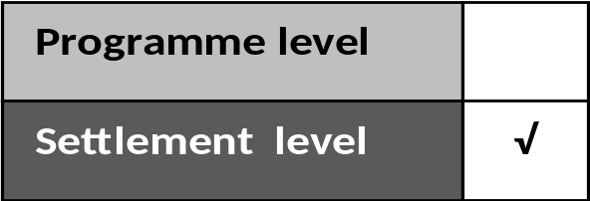
Participation at the project level
At the project level informal settlement participation is needed throughout an upgrading project.
The intensity of participation can vary across the life of a project, and so can the depth of participation and extent of community control

Slide 25
Participation in the UISP phases
Phase | Participation
Phase 1: Application | The community must have a role, and take the initiative if needed. The process should start from a bottom-up approach and not with an imposed decision from outside.
Phase 2: Initiation: | Both full control and cooperation, and at a minimum consultation can be used
Phase 3: Implementation | A range of participation levels can be used from full control to informing of progress only
Phase 4: Consolidation | The participation level used will depend on the basis by which consolidation is undertaken. If the People’s Housing Process is undertaken the level will be full control. If a subsidised house is being provided then informing would be applied
Maintenance stage | Both the municipality and community should be involved according to their abilities. For example day-to-day maintenance of school buildings could be managed by community members, while major repairs should be managed by municipalities as they require significant financial resources and technical skills.

Slide 26
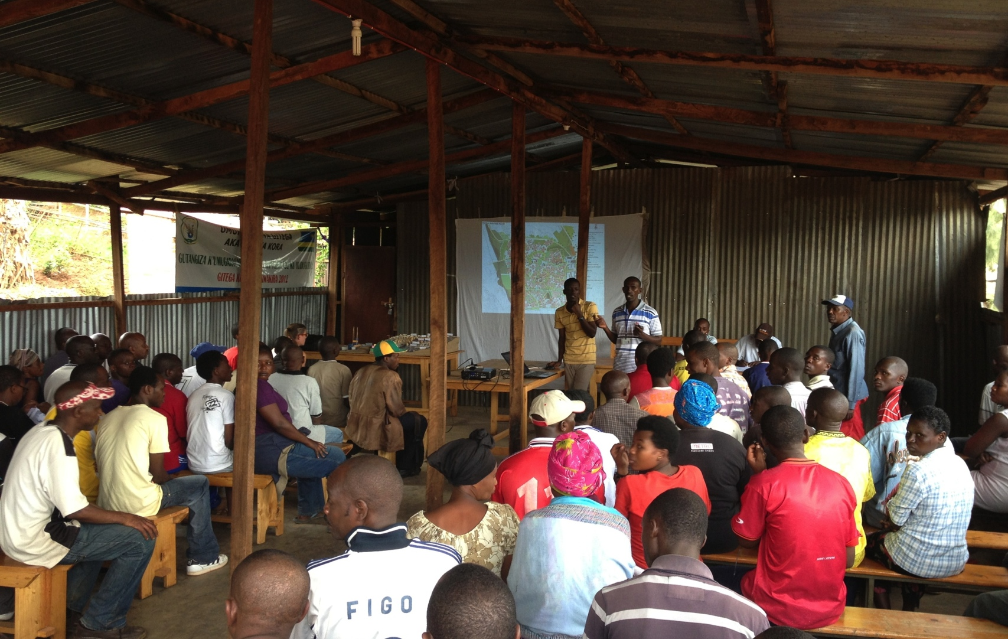
4. Who? The stakeholders in informal settlements upgrading
The selection of the participants/stakeholders is heavily influenced by the scope and the scale the project is meant to affect.
Identifying key stakeholders and gaining entry is a complex process and needs to be informed by an understanding of local leadership, social groups and power dynamics.

Slide 27

Who? The stakeholders in informal settlement upgrading cont.
Various factors must be carefully considered in the initial identification of participants considering both informal networks and marginalised groups.
This step is called stakeholders’ analysis and selection, and is a vital tool for understanding the social and institutional context of a project or area.

Slide 28
Activity 4.6: Stakeholder Analysis
Activity Type: Facilitated Group Discussion
Timing: 15 minutes
Purpose: To explore issues around stakeholder analysis.
Instruction: The facilitator will lead a discussion on the following questions.
  Which stakeholders are easy to find?
  What are informal networks? What informal networks are you aware of?
  What are some examples of marginalised groups?
  What does the term gatekeeper mean?
  What can go wrong in identifying stakeholders?
  What can you do to identify the stakeholders and gain entry into an informal settlement?

Slide 29
Stakeholder analysis
Stakeholder analysis includes a consideration of:
Who will be affected by the project (positively or negatively)?
Who could influence the project (positively or negatively)?
Which individuals, groups, or agencies need to be involved in the project?
How will they be involved?
Whose capacity needs to be built upon to enable them to participate?
.

Slide 30
Guidelines for selecting stakeholders
Guidelines
Cannot be excluded
Not decision-makers but should be present
Must be involved in decision-making
Would like to be involved

Slide 31
Activity 4.7: Stakeholder Selection
Type of activity: Small Groups (Triads)
Timing: 20 min
Purpose: To apply your knowledge of selecting stakeholders and define their appropriate level of engagement.
Instructions: Read the case study in the Participants Manual and complete the stakeholder analysis form.
  Who are the possible stakeholders to be involved in order to have well-balanced representation in the project?
  What are the characteristics and interests of each stakeholder?
  What positive or negative impact could they have on the project?
  What action could you take to strengthen the positive impact or reduce the negative impact?

Slide 32
In what way can participation be structured?
Depending on the size, nature and complexity of the scope of an informal settlement upgrading, a range of organisational structures may be appropriate
The participatory planning team will need to work with these structures to enable participation.
This, together with the stakeholders’ selection, constitute the basic organisational framework for meaningful participation.
Community Committee
Project Committee
Sub- Committee and Task Team
Community Development Worker
Co-ordination Committee
Steering Committee
Ward Committee

Slide 33
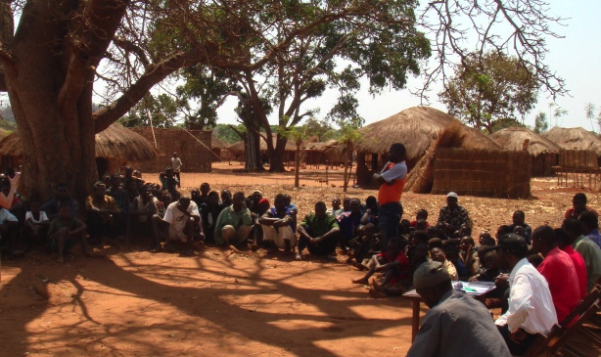
5. Participatory methods and techniques
There are various tools that can be used to involve people in the different parts of an upgrading process, but it’s not possible to elaborate a universal recipe for participatory processes.
No one approach is applicable to all situations.

Slide 34
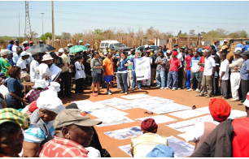
Overview of participatory methods
There are methods for analysis and planning and methods for doing and reviewing.
The differences between participatory methods lie in their purpose, the level of participation they aim to work at and their guiding principles.
Some methods are large scale and multi-sectoral, others are more focused in scope.

Slide 35
Communication skills for a participatory approach
There are many tools and techniques for encouraging community participation in an informal settlement upgrading process – but the most important tool is YOU!
No methods, tools or techniques will work if the person using them has poor communication skills or a bad attitude.

Slide 36
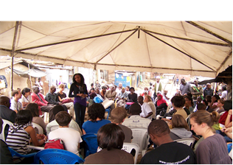
Communicating means making sure that your information gets across to another person in such a way that they can understand it in the way you meant it.
It involves sending messages and receiving messages, listening to the other people understanding them.
Communication is a two-way process.
People need to feel heard!

Slide 37
Activity 4.8: Mutual Understanding
Type of activity: Big group experience
Timing: 10 minutes
Purpose: To illustrate the challenges of achieving mutual understanding.
Instruction:
  In this activity a volunteer from the group will give you directions for drawing a diagram.
  Use the blank space below to draw the diagram as you follow the directions you are given.

Slide 38
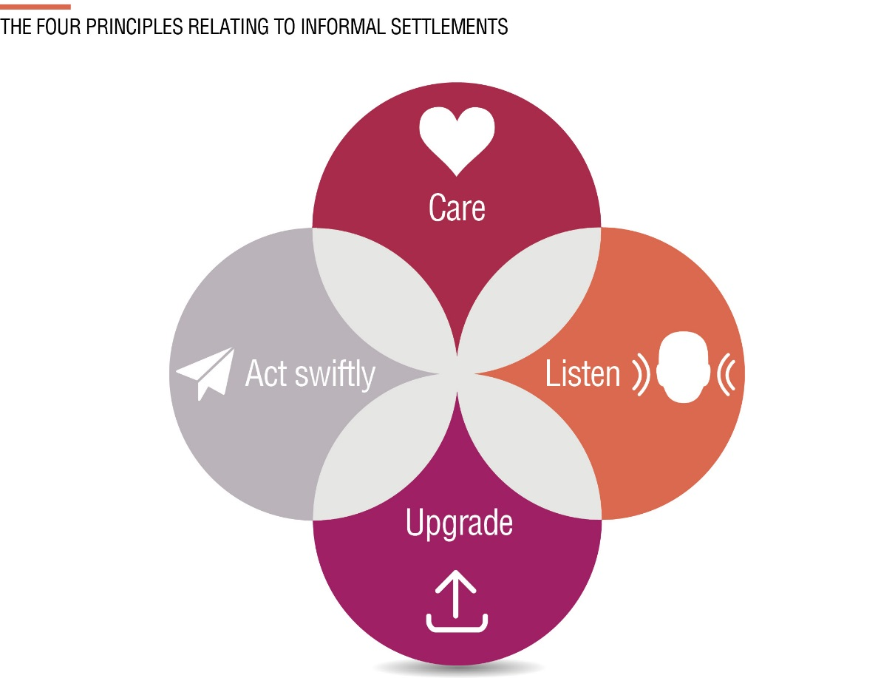
Active listening
One of the key principles arising out of the Constitutional Court cases on the right to housing is that municipalities must listen to their citizens.
Municipalities cannot listen – the people who represent the municipality must listen.

Slide 39
Activity 4.9: Active Listening
Type of Activity: Pairs
Timing: 15 min
Purpose: To remind you of the impact of active listening for constructive conversations.
Instruction: You will work in pairs. In each pair one person is Person A and the other is Person B. The activity has four stages.
  Think of something that happened to you recently, that was either very positive or very challenging
  Person A will tell their story to Person B.
  Person B will tell their story to Person A.
  After the activity we will discuss the following questions:
    How did you feel while you were telling your story?
    What made you feel that way?
    What effect did this have on your story?

Slide 40
Activity 4.10: Know Your Listening Behaviour
Activity Type: Individual
Timing: 10 minutes
Purpose: To examine your own listening behaviour.
Instruction: If you plead guilty to any of the symptoms of poor listening in the list set out in the Participants Manual, tick it.
NOTE: These questions were put to approximately 50 managers who were recognised as excellent communicators, and yet most of them admitted to at least four of the symptoms.

Slide 41

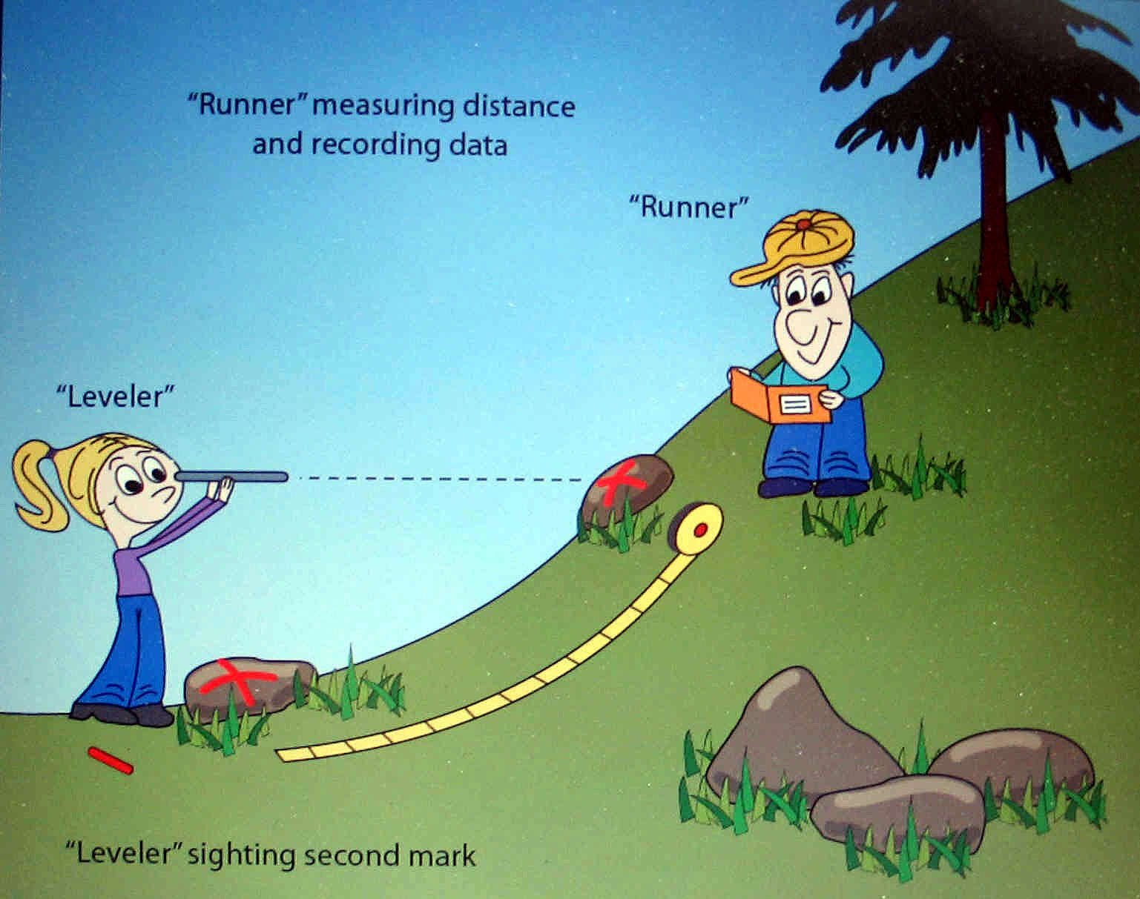
Tools and techniques for a participatory approach
Tools for collecting information and building relationships
Listening
Looking, observing and measuring

Slide 42

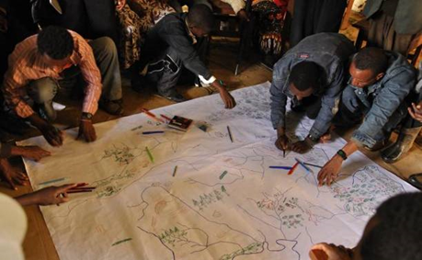

Tools and techniques for a participatory approach
Mapping and making models (drawing with everyone):

Slide 43
Activity 4.11: Mapping from Memory
Type of activity: Groups
Timing: 15 min
Purpose: To think spatially to identify the key elements of the settlement, and reflect on perception.
Instructions: You will work in the same group you worked to draw this map in Module 2.
  Review the map you drew in Module 2, showing the risks in the settlement. Are there any changes or additions you want to make?
  Add to the map the assets you know about in the settlement. Try to show the different types of assets: physical, natural, economic and social assets.
  What have you learnt from the process of drawing this map

Slide 44
Four techniques that encourage sharing of ideas and knowledge
Brainstorming (all ideas count
Games and role-play
Group work and intermixing (expanding perspectives by learning from others)
Prioritizing (what needs to be done first
→ When using all the tools and techniques described above, you need to listen and care, so that effective communication happens and there is mutual understanding.

Slide 45
Community surveys
This is a broad term to describe gathering data about the community, with the community. Different types of data can be gathered as follows:
Demographic profile.
Analysis of risk factors
Asset inventory

Slide 46
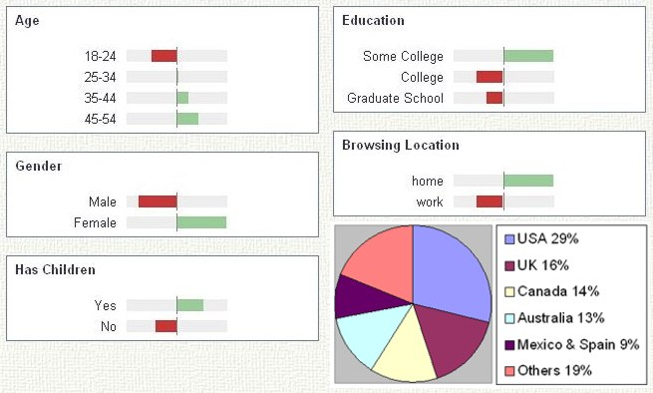
Community surveys - demographic profile

Slide 47
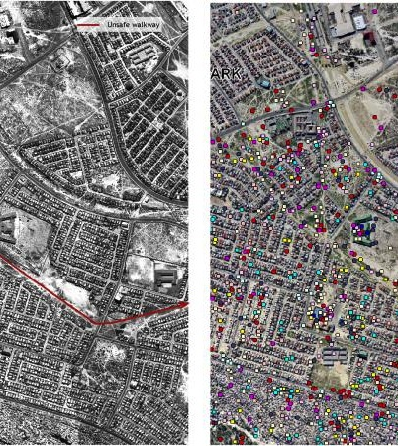
Community surveys – analysis of risk factors
Analysis of risk factors: crime mapping

Slide 48
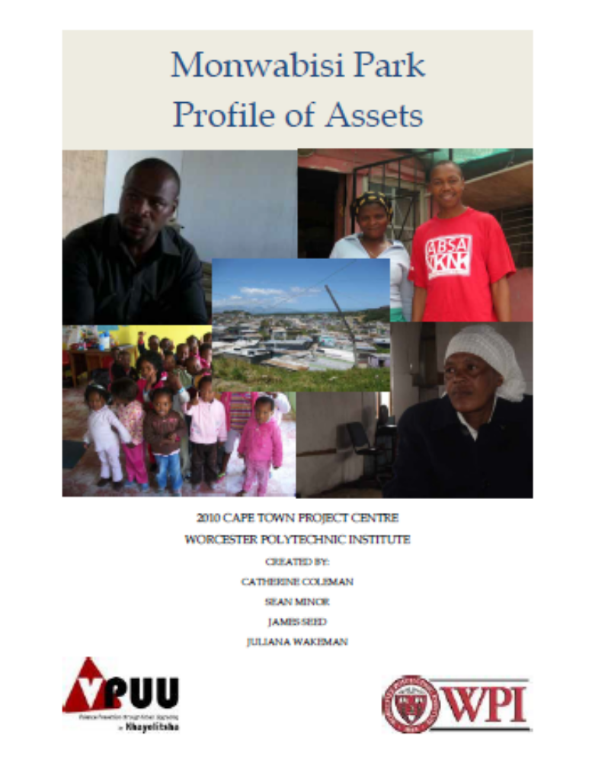
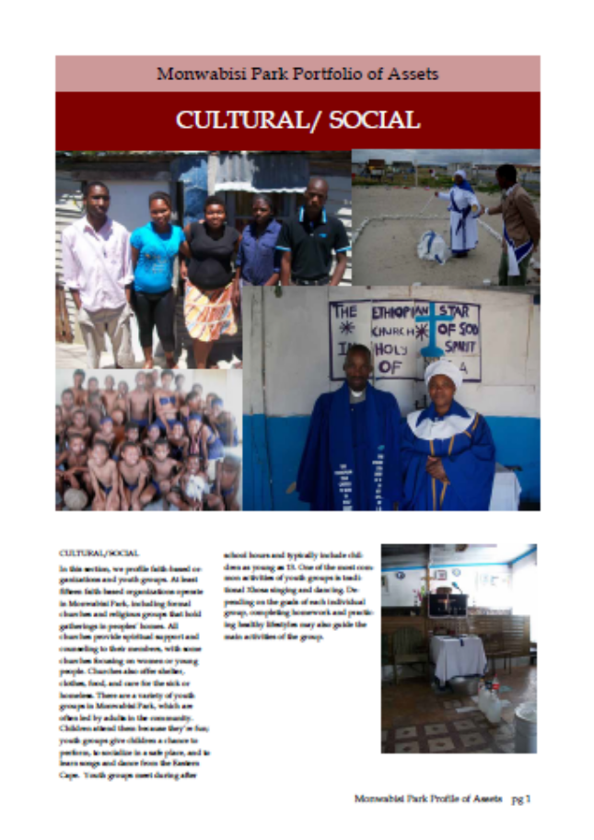
Community surveys - asset inventory

Slide 49
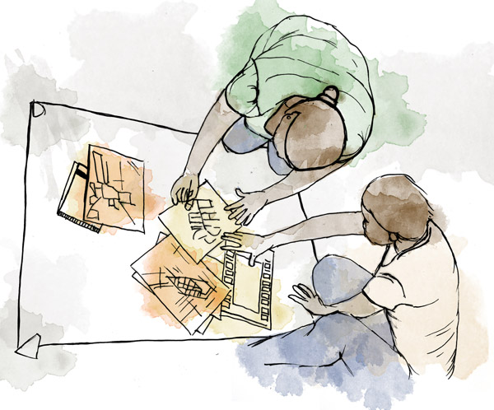
Action Planning
The participatory process of identifying key issues and agreeing on priority projects in a community
Many techniques to
  encourage people to participate
  identify and record what people express
  collectively prioritise and identify action steps.

Slide 50
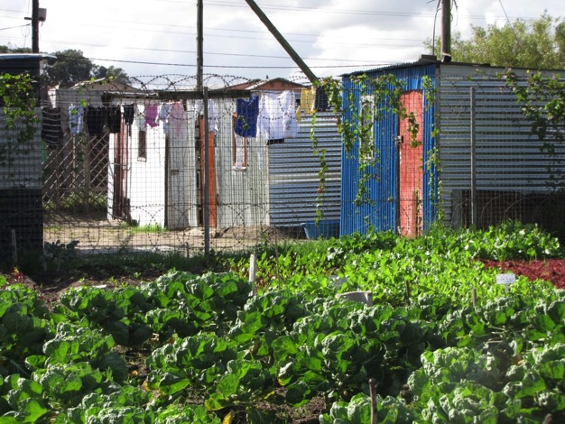
Action Planning
Eg: Participatory Community Action Plan (Sustainable Livelihood Focus)
Informal Settlements at Kenville (Mysore and Temple) and Redcliffe in Thekwini
Developed plans for:
Tavern and spaza shop owners
Early child development and crèches
Health sector plan
Home based care plan
Community gardens
Fashion design and dressmaking groups

Slide 51
Tools and techniques for a participatory approach
Participatory Action Planning (PAP): DAG case study
The DAG approach involves three workshops at the local settlement level.
These workshops engage local participants in identifying their key development priorities over the short, medium and longer term.
Key outcomes is that local partnerships between the local committee and the municipality are strengthened
Over the longer term, the municipality has the ability to plan and implement informal settlement upgrading interventions in a more programmatic manner.

Slide 52
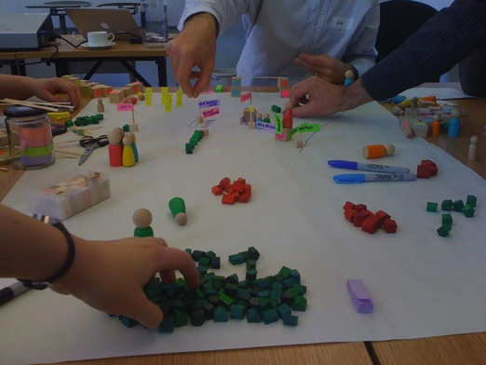
Assessing problems and planning for improvements
Community surveys such as demographic profiling, risk analysis and asset identification are ways of gathering specific useful informal on needs and opportunities in a community.
Community action planning offers a method for identifying key issues, ways of improving the situation and agreeing on priority steps to start.

Slide 53
Risk and vulnerability index
Moving beyond an assessment of one individual settlement, there are examples of surveys and evaluations which consider the relative or comparative levels of risk between a number of informal settlements.
This is useful for a municipality when trying to decide the most urgent situations of need, and how to prioritise responses.

Slide 54
Activity 4.12: Participation in the UISP Phases
Type of activity: Small group work
Timing: 15 min
Purpose: To identify ways to engage the community in the phases of the UISP project.
Instructions:
  Refer to the kinds of activities that take place in each of the UISP phases (refer to Module 3 for the details.)
  Identify what kind of participatory activities you can build into each phase to deepen community engagement.
  Complete the table in the Participants Manual.

Slide 55
Activity 4.13: The Challenges of Participation
6. Participation is challenging
Type of activity: Pair work
Timing: 10 minutes
Purpose: To share knowledge and experience on how to respond to some of the challenges of participation you identified at the start of this module.
Instruction: Your facilitator will give each pair one of the challenges identified this morning. With your partner, discuss what the cause of the challenge is and what might be a way to avoid or respond to the challenge.

Slide 56
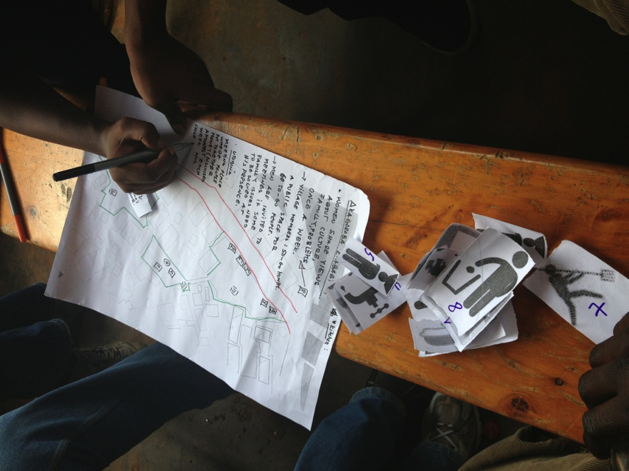
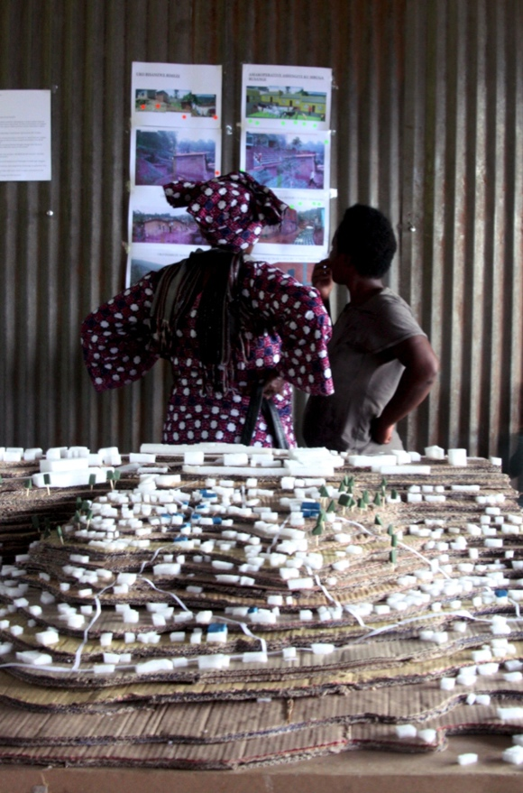
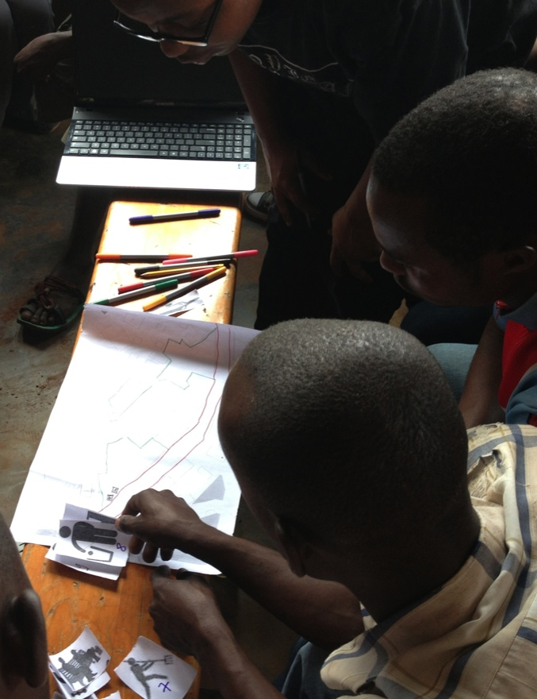
Developing a meaningful participatory process is mainly a matter of creating an enabling environment, with appropriate channels of communication and, essentially, the allocation of time and resources needed to promote it.
Participatory methods can bring together information from a diversity of sources and activate synergies, maximizing resources in upgrading projects.
This starts with considering the community the most important of those resources.
Summing up

Slide 57
What Did You Gain?
What were the most valuable things you learnt in this module? How will you apply them in your work?

