Slide 1
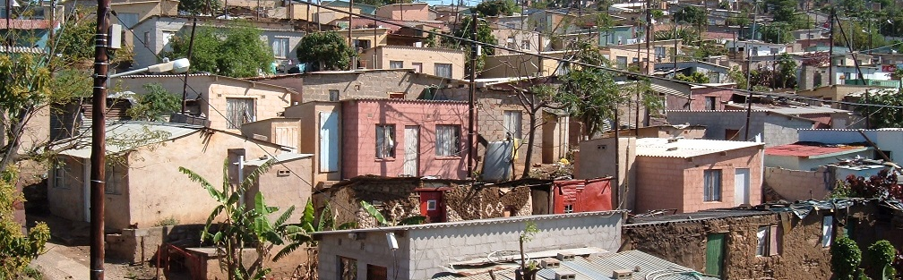


INTRODUCTION TO
INFORMAL SETTLEMENT
UPGRADING
MODULE 7: SECURING TENURE

Slide 2
Module purpose
The purpose of this module is to enable you to understand the nature of tenure security in broader terms than registered individual title, how tenure security applies to incremental informal settlement upgrading and the options for intervention, so that solutions can be developed to provide tenure security.

Slide 3
Learning outcomes
After completing this module you should be able to:
Define tenure security and explain its importance in informal settlement upgrading;
Discuss some of the existing, local tenure arrangements in informal settlements;
Discuss how policy and legislation can support an incremental approach to tenure;
Identify different tenure security options for incremental informal settlement upgrading.

Slide 4
Module content
Understanding tenure security
Providing tenure security incrementally
The legislative and policy context for tenure security
Addressing tenure security in the upgrading process
Making it practical

Slide 5
Activity 7.1: Know what you know
Type of activity: Triads (three people)
Timing: 10 minutes
Purpose: To share personal experience and reflect on tenure security.
Instruction: In your groups discuss tenure using the questions in the Participant Manual. Note: there are no right or wrong answers. After the group discussions, the facilitator will highlight key points.

Slide 6
1. Understanding tenure security
Defining tenure
There are various kinds of tenure such as individual ownership or rental.
The UN Special Rapporteur offered this definition in 2012:
  Tenure is the set of relationships with respect to housing and land, established through statutory law or customary, informal or hybrid arrangements.
What’s important about this definition is that it emphasises relationships:
This definition also shows that tenure is established in different ways, of which statutory law is one. Others are customary and informal arrangements. A fourth way is through hybrid arrangements.
  → Tenure is not simply about the law, or about legal forms of holding land or housing. It is about the relationships that people have to land or property.

Slide 7
Tenure form and function
TENURE FORM refers to individual ownership, group ownership, rental or other variations
Title and tenure are not the same thing
Thinking of tenure and title as the same thing is problematic because it:
  ignores a whole range of existing tenure arrangements,
  shuts down possibilities for improving tenure incrementally, and
  focuses policy and practical attention on getting everyone into registered title which would take decades to achieve.

Slide 8
Tenure form and function
Tenure form does not bring tenure security in itself;
Tenure security comes from the ability to enforce a socially and politically meaningful and socially legitimate tenure system, regardless of what type or form of tenure it is.
Tenure is about much more than form, but much more important to consider what FUNCTIONS tenure performs.

Slide 9
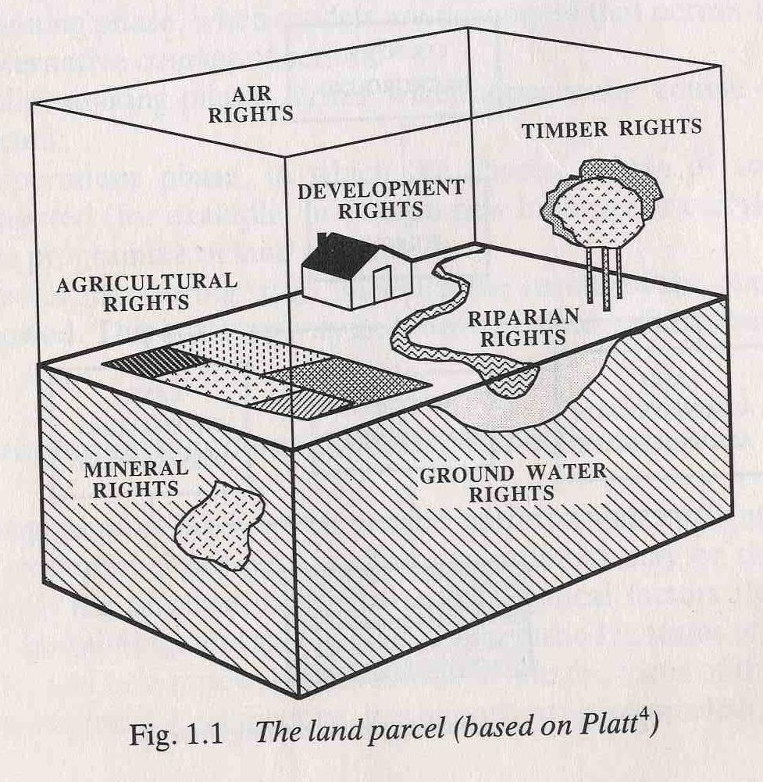
Tenure Rights
Some writers developed the idea of a “bundle of rights” and of rights as “sticks” in the bundle.

Slide 10
Activity 7.2: Tenure: A bundle of rights
Type of activity: Individual
Timing: 10 minutes
Purpose: To build understanding of the concept of tenure rights.
Instruction: Complete the following self-assessment. In the Participants Manual, tick the tenure rights that you enjoy where you currently live.

Slide 11
Tenure norms and practices
Norms and practice can differ
Practices refers to the established way of doing things or what actually happens on the ground
Norms can be understood as the ideals of laws, whether these laws are legislated or locally developed rules
A gap between a norm or local rule and practice might exist because the norm is not responsive or adequate or appropriate in some way
The gap could be closed by reviewing the local rule or norm so that it matches practice more closely

Slide 12
Tenure authority and legitimacy
Authority refers to the power to enforce laws and rules concerning rights, responsibilities, and benefits
Concept of legitimacy refers to authority that is socially and locally acceptable and this is what really makes tenure secure for people
In this module we refer to this as local recognition.

Slide 13
Defining tenure security
Passive tenure security:means being free of the risk of being evicted from the land.
  In South Africa we have laws and a constitution which offer protection against eviction
  Threat of evictions can come from the government, community and the family or “market evictions”
  There are procedural requirements in law and if these are not followed then an eviction would be illegal
  Recent Constitutional Court judgements also show that municipalities must engage meaningfully with people under threat of eviction and that attention must be given to the provision of alternative accommodation
Active tenure security:means being able to perform transactions on a parcel of land for example to buy, sell or lease it.

Slide 14
Activity 7.3: Tenure security
Type of activity: Triads (three people)
Timing: 10 minutes
Purpose: To understand why tenure security is important.
Instruction: In your groups discuss tenure security, using the questions set out in the Participants Manual. After the group discussions, the facilitator will highlight key points.

Slide 15
What is the importance of tenure security
Wealth accumulation is where owning a property enables you to increase how much money you have
Livelihood security is where owning a property enables you to make a living or to benefit from social capital, such as providing accommodation to family members who rely on and support each other
Households need security in order to make their own investments in housing, called consolidation
Without tenure security it is difficult, if not impossible, for people in informal settlements to get access to basic services, small scale finance and public investment in infrastructure such as water services

Slide 16
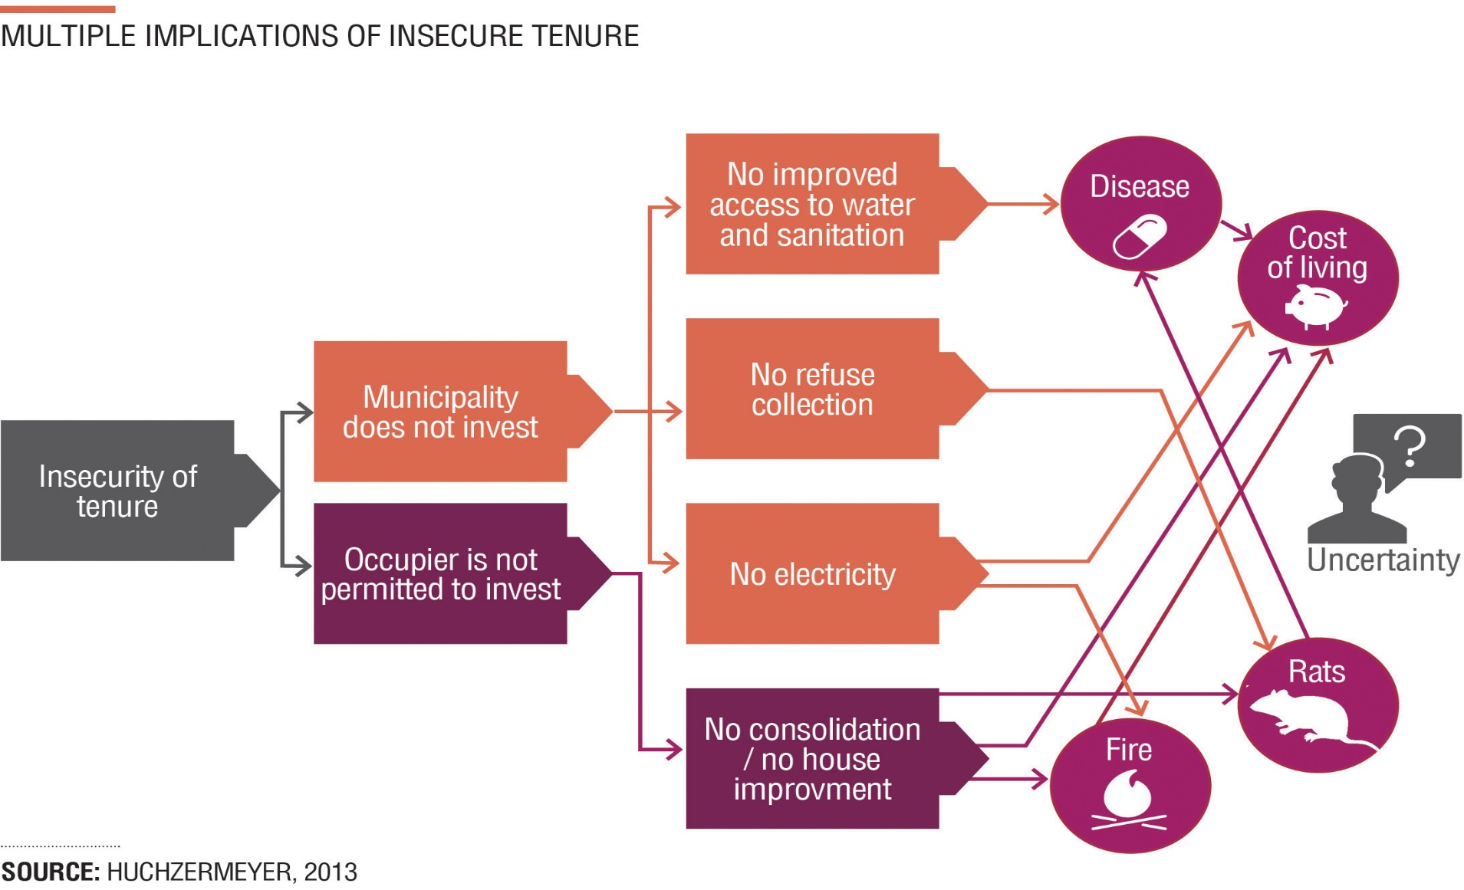
Multiple Implications of Insecure Tenure

Slide 17
Tenure diversity and incremental tenure
Tenure diversity refers to a range of tenure options, rather than only ownership.
It is possible to improve tenure security in informal settlements in an incremental way, with the foundation of the constitutional rights that protect people against arbitrary eviction.
There is a perception amongst some in SA that ‘freehold title’ is best but others argue for tenure diversity.
→ From a tenure perspective the first step to take is to recognise the importance of tenure diversity. An incremental approach to tenure is thinking of a continuum along which progression towards tenure security is made step by step.
  .

Slide 18
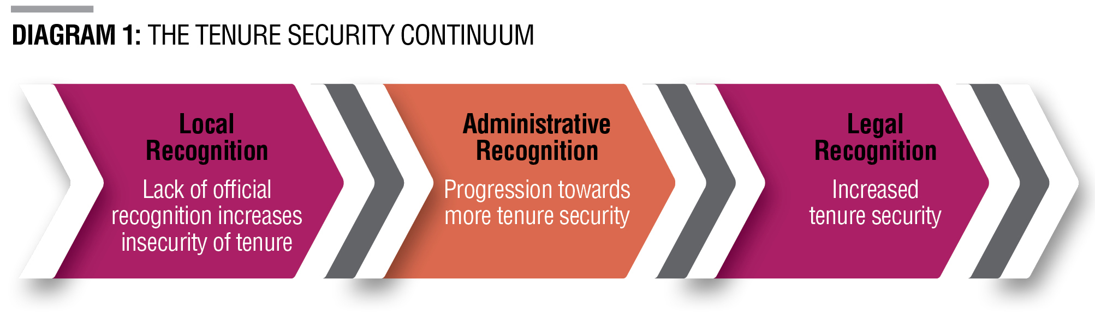
2.0 Providing tenure security incrementally
The Tenure Continuum
Local recognition refers to the settlement level practices that have developed into norms over time. Norms are local rules or laws that have the force of social legitimacy.
Administrative recognition uses instruments that may arise from policies or administrative practices to improve tenure security. Security derives from a commitment by authorities in the form of council resolutions or administrative systems.
Legal recognition uses a legal procedure, in terms of a law, often a planning law, to grant legal status to an area. It usually results in declaring the area in terms of this law (a settlement area, an area zoned for informal housing).

Slide 19
Activity 7.4: Recognising tenure
Type of activity: Pairs
Timing: 15 minutes
Purpose: To apply your understanding of the concepts of local, administrative and legal recognition of tenure.
Instructions: Categorise the tenure options in the table in the Participants Manual into the three categories listed (place a tick).

Slide 20
Working with local arrangements
A key principle in implementing tenure security is to work with what tenure arrangements already exist at a local level in an informal settlement
These could include:
  Sales, transfers and bequeathing of land
  Organised local processes for how people access, hold and transfer land
  Verbal and written evidence of occupation
  Systems of local leadership and authority
  Perceptions about tenure security

Slide 21
Activity 7.5: Local Registration Practices
Type of activity: Group work
Timing: 20 minutes
Purpose: To understand local registration practices and their importance in an upgrading project.
Instruction: You will be given a case study. Read it together and answer the questions in the Participants Manual.

Slide 22
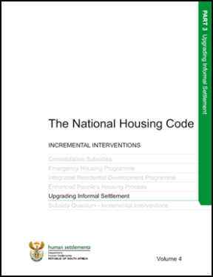



3. The legislative and policy context for tenure security
Government policies that address tenure security
Housing White Paper
Breaking New Ground
UISP and Housing Code
Outcome 8
National Development Plan

Slide 23
Key laws that address tenure in informal settlements
At a very broad level there are three main categories of laws that guide and support the provision of tenure within the upgrading process in informal settlements:
Laws that protect rights of occupation (The Constitution and PIE)
Laws that set the framework or principles for tenure within the housing environment (The Housing Act)
Laws that determine development procedures and land use management requirements that provide legally secure forms of tenure (SPLUMA)

Slide 24
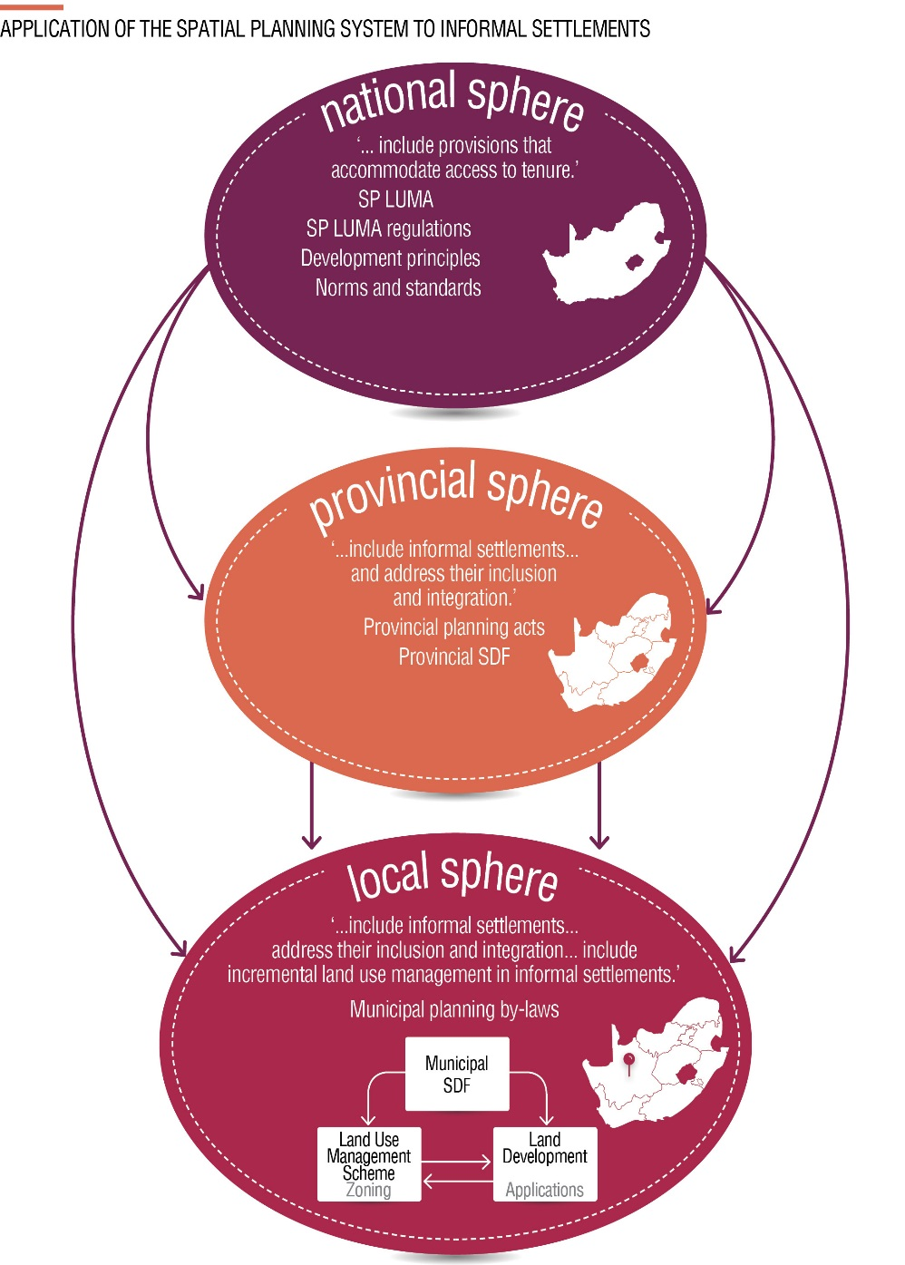
SPLUMA, provincial planning laws and municipal bylaws
SPLUMA is a national framework legislation that sets out a new spatial planning and land use management system regime for South Africa.
It gives guidance to provincial planning laws and to municipal planning by-laws so that they will be consistent and aligned to SPLUMA

Slide 25
The legislative and policy context - key points
Government recognises tenure rights because of the important role these rights plays in enhancing citizenship.
Tenure security must be addressed through participatory approaches to develop appropriate arrangements acceptable to both the municipality and residents.
However, little guidance is provided through these policies on what these various tenure arrangements could be or how one develops them during the upgrading process.
This module will, therefore, help you to identify different tenure options and suggest the processes to follow to arrive at tenure security in consultation with communities.

Slide 26
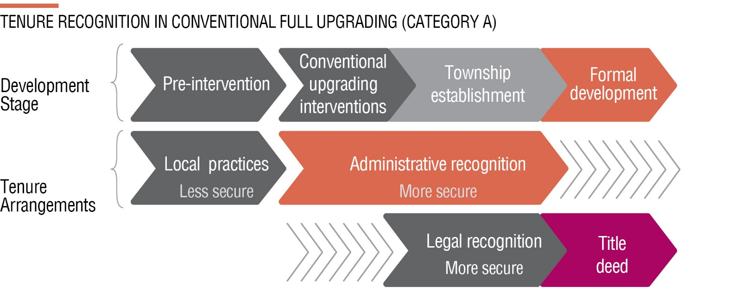
4 Addressing tenure security in the upgrading process
Providing tenure security in different developmental pathways - Conventional full upgrading
→ This is the conventional approach to tenure, where formal township establishment leads to registered title. There might be opportunities in the development process, depending on how long it takes, to introduce some administrative security mechanisms along the way.

Slide 27
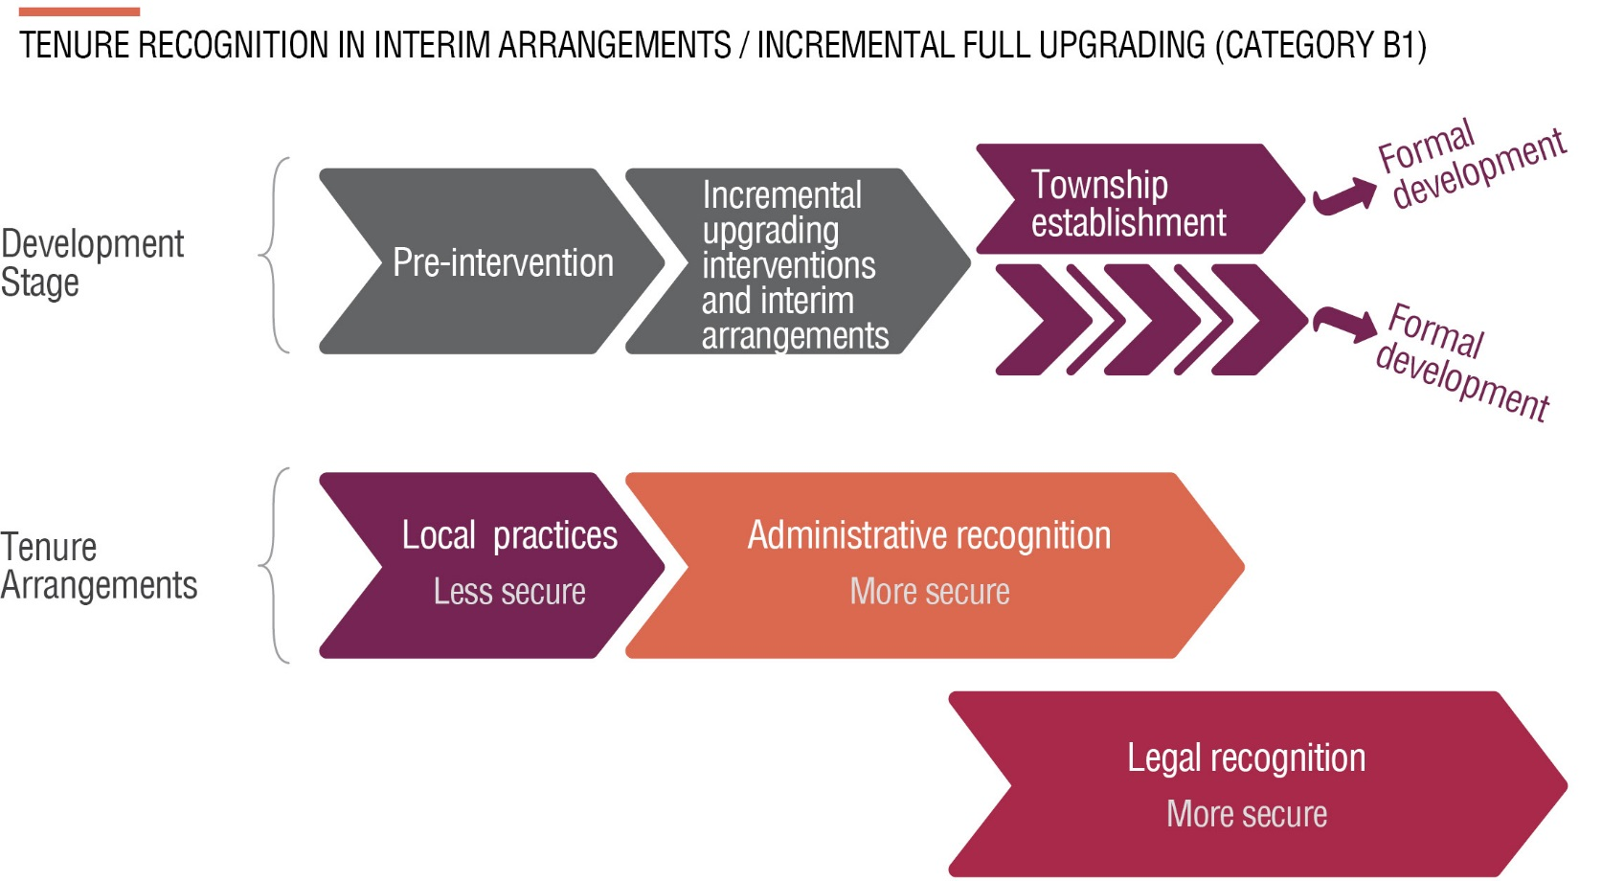
Providing tenure security in different developmental pathways – Interim arrangements (B1) and Incremental full upgrading (B1 extended)
→ In this option tenure builds on the local recognition that already exists. Tenure in this category can be incrementally secured using a range of options including administrative and legal recognition mechanisms

Slide 28
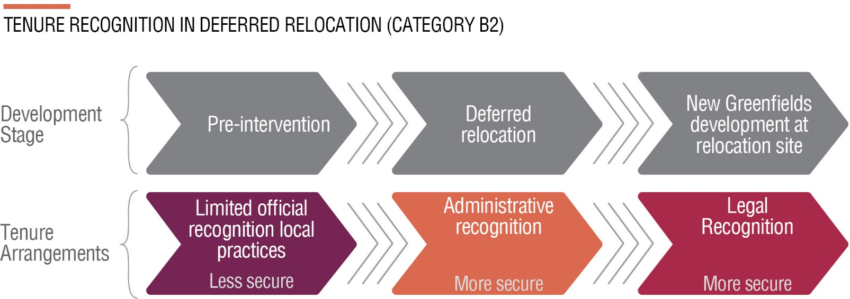
Providing tenure security in different developmental pathways – deferred relocation (B2)
→ Should recognise existing occupation at the site, provide for recognition of the right to be relocated in future and include engagement/consultation with existing residents and the municipality on that relocation. Tenure recognition is of an interim nature, as once residents move to the new location, tenure options will need to be reconsidered on either a full, incremental or interim basis.

Slide 29
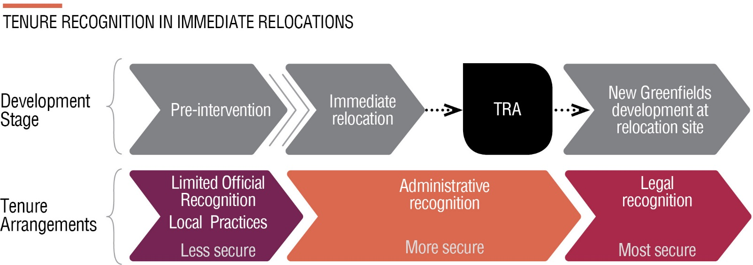
Providing tenure security in different developmental pathways – immediate relocation (C)
→ Residents and the municipality should engage on the relocation itself and tenure should be secured at the relocation destination on a full, incremental or interim basis

Slide 30
Activity 7.6: Addressing tenure security in the upgrading process
Type of activity: Pairs
Timing: 15 minutes
Purpose: To apply your understanding of how tenure security is provided in informal settlements during the upgrading process.
Instructions:
  1. Refer to the list of tenure security options in the Participants Manual.
  2. For each one decide in which informal settlement development pathway it could be used to provide tenure security (i.e. conventional formal full upgrading, incremental full upgrading with interim arrangements, deferred relocation, or immediate relocation).
  3. Write the development pathways for which it is appropriate in the space below the option. (Note: it may be appropriate for more than one development pathway, or it may not be appropriate for any.)
  4. Then note down at what stage in the development pathway you would use that option.

Slide 31
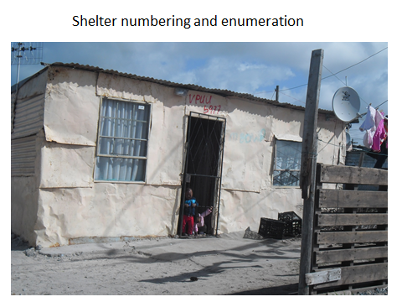
Providing tenure security in different developmental pathways

Slide 32
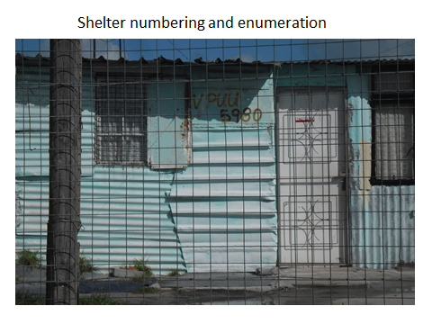
Providing tenure security in different developmental pathways cont.

Slide 33
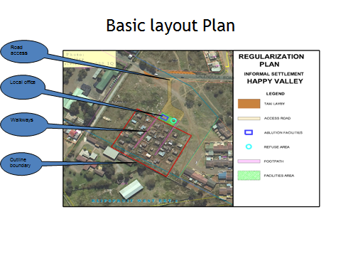
Providing tenure security in different developmental pathways cont.

Slide 34
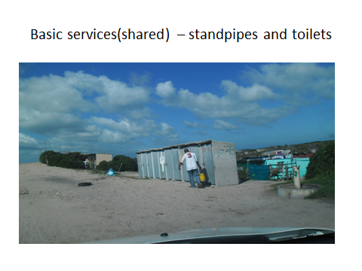
Providing tenure security in different developmental pathways cont.

Slide 35
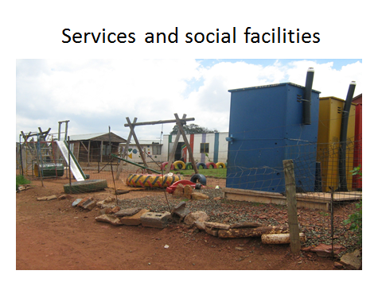
Providing tenure security in different developmental pathways cont.

Slide 36
5. Making it practical
Guidelines for Implementing incremental tenure recognition
Be pragmatic
Actively negotiate in participation processes for achieving a better fit with the body of local practices in informal settlements
There is no blue-print
Look at how you can do things differently

Slide 37
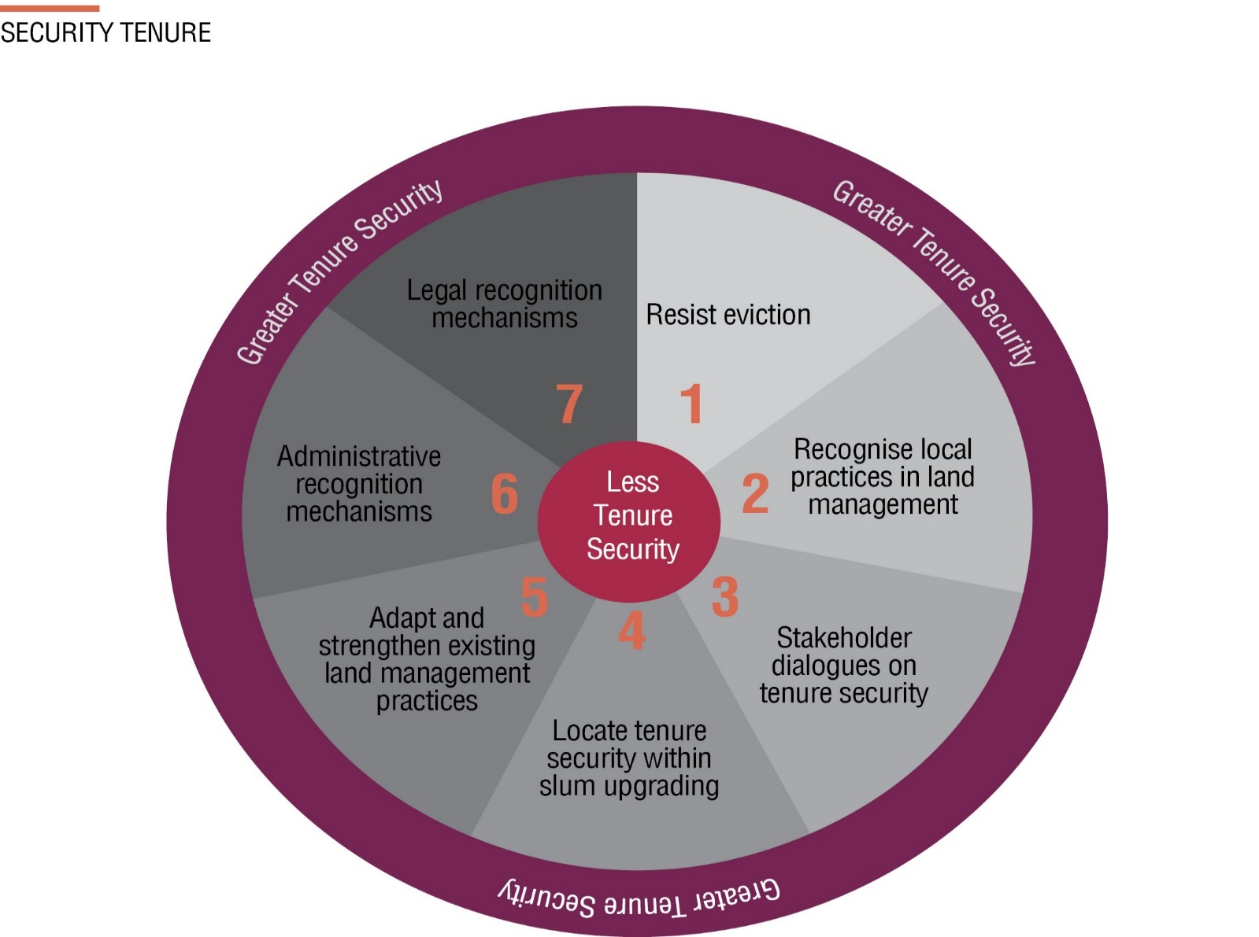
Different options for tenure security

Slide 38
Examples of different options for tenure security
Local community initiatives:
Springvalley: Resisting eviction and engaging on relocation
Folweni and Mandela informal settlements: Local practices in land management and local recognition
Springvalley: Adapting and strengthening existing land management practices, including tenure arrangements
Monwabisi Park: Administrative recognition

Slide 39
Examples of different options for tenure security cont.
Legal Recognition:
City of Cape Town : SR2 -Single Residential Zone 2: Incremental Housing
City of Johannesburg Amendment Scheme designation of Transitional Residential Settlement Areas (TRSAs).

Slide 40
How is securing tenure funded?
UISP: If security of tenure is being provided as part of an upgrading project, there is funding available for land acquisition, pre-planning, detailed town planning and land surveying.
IRDP: If security of tenure is being provided as part of a project, there is funding available for land acquisition, pre-planning, detailed town planning and land surveying.
Municipality: It is assumed that the municipality will need to cover the costs of the other initiatives if neither of the above scenarios apply.

Slide 41
Activity 7.7: Making it practical
Type of activity: Groups
Timing: 15 minutes
Purpose: As part of the work-integrated assignment following this training block, you will interview residents of the settlement where you are working to understand the existing tenure arrangements and tenure security in the settlement. The purpose of this activity is to give you time to prepare some questions you will use in the interviews.
Instructions: Write down at least five questions you will ask residents in the interview about their tenure arrangements and tenure security.

Slide 42
Summary
  Eight points on what you can do to secure tenure in incremental informal settlement upgrading.
  Understand existing local practices for securing tenure and
  managing land
  Build from existing local land management practices, especially the local evidence being used
  Adapt and strengthen the local practices, especially the figures of authority and the access they give more vulnerable groups that are likely to include women and children
  Recognise the agency of residents and local structures in
  managing land

Slide 43
Summary cont.
  Promote the roles of NGOs in supporting organisations of the poor to adapt and strengthen local practices in land management and to look for alternatives to evictions.
  Do things differently by finding and demonstrating context-specific means for administrative and legal innovation to secure tenure through different forms of official recognition
  Innovate by applying existing laws in new ways and using the opportunities that SPLUMA provides to serve tenure security objectives
  8. Advocate more widely for increasing routes to tenure security.

Slide 44
Activity 7.8 What did you gain?
Instruction: Write down three useful ideas you gained from this session

