Slide 1
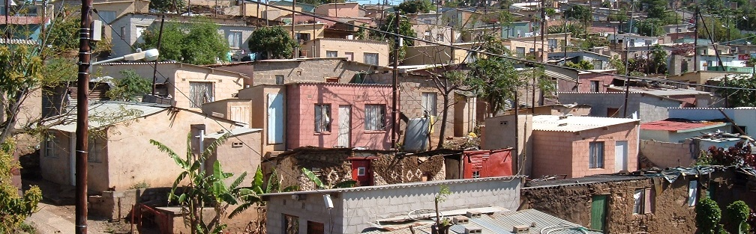


INTRODUCTION TO
INFORMAL SETTLEMENT
UPGRADING
MODULE 9: BUILDING HOUSES INCREMENTALLY

Slide 2
Module purpose
This module will provide you with an understanding of the incremental approach to housing consolidation (i.e. providing better houses for people to live in), and explain what municipalities can do to support people to upgrade their houses, so that this approach can be built into plans to develop sustainable human settlements.
The overall purpose is to enable you to encourage and support incremental housing processes in order to help households build better homes.

Slide 3
Learning Outcomes
After completing this module you should be able to:
Recognise incremental approaches to housing as viable options for housing transformation;
Recognise that there are different forms of incremental upgrading processes, with a focus on the potential of self-build processes;
Describe a range of ways in which municipalities can provide support for housing improvements;
Support people-centred approaches with regard to housing provision and improvement;
Identify the various support systems and service providers in housing provision and improvement.

Slide 4
Module content
Incremental housing
What factors affect a household’s ability to consolidate their house?
Supporting housing consolidation

Slide 5
1. Incremental housing
What is incremental housing?
Incremental housing is a step-by-step process of building and upgrading a house.
It is a process whereby households build and extend their houses on an ad hoc basis in response to their needs and the availability of resources.
  → The essential element of incremental housing is that it enables households to respond to their own priorities and needs, and to have a greater level of authority over their own housing solutions.

Slide 6
People are doing it for themselves
South Africa’s national programme for helping poor households to access housing is based on the premise that the government must build a house for each household.
However in South Africa, and all over the world, poor people are building their own houses.
As shown in the 2011 Census there were 1.25 million households in informal settlements and a further 700 000 in backyards.
While these structures are informal, they provide shelter and represent a significant personal investment.
  → Generally, when people start to improve their dwellings they manage the improvements themselves, and they do the upgrades incrementally.

Slide 7
Activity 9.1: People are doing it for themselves
Type of activity: Group work
Timing: 30 minutes
Purpose of the activity: To recognise people’s creativity and the ways in which people house themselves and incrementally improve their own housing.
Instructions: The facilitator will give you an album of photographs of houses that people have built for themselves in informal settlements.
  What does each picture say to you?
  Write a few comments on each picture in the Participants Manual

Slide 8
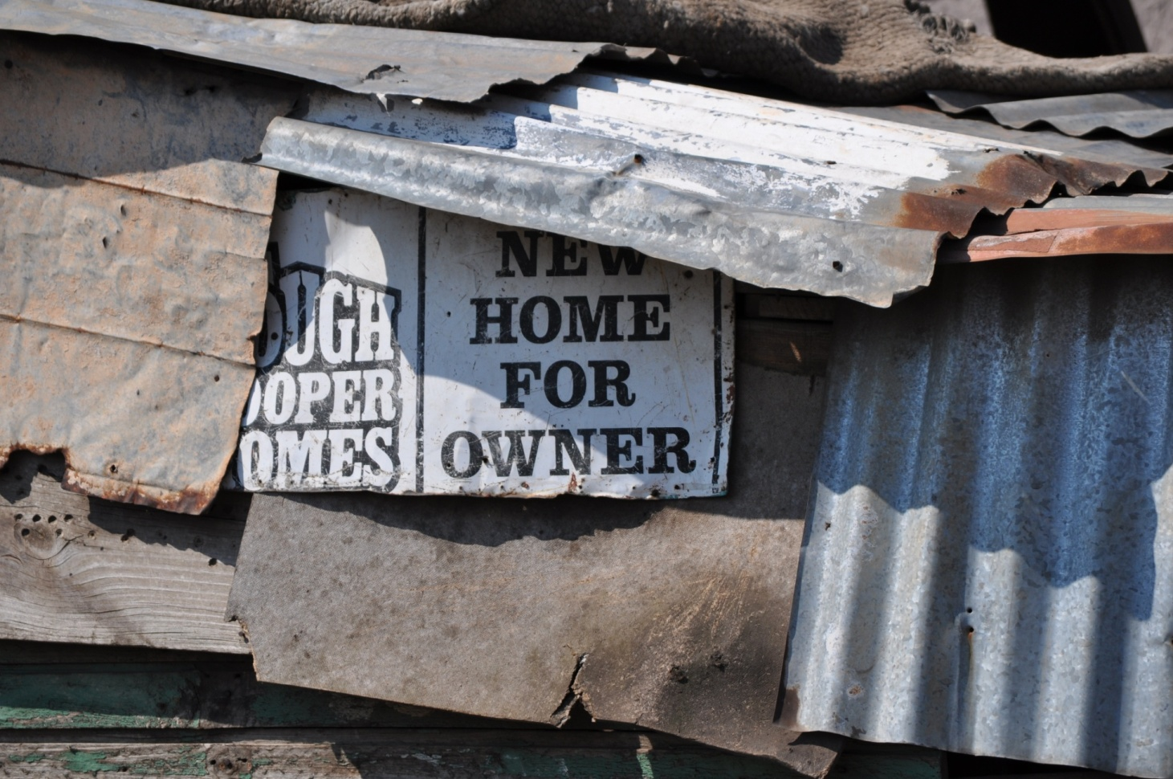
Advantages of incremental housing
“If we can figure out how to tap into the vitality and creativity of the people living in informality DESPITE the power differences, and how to LIBERATE the creativity from the bottom up we will be taking a big step towards the future we hope to see”.
UN Habitat: Janice Perlman. Urban Informality – Marginal or Mainstream?

Slide 9
Advantages of incremental housing cont.
It enables households to invest constantly in improving their living conditions, as and when they are able to afford it.
Households are improving their housing circumstances rather than waiting in poor conditions until a house is delivered by government.
It enables government to use its funds to improve services and social and community facilities
It is needs-oriented, being specific to the site and user.
The house can be designed for flexibility.
No mortgage or formal credit is usually involved or required.
Having a regular wage income is not a requirement to build a house incrementally.

Slide 10
Activity 9.2: The case for incremental housing
Type of activity: Pair work
Timing: 5 minutes
Purpose: To reinforce the case for incremental housing.
Instructions: List as many reasons as you can why incremental housing and self-build options for informal settlements must be encouraged.

Slide 11
Will incremental housing become more significant?
There is increasing recognition of the growing pressure on the funds available for human settlement.
As a result there is now increasing emphasis on informal settlement upgrading, and the need to develop mechanisms and approaches for the building or consolidation of houses within informal settlement upgrading projects.
Incremental housing approaches are further supported by the National Development Plan which indicates the following:
Large amounts of money have been spent on the housing sector, but major problems remain. The system of state-provided housing has benefited many poor households, but may have undermined the incentive for people to upgrade their own housing circumstances and may have increased a dependency on the state for the supply of private goods. A national discussion is required on the future funding of housing in South Africa, and on the respective roles of the state, the private sector and individual households in providing housing and creating integrated and sustainable human settlements. (NDP p 270)

Slide 12
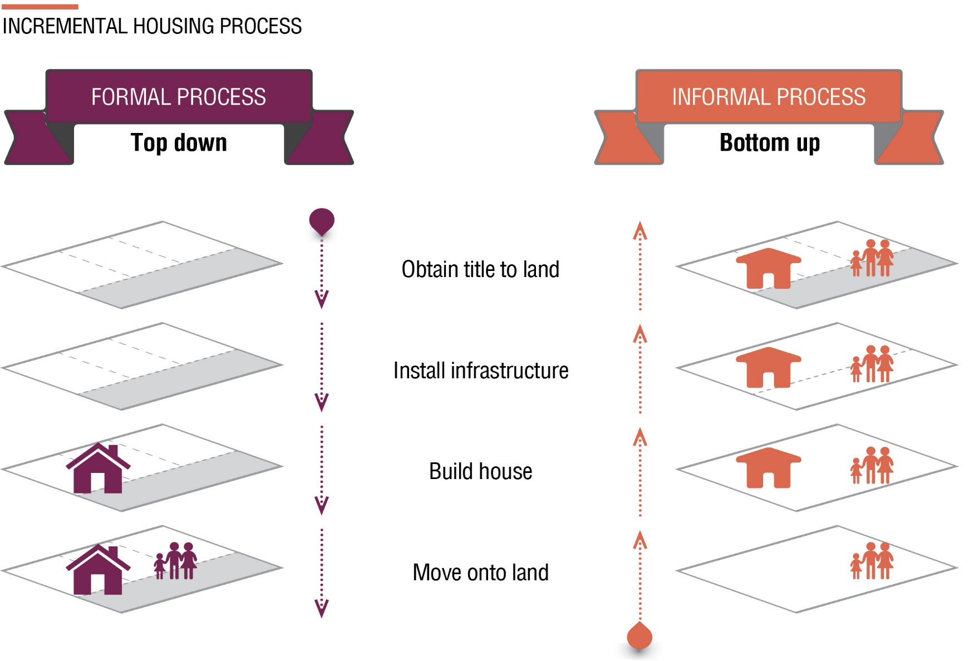
How do people build incrementally?

Slide 13
Ways in which households build incrementally
Self-build: The households build the house themselves, often with the help of family members in a process called sweat equity
Local contractors: The household accumulates materials and contracts a local builder, generally on a labour only basis, in stages, as resources allow.
Community build: This is a process where the community as a group access materials and build the houses. This is called the People’s Housing Process and enables access to a certain level of government subsidy.

Slide 14
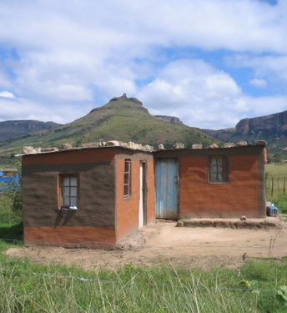
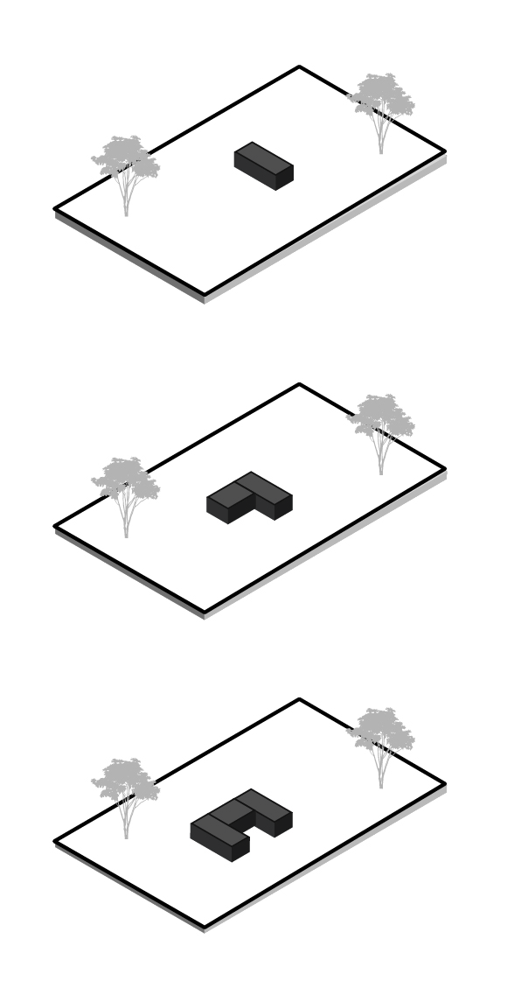
Examples of incremental building
Source: panaramio.com/rafapalli

Slide 15
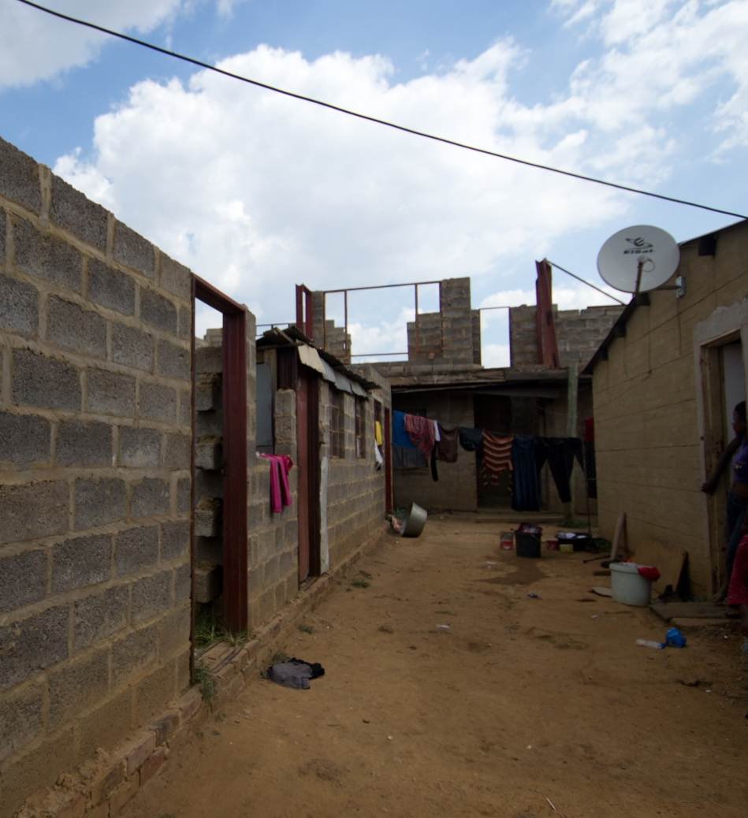
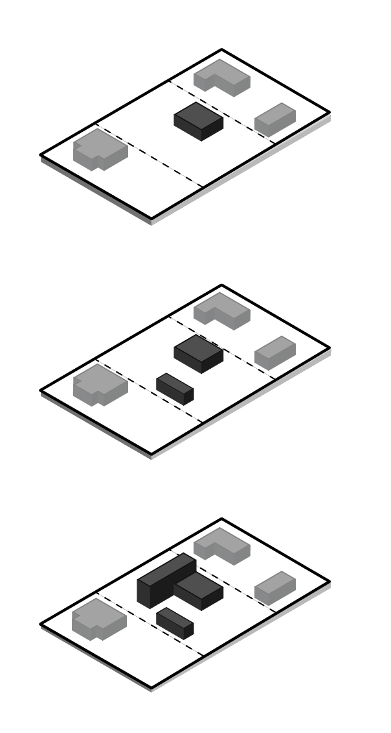
Examples of incremental building
Image: J Bennett

Slide 16
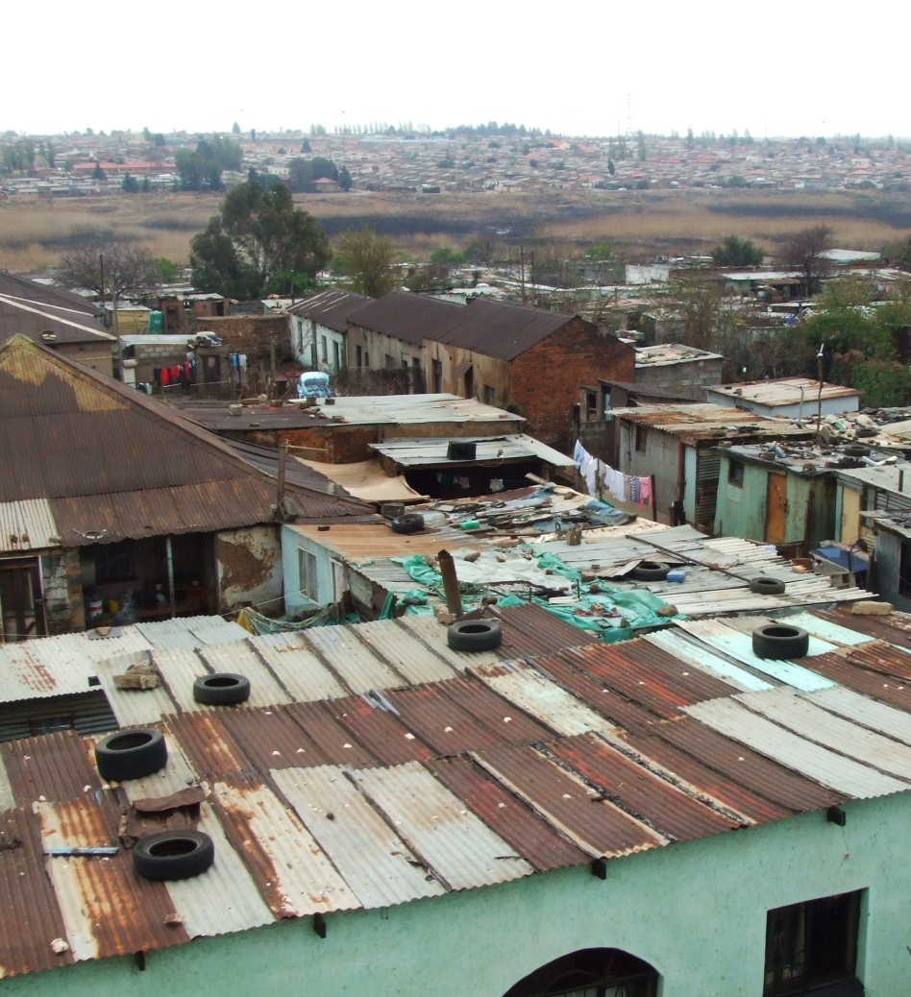
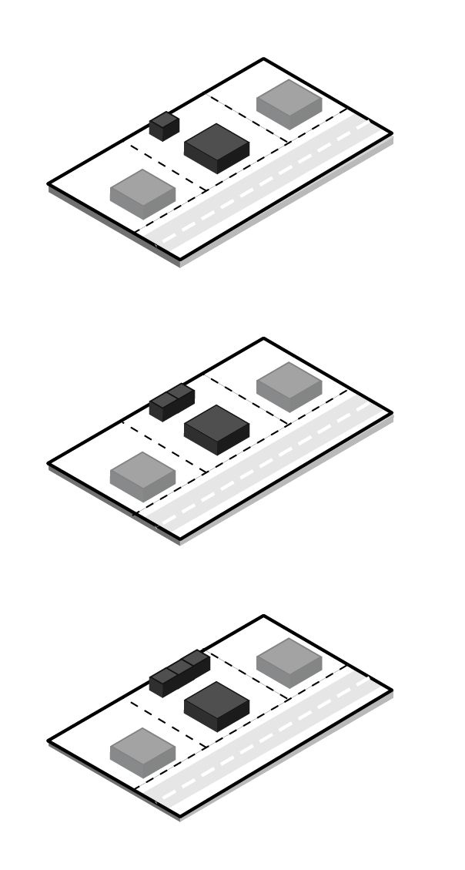
Examples of incremental building
Image: C Morgado

Slide 17
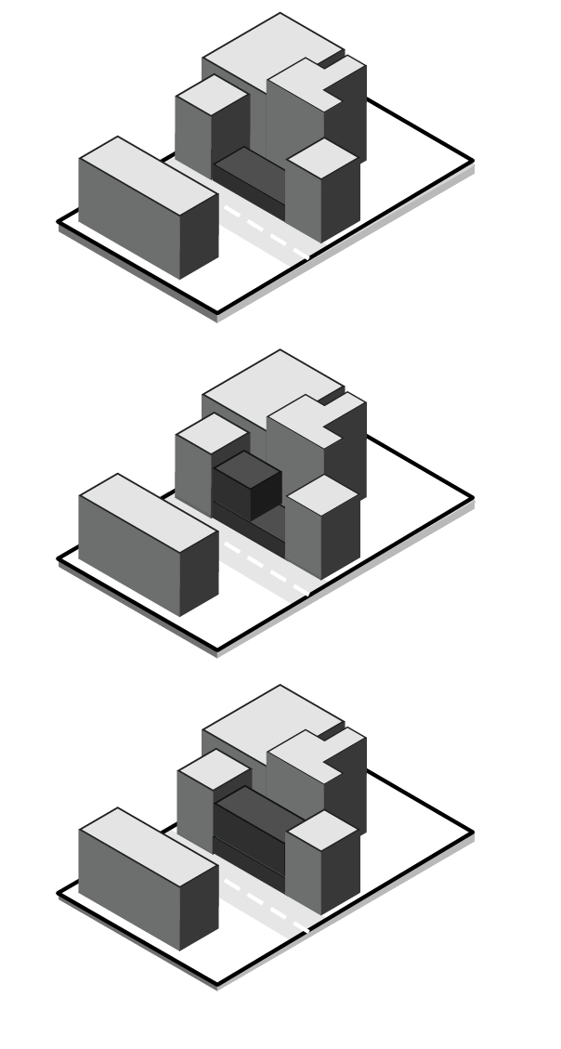
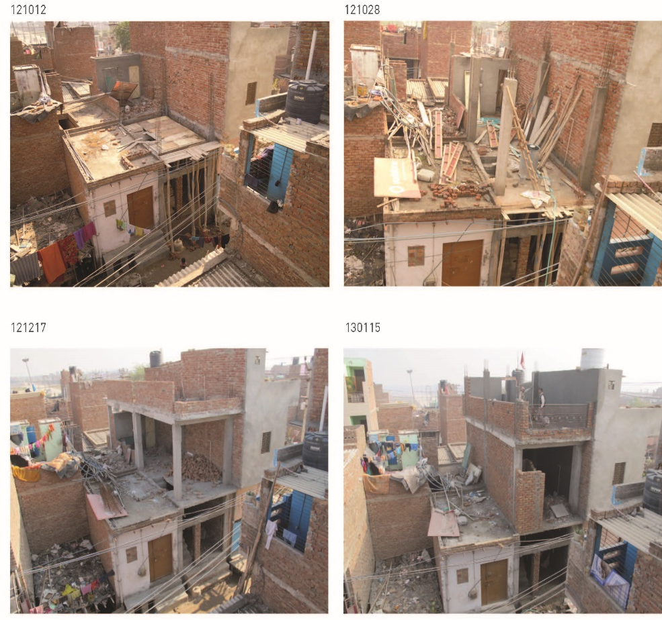
Examples of incremental building
Source: India, Julia King, 2013

Slide 18
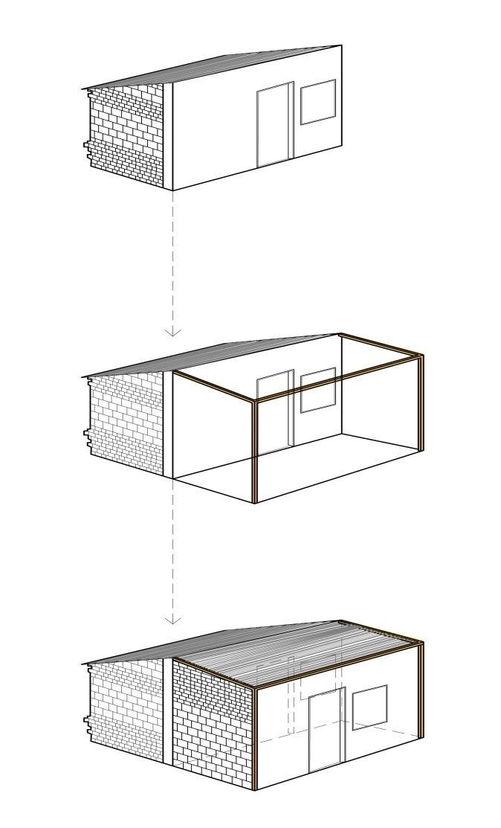
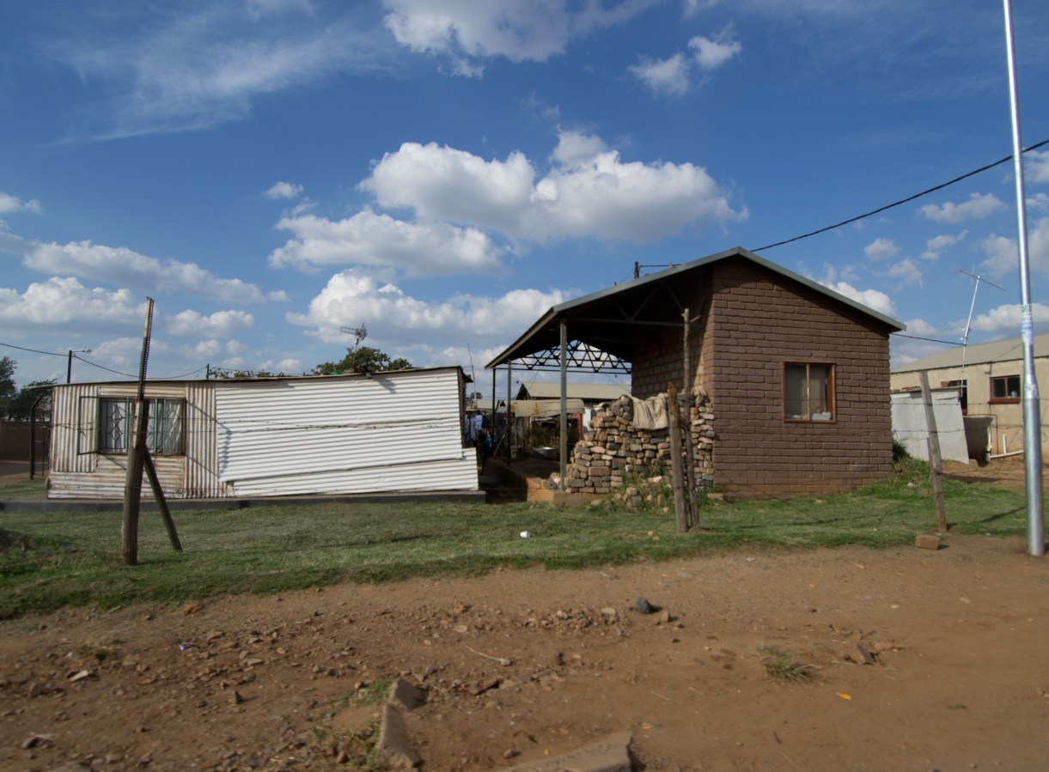
Examples of incremental building
Image: J Bennett

Slide 19
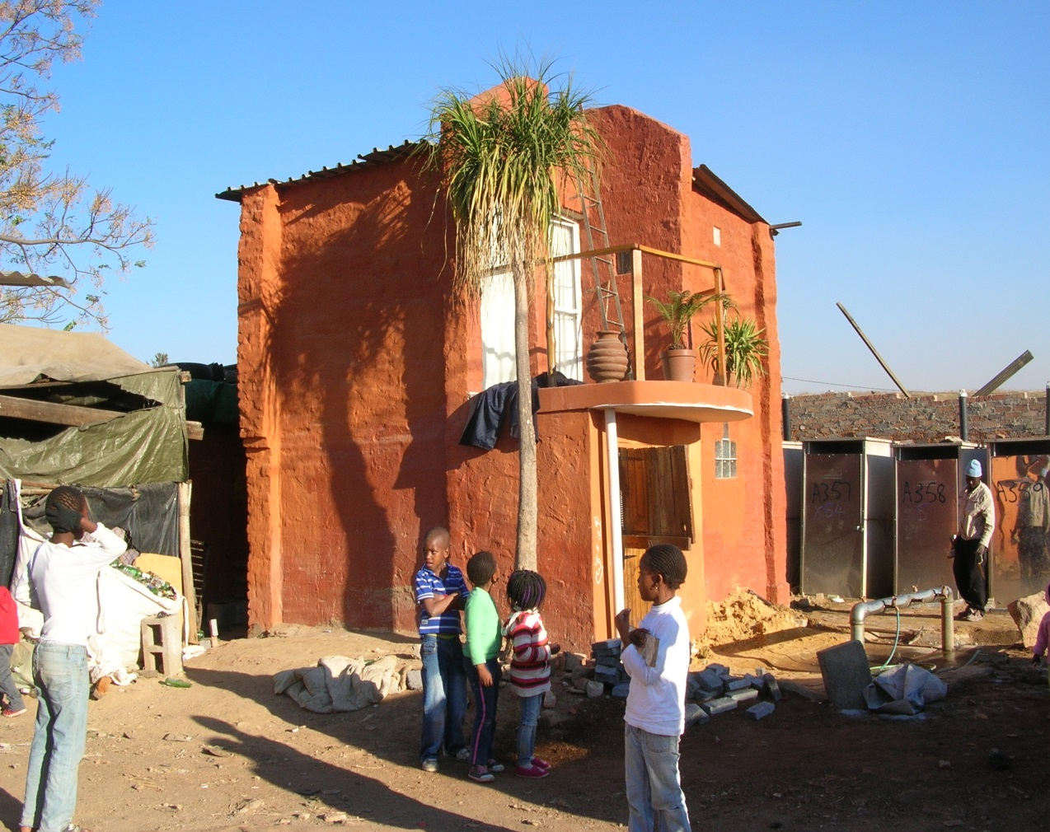
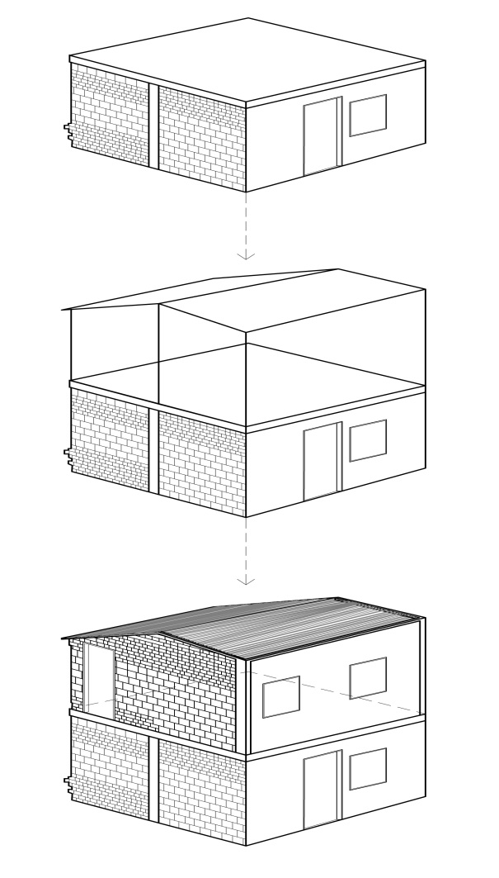
Examples of incremental building
Image: M Huchzermeyer

Slide 20
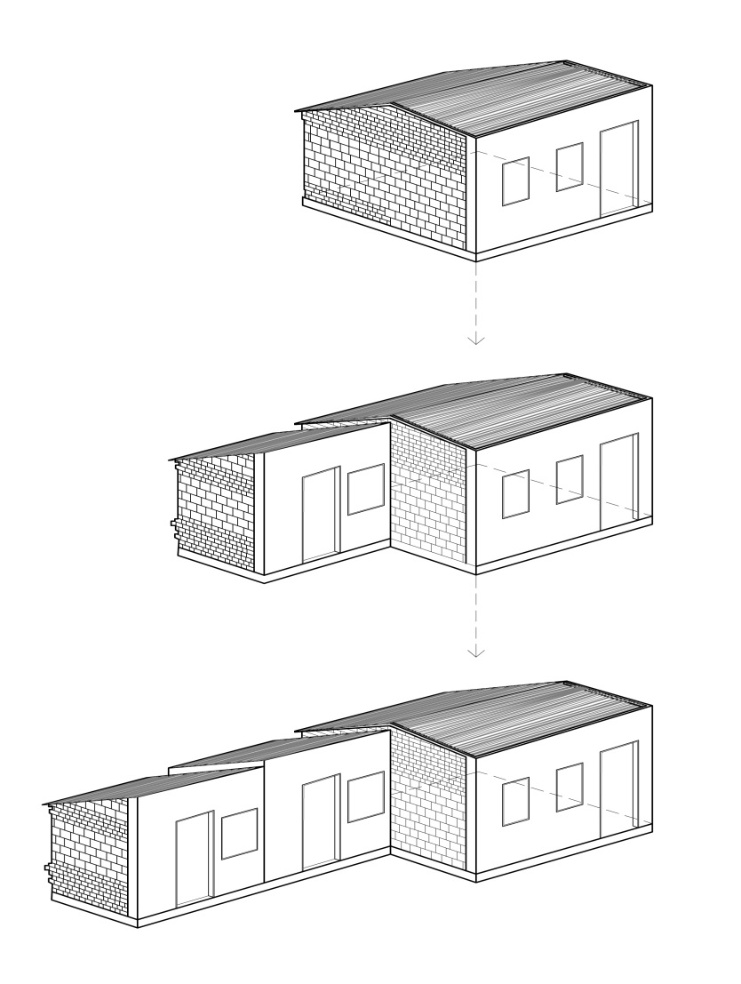
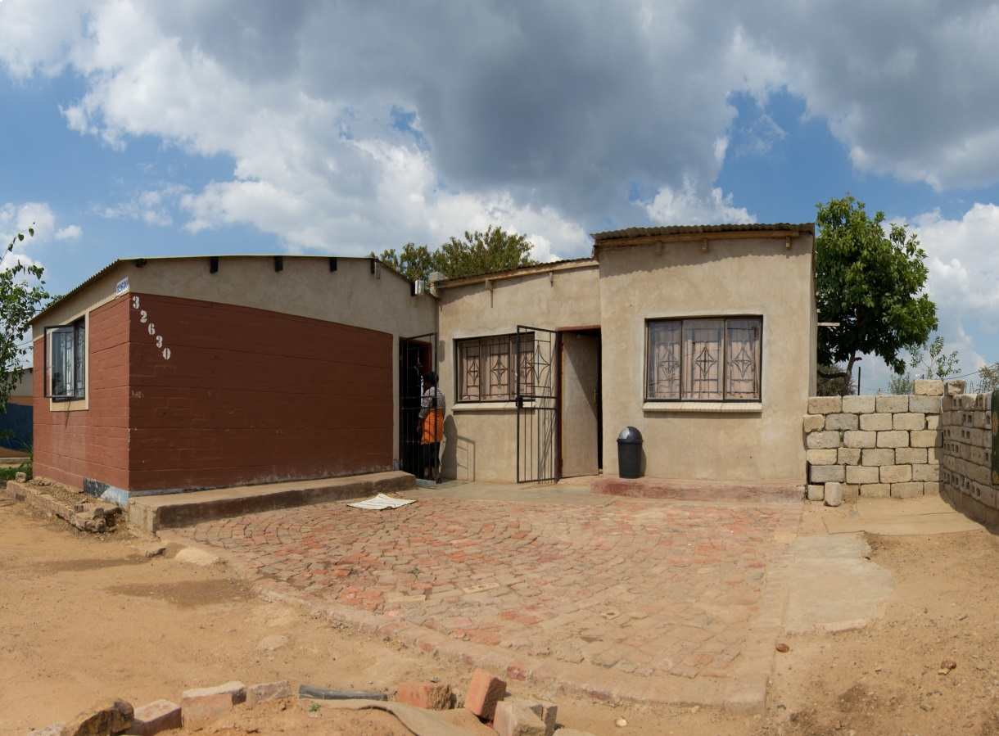
Examples of incremental building
Image: J Bennett

Slide 21
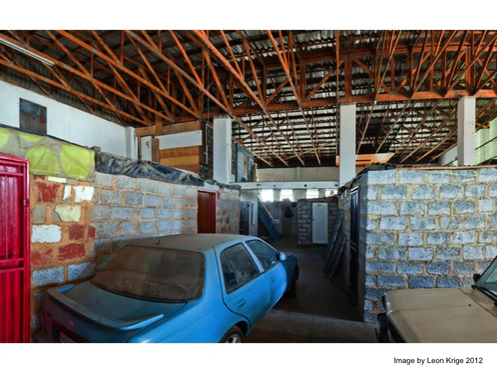
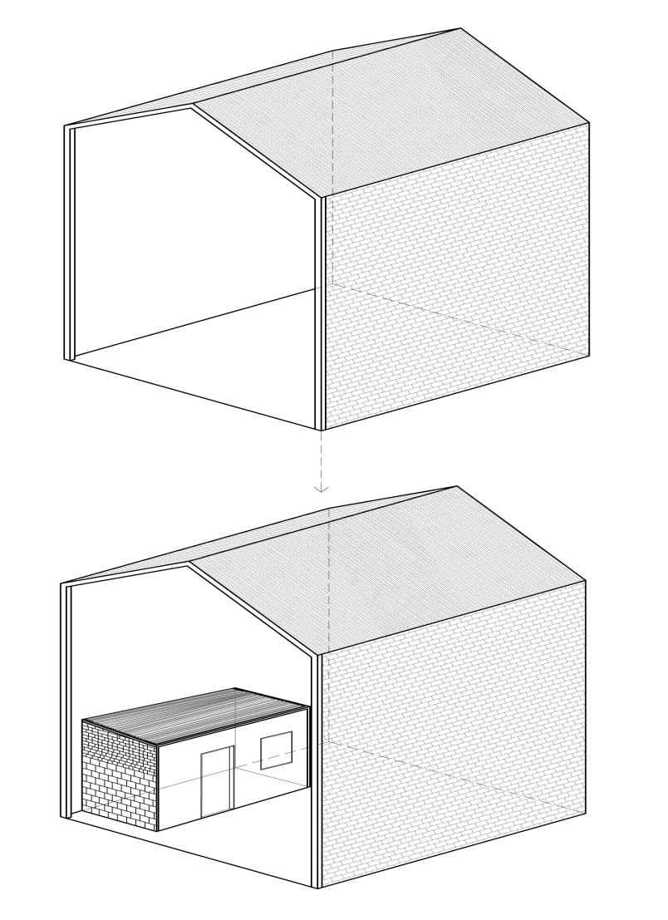
Examples of incremental building
Image: L Krige

Slide 22
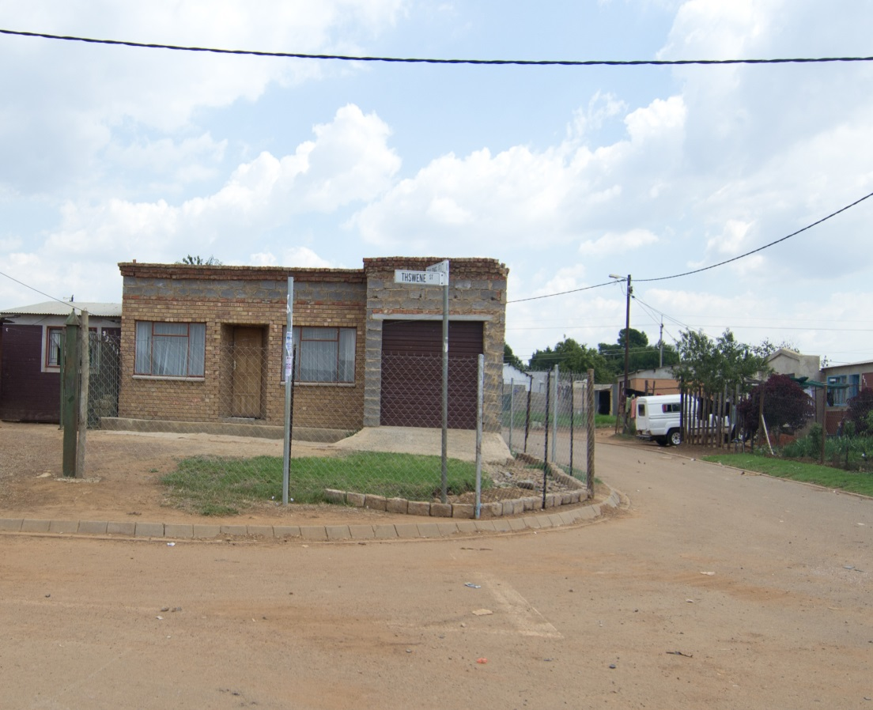
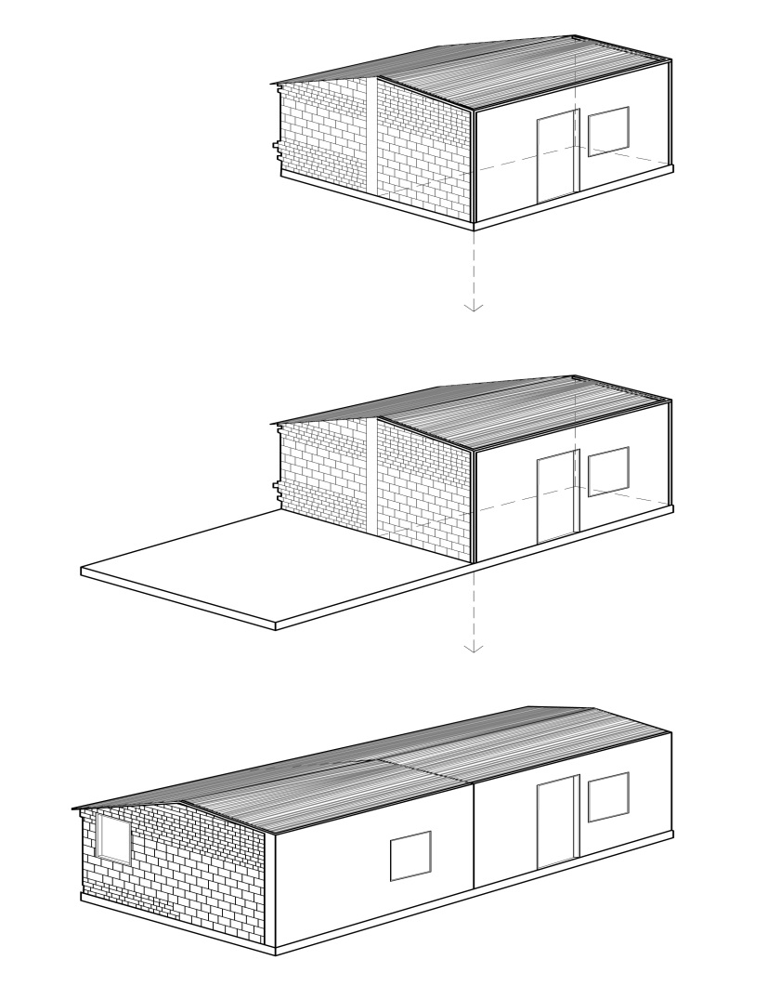
Examples of incremental building
Image: J Bennett

Slide 23
2. What factors affect a household’s ability to consolidate their house?
Activity 9.3: Factors that affect incremental upgrading
Type of Activity: Pair work
Timing: 5 minutes
Purpose: To think about factors that affect a household’s ability to upgrade their house.
Instructions: In your pairs, discuss the following question:
  What will affect people regarding investing in their houses and incrementally improving them?

Slide 24
Factors that encourage self-build
The extent to which the household needs a house as opposed to temporary shelter.
Tenure security
Knowledge of housing processes
The extent to which the households thinks there is the potential of securing alternative housing, particularly a fully subsidised house.
The extent to which town planning and building regulations and constraints can be overcome or simplified.
The extent to which there is government investment in the area

Slide 25
Affordability of housing improvements
Affordability can be facilitated by the following:
Availability of a subsidy
Savings
Disposable income
Credit availability
Household and community contributions

Slide 26
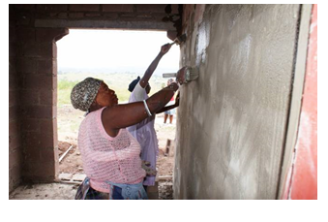
Access to support for incremental house building
Households are unable to improve their housing unless they can find access to:
Management skills
Technical support
Access to building materials
Contractor development

Slide 27
Actors (and roles) in incremental home building
The following people or groups play important roles in the process of building houses incrementally
Households
Government
Community Organisations
Non-profit/ Community Resource Organisations
Private Sector

Slide 28
Activity 9.4: The risks of incremental housing
Type of Activity: Individual
Timing: 5 minutes
Purpose: To identify the disadvantages or risks of self-build incremental housing.
Instructions: Write down in the Participants Manual all the disadvantages or risks of self-build incremental housing and self-build that you can think of.

Slide 29
Challenges in incremental housing building
Orientation: The house is not oriented on the site to maximise sunlight and allow future expansion
Fire safety: The house is built with flammable materials or too close to other structures
Floor to ceiling heights: These are too low which negatively affects comfort and ventilation
Ventilation: Windows and doors are not located so as to ensure proper ventilation of the dwelling
Durability: The house is built with materials that do not last
  → One of the roles of the municipality is to support households to avoid these disadvantages and overcome the factors that limit households from upgrading their homes.

Slide 30
3. Supporting housing consolidation
Options for the municipality
Provide enabling urban planning and management
Land tenure security:
Town planning layouts and house design
The type of design
Municipal assistance
Building regulations

Slide 31
How Municipalities can support incremental self-build
Provide enabling urban planning and management
Encourage household investment in housing
Facilitate access to finance
Provide technical support
Facilitate access to building materials.

Slide 32
How Municipalities can support incremental self-build
Encourage household investment in housing
Political and community support
Protecting prior investment in housing
Knowledge and capacity development
Arranged homebuilding programmes
Income generation

Slide 33
How Municipalities can support incremental self-build
Facilitate access to finance
Borrowing from family;
Revolving credit stokvel finance;
Materials supplier credit, which is credit provided on building materials purchases;
Informal money lenders;
Small loans/credit;
Employer loans.
Facilitate connections between the households and reputable financial institutions

Slide 34
How Municipalities can support incremental self-build
Provide household technical support
Information-sharing regarding building norms and standards and approval processes.
Potential innovative building options to assist consolidation such as shared walls.
Advice on house placement on sites.
Determining boundaries and dispute resolution support.
House design and costing
Household construction management support

Slide 35
How Municipalities can support incremental self-build
Local construction sector capacity development
Training and development of local house building capacity
Materials manufacture/assembly and supply

Slide 36
Dealing with building regulations
Currently there are no appropriate regulations in place to effectively enable incremental housing processes. Municipalities need to find innovative approaches that can overcome this obstacle. Some of these approaches include:
Innovative zoning approaches
Primary building rights
Town planning, building standards and controls
Structured programme approaches

Slide 37
The Enhanced People’s Housing Process (EPHP)
EPHP can only be applied when there are approved community resource organisations (CROs).
The EPHP is made up of four different forms of funding:
  Capital funding
  Capacity building fund
  Community contributions/equity
  Bridging finance
The EPHP promotes the use of housing support centres as part of providing household technical support.

Slide 38
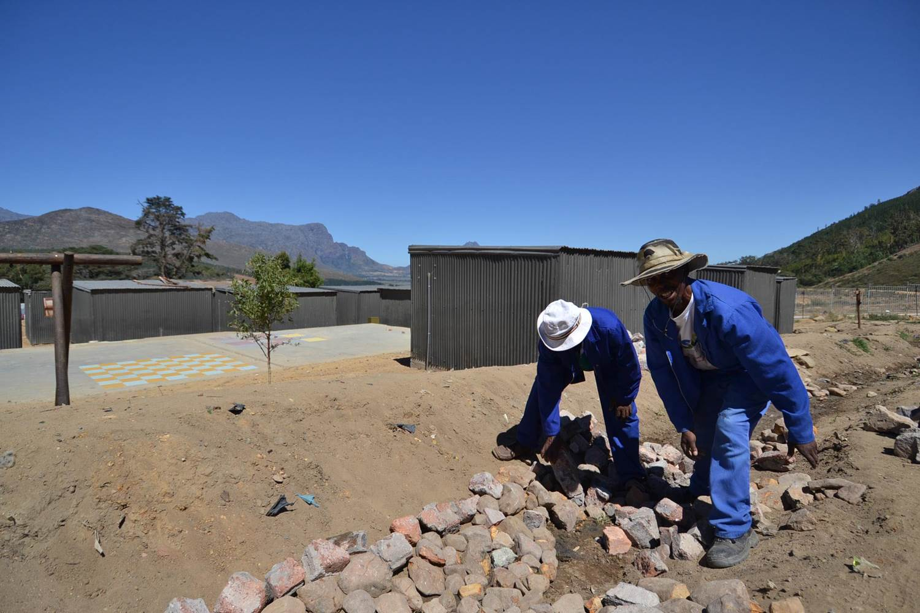
Case study 1: Skills mobilization — Masithembane, Homeless and Squatters Housing Project (HOSHOP) and Sinako Ukuzenzele, Khayelitsha, Western Cape

Slide 39
Activity 9.6: What did you gain?
Type of activity: Group work
Timing: 15 minutes
Purpose: To stimulate thinking and action to support housing consolidation.
Instructions: In your groups, draw up a list of possible actions you can take to support people in the informal settlements you know to upgrade their houses.

