Slide 1
A resource base for open land data
By Romy Sato
Ukesa webinar
22 Feb 2024

Slide 2
The Land Portal Foundation
…was established to create, curate and disseminate land governance information by fostering an inclusive and accessible data landscape
1
Knowledge creation & curation
2
Open data
advice & advocacy
3
Debates
about land & data
Notes:
We aggregate, curate & open up data from various sources and of different types…
Based both on new and long-standing partnerships – e.g. with CSIR

Slide 3

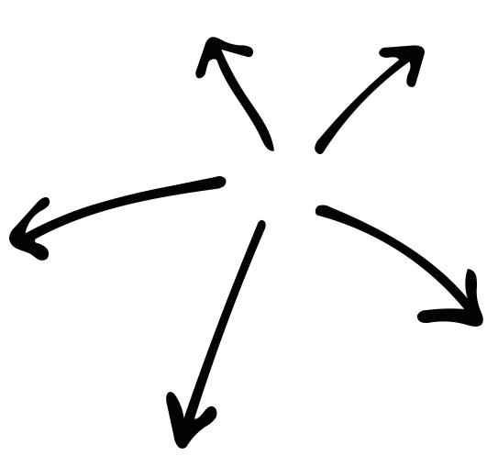
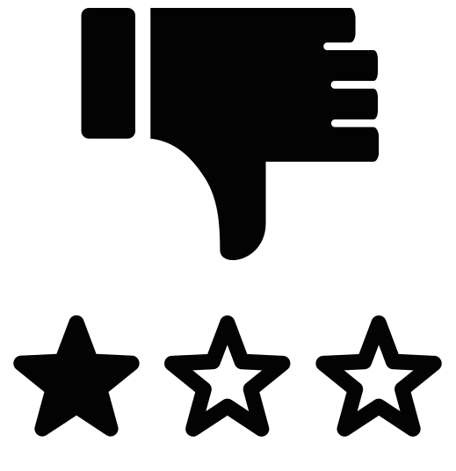

Context
Land data is often…
Dispersed
Too much /
Not well organized
Poor quality
Not accessible
Limited internet access
Poor data infrastructures
Notes:
The situation is that:
Land data is dispersed
There is too much information, not well-organized
May be of poor quality
May not be accessible & open (e.g. paid journals, info is not digital)
Plus:
Limited internet access
Poor data infrastructures: cell phone and wifi penetration - connectivity - gap of around 40% in SSA (?)
Lack of open data on land

Slide 4
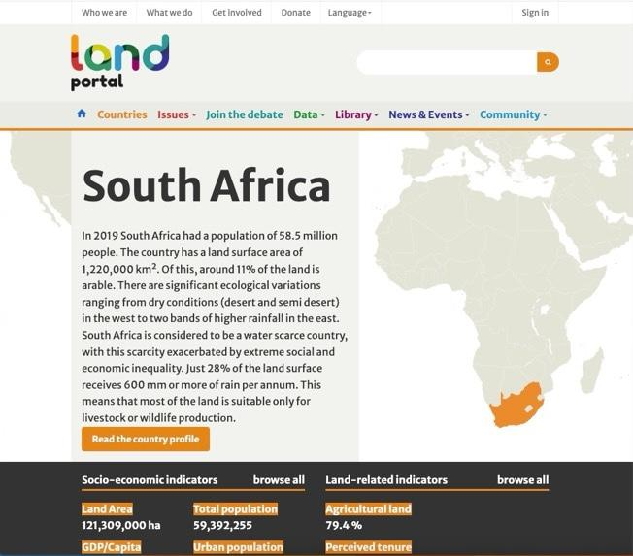
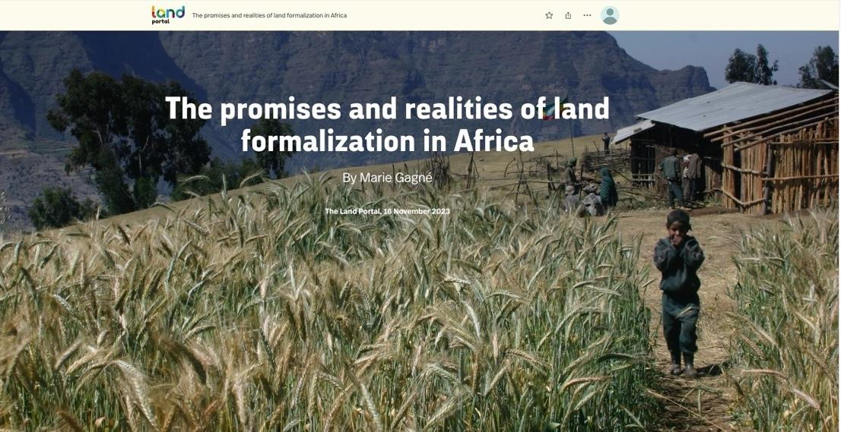
Knowledge creation
Synthesizing information and translating complex data
84 country profiles
Data stories

Slide 5
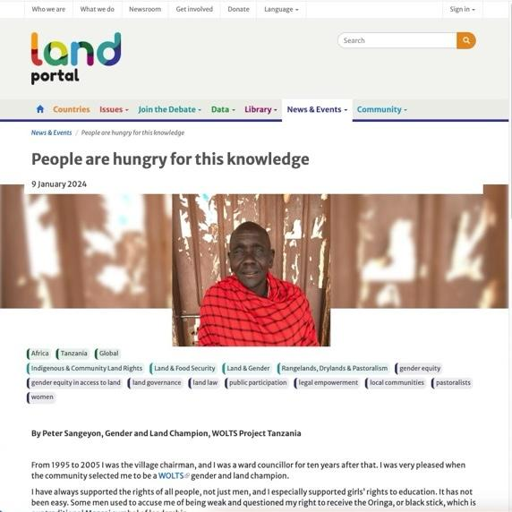
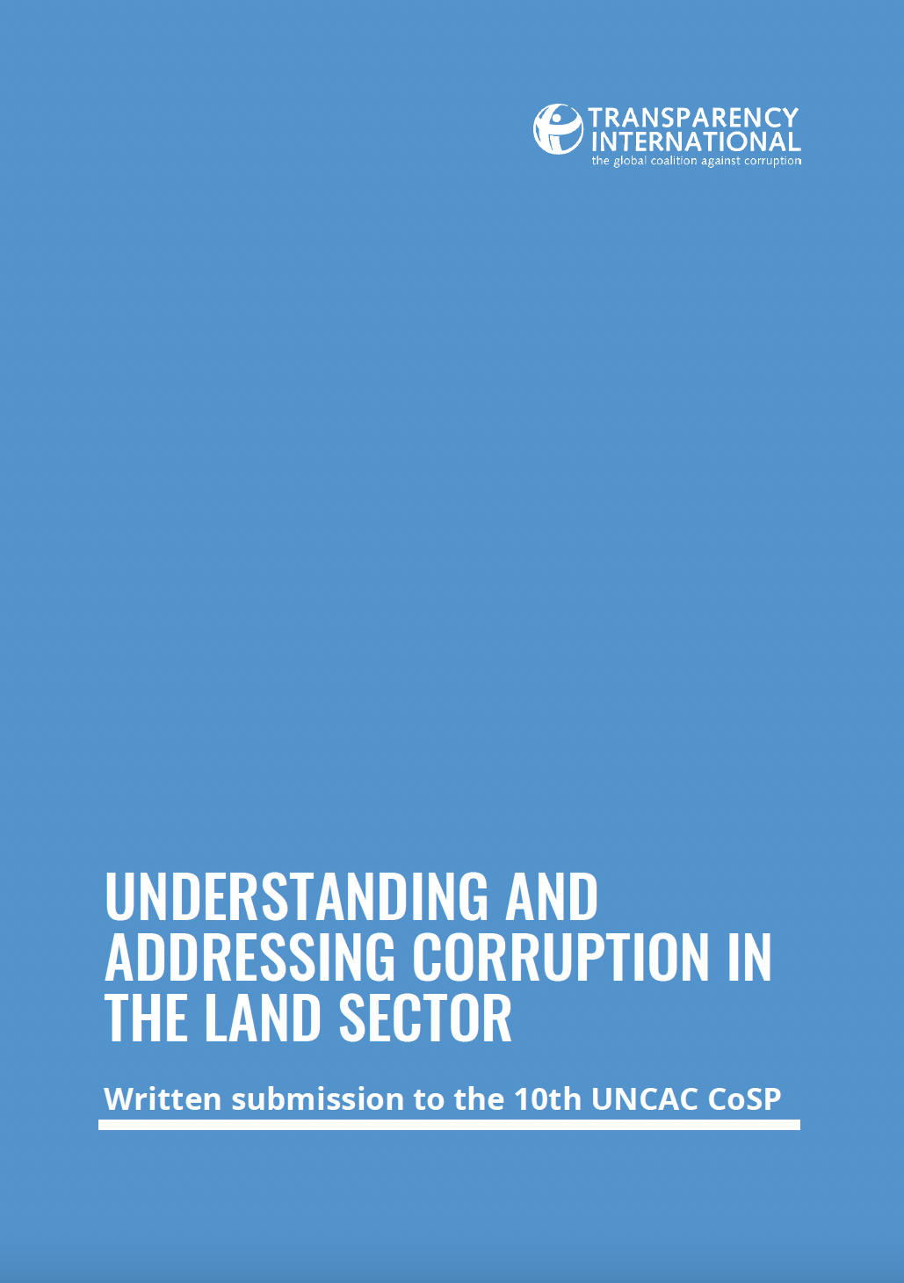
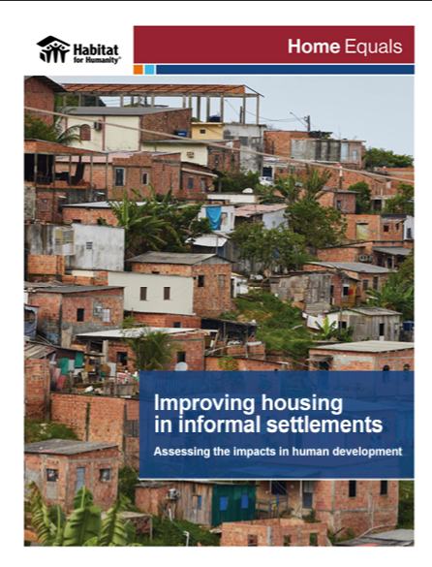
Data curation: Publications, News, Blogs
Transparency International. 2023
Habitat for Humanity, 2023
Visit our Land Library!
Notes:
What kind of data we aggregate and curate?
Library resources
Statistical datasets
Spatial datasets
Development projects focused on land
Blogs
News
Events

Slide 6
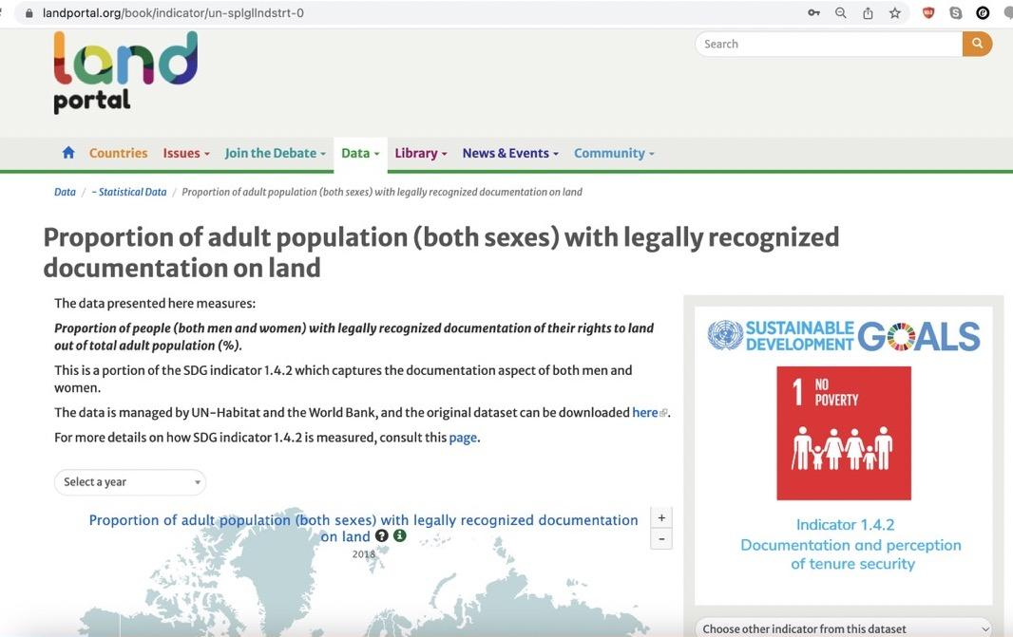
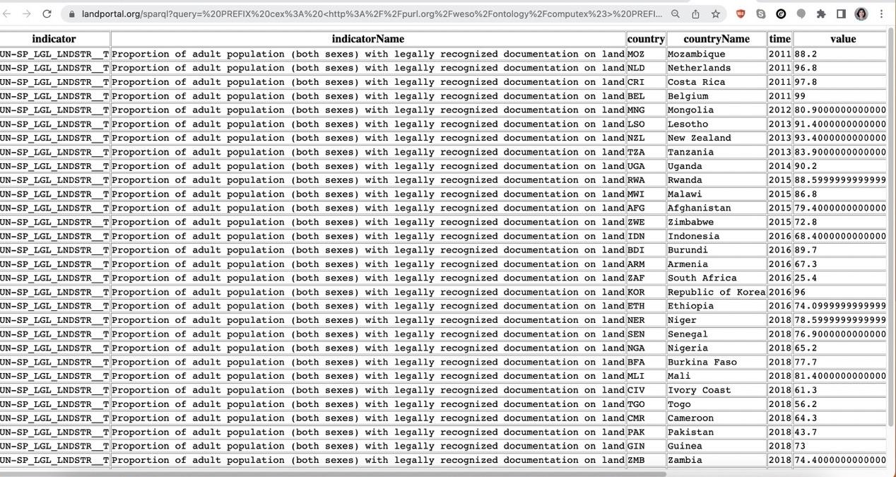
Data curation: Statistical and spatial datasets
Search & download datasets in open data formats

Slide 7
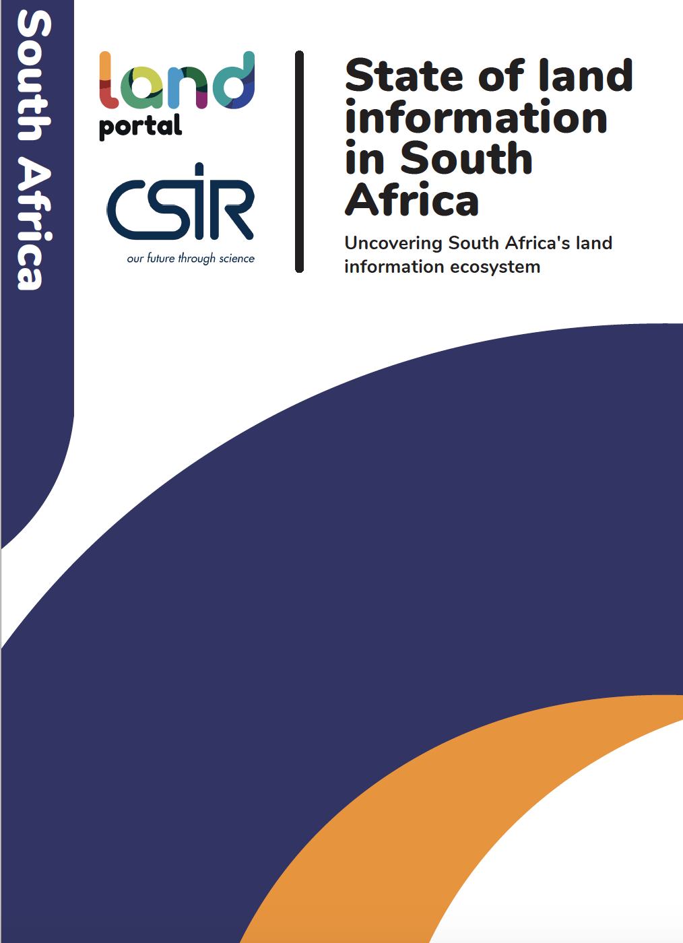
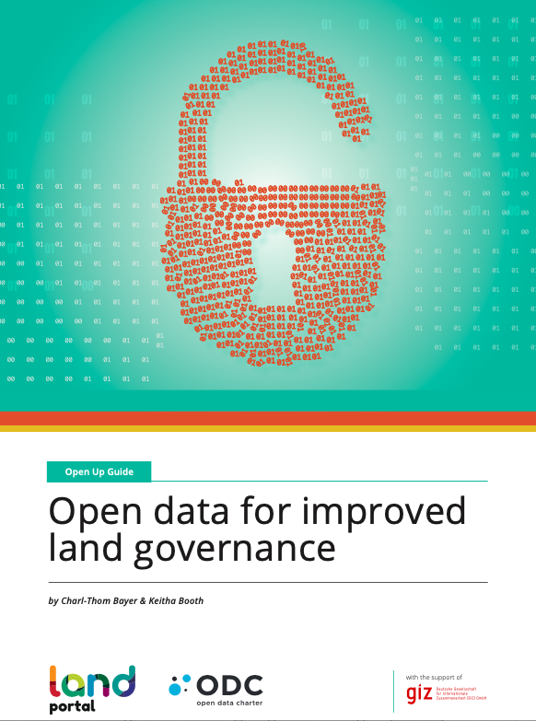
Advocacy for good land data governance
SOLI
Open Up Guide
Opening up land data
Transparency
Inclusion
Opportunity
Land access, land rights
Notes:
Opening up data is in fact a process of empowering people to access & use the data
Open data: digital data that is made available with the technical and legal characteristics necessary for it to be freely used, re-used, and redistributed by anyone, anytime, anywhere.

Slide 8

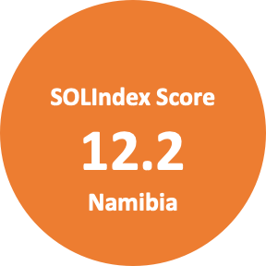
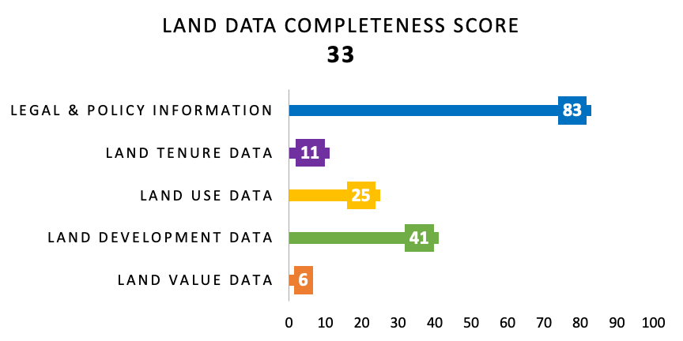
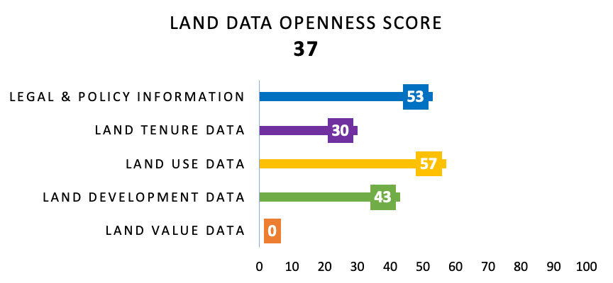
Open land data indicator: SOLIndex
How OPEN is LAND DATA around the world?
WHY - Land data in the public domain enables use, ensures transparency, and improves decision-making and service-provision
Out of 100
Notes:
WHAT - An indicator that assesses the openness of land data and information at the global and country levels
WHY - Land data in the public domain enables use, ensures transparency, and improves decision-making and service-provision
FOR WHOM - Land data custodians policy-makers, researchers, land+ dev practitioners
Data tools of the Land Portal: SOLIndex, SOLI and Open Up Guide
Open data as a means to increased transparency and good data governance - to enable land access to vulnerable groups

Slide 9

Thank you
Romy Sato
  Knowledge Management Lead
    romy.sato@landportal.org
    www.landportal.org
Notes:
Discussion
Advocacy and impact – How do you achieve your objectives? How do you measure impact?
Promoting inclusivity Being an open platform for anyone to publish, post
Promoting openness – partnerships with governments, e.g. Senegal, Mozambique
Impact – our audience is global and very diverse, but mostly researchers and practitioners (more than 57% in our User Survey)
Impact – solid methodology that includes User Survey, Web-analytics and Outcome Harvest Interviews
Challenge – fines due to copyrighted images, consequence of advance of AI
Network and partnerships between us – LANDex, Rick
Quick stats from the User Survey
44% respondents are based in Africa
68% are men
Age: 45-54 is the top age group
Practitioners and researchers represent 57.1% of respondents in the survey
Sample: 315 respondents

