Slide 1
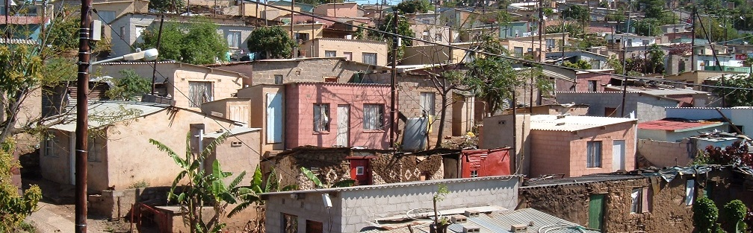


INTRODUCTION TO
INFORMAL SETTLEMENT
UPGRADING
MODULE 12: INSTITUTIONAL ARRANGEMENTS

Slide 2
Module purpose
The purpose of this module is to enable you to understand the core institutional requirements for effective informal settlement upgrading programme and project implementation, so that you can contribute to effective organisation structuring for informal settlement upgrading.

Slide 3
Learning outcomes
After completing this module you should be able to:
Distinguish between the core functions of organisation structures at the programme level and the project level of informal settlement upgrading initiatives;
Identify the actors that need to be mobilised to perform informal settlement upgrading related functions at the programme and project level and their roles;
Provide suggestions on appropriate organisation structures at the programme level and the project level for implementing different informal settlement upgrading plans;
Review and make recommendations regarding the terms of reference for institutional arrangements.

Slide 4
Module content
Institutional arrangements: programmes and projects
Organising to implement a settlement upgrading plan
Making institutional structures work

Slide 5
1. Institutional Arrangements: Programmes and Projects
Activity 12.1: Know what you know
Type of activity: Pair work
Timing: 5 minutes
Purpose: To share experience of the challenges of working in institutional structures.
Instruction: Discuss the following question with your partner.
  From you own experience of working in structures and committees within the informal settlement context, what can go wrong with the structure or committee and cause them to be less effective?

Slide 6
Why are institutional arrangements important?
An informal settlement upgrading initiative at a municipal level needs to involve and organise a number of different actors, each doing different things at different times
Effective organisation and management of these actors is needed to ensure that the initiative achieves its purpose on time, within budget, and delivers the service to the standard agreed
Working in ‘Silos’ vs working Collaboratively
This module we will look at organising informal settlement upgrading at both the Informal Settlement Upgrading Strategy and Programme level and the municipal informal Settlement Upgrading Plan level.

Slide 7
Activity 12.2: Revising programmes and work streams
Type of activity: Pair work
Timing: 15 minutes
Purpose: To re-cap on what was learnt in Module 5 about work streams.
Instructions: With your partner, find the answers to the questions in the Participants Manual

Slide 8
The role of the programme level organisational structure
At the Informal Settlement Upgrading Strategy and Programme level an organisational structure will be needed to:
  Compile the Informal Settlements Upgrading Strategy;
  Mobilise and involve the organisations/departments who need to execute functions associated with the implementation of the strategy;
  Enable the implementation of the individual Informal Settlement Upgrading Plans;
  Coordinate the implementation of the Informal Settlement Upgrading Plans and projects and help them to share learning and resources;
  Make the implementation of the various Informal Settlement Upgrading Plans easier and more efficient.

Slide 9
Activity 12.3: Programme level actors
Type of activity: Facilitated group discussion
Timing: 20 minutes
Purpose: To identify the actors that need to be involved in a municipal-level upgrading programme.
Instruction: Your facilitator will present the case of the Emthonjeni programme in Khayalitsha. As you listen to the case study, think about the questions in the Participants Manual. You will discuss these questions after the case study presentation.

Slide 10
Getting organised at the programme level
An informal settlement upgrading strategy and programme requires the involvement of an array of actors from different departments.
Some form of organisation structure will be necessary to coordinate and integrate the activities of these different actors
Most common form is the programme steering committee which could be supported by:
  Technical committee;
  Sub-committee / task team
  Coordination Committee

Slide 11
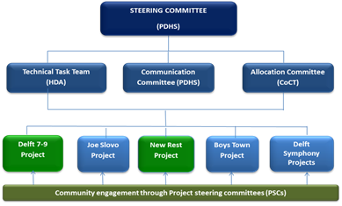
Getting organised at the programme level cont.
The N2 Cape Gateway Programme Level Organisation Structure:
Programme level
of N2 Gateway
Organisation

Slide 12
Activity 12.4: Programme Steering Committees
Type of activity: Group work
Timing: 20 minutes
Purpose: To apply your knowledge of structuring the institutional arrangements for a municipal informal settlement upgrading programme.
Instruction: On a piece of flipchart paper, draw an organisation structure (organogram) for the VPUU Emthonjeni Programme, at the municipal programme level. Show what sub-committees are required at programme level and how the programme level structures will interact with the project level structures.

Slide 13
Terms of Reference
An Informal Settlement Upgrading Strategy and Programme Steering Committee has a Terms of Reference which should contain:
Some explanation of the background or context to the establishment of the structure.
A statement of the “Purpose” of the structure.
A description of the “Composition” of the structure -
Details of how the “Proceedings” must be managed -
Details of when and how the committee will be terminated.

Slide 14
Organising to Implement a Settlement Upgrading Plan
Building an effective organisation structure at the informal Settlement Upgrading Plan level requires that the same questions be asked as at the programme level:
Who should be involved and what should their function be?
In what kind of structure?
How should this structure be institutionalised and managed?

Slide 15
Project level actors and their functions
1. Officials;
2. Representatives in the political in the
representational system;
Community counterparts;
Specialists and technicians;
5. Interested and affected parties.

Slide 16
Activity 12.5: The actors in a UISP project
Type of activity: Triads
Timing: 20 minutes
Purpose: To identify the project level actors that may need to be involved in a UISP project.
Instruction: For each phase of the UISP identify the actors and the main role they play. Write the actor and the role they play on cards. Use different coloured cards for each phase.
  Refer to the list of five constituencies above.
  We will discuss your conclusions in plenary.

Slide 17
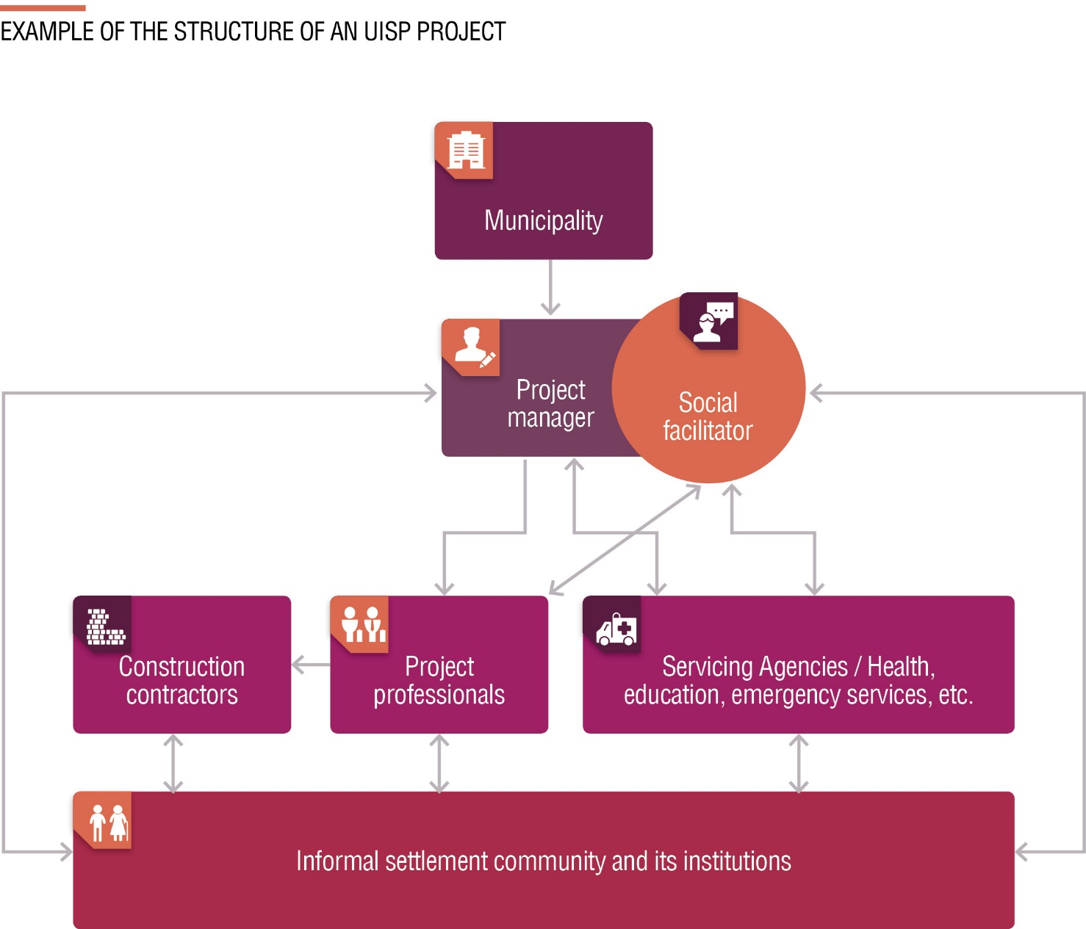
Roles and responsibilities in an UISP project
  Example of the Structure of an UISP Project

Slide 18
Roles and responsibilities in an UISP project cont.
In the UISP the Municipality, as the developer, is responsible for:
Submitting the UISP application or allocate UISP programme funds
Providing the bulk services
Ensuring implementation of the UISP project including financial control.
Procuring and managing the project team.
Monitoring and reporting on progress
Taking over the installed services and maintaining and running them

Slide 19
Roles and responsibilities in an UISP project cont.
The UISP makes provision for a Project Manager who is responsible for:
Scheduling/ coordinating and integrating the various work streams at the project level.
Management of the project professional team, including the social facilitation team, the project town planners, engineers and the land surveyor.
Reporting/ Communication with programme level of the municipal ISU (if there is one).
Compilation of the various business plans.
Assisting and coordinate agencies implementing ISU activities in the project.
Ensuring that community participation in the project occurs successfully.

Slide 20
Roles and responsibilities in an UISP project cont.
In UISP upgrading projects the Social Facilitator (or team) is responsible for:
Socio-economic surveying of households in the settlement;
Facilitating community participation;
Project information sharing and progress reporting within the community;
Conflict resolution, where applicable;
Housing support services comprising:
  Training and education on housing rights and obligations;
  Capacity building of housing beneficiaries;
  Assistance with the selection of housing options;
  Management of building materials;
  Relocation assistance.

Slide 21
Roles and responsibilities in an UISP project cont.
Project Professionals
Town planner:
  Works with the community to compile a land use plan for the settlement
  Works with the community to compile the layout plan which shows the boundaries of the various plots.
Engineer:
  Designs of the infrastructure services to be installed in the settlement (water, access, storm water, sanitation).
  Manages the procurement of the contractors that build the engineering services.
  Supervises the construction of the infrastructure.
Land Surveyor
  Pegs the layout out on the ground.
  Records the positioning of the pegs on a plan.

Slide 22
Roles and responsibilities in an UISP project cont.
Servicing Agencies
  A number of servicing agencies need to become involved in Project level ISU. These include:
    Emergency Services- particularly fire and policing
    Health
    Social Services
    Education
Community Structures
  Ward Committees

Slide 23
Activity 12.6: Case study: Boystown project social compact
Type of activity: Facilitated group discussion
Timing: 30 minutes
Purpose: To examine a terms of reference in the form of a social compact.
Instruction: You will be given a copy of the Boystown Social Compact.
  Find the information set out in the Participants Manual in the document and discuss each point.

Slide 24
3. Making institutional structures work
Factors which could significantly improve the effectives of any institutional structure established in respect of informal settlement upgrading:
Having a champion
Testing
Regularity
Conflict
Preparation and purpose
Records

Slide 25
Activity 12.7: Evaluate your own conflict handling skills
Type of activity: Individual
Timing: 5 minutes
Purpose: To reflect on your own conflict handing behaviour.
Instruction: Complete the assessment that the facilitator will give you.
Note: This exercise is confidential. You will not be required to reveal your secrets in plenary, unless you choose to!

Slide 26
Activity 12.8: What did you gain?
Type of activity: Facilitated group discussion
Timing: 15 minutes
Purpose: To share tips on how to address the challenges presented by working with institutional structures.
Instruction: Referring to the issues identified at the start of this module, what tips do you have for how to avoid stumbling blocks or how to deal with challenges?

Slide 27
Reflect on what has been covered in this module.
Write down three important things about organising for informal settlement upgrading at the municipality wide, programme level, that you will apply in your work.
Now write down three important things about organising at the Settlement Upgrading Plan implementation level, that you will apply in your work.

