Slide 1
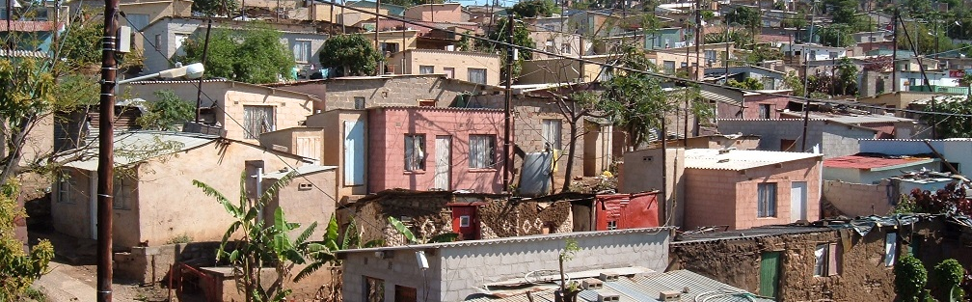


INTRODUCTION TO
INFORMAL SETTLEMENT
UPGRADING
MODULE 10: PLANNING UPGRADE PROJECTS

Slide 2
Module purpose
The purpose of this module is to enable you to understand and apply the principles and processes necessary to develop effective plans for individual upgrading projects or settlement-level response plans.

Slide 3
Learning Outcomes
After participating in the module, you should be able to:
Describe the benefits of a systematic, planned project approach;
Describe the main elements of an upgrading project response plan;
Identify the main planning priorities and key success factors for different categories of upgrading projects;
Identify the range of activities within the phases of the UISP;
Interpret a simplified Gantt schedule for a typical full upgrading project utilising the UISP.

Slide 4
Module content
A planned approach to informal settlement upgrading
Developing a settlement upgrading plan
Planning for different informal settlement types
Planning when using the UISP

Slide 5
1. A planned approach to informal settlement upgrading
Activity 10.1: Know what you know
Type of activity: Pair work
Timing: 10 minutes
Purpose: To share experiences of planning.
Instructions: Think of an experience you have had that proves the point of the saying below. Then tell your partner about it.
  “Failing to plan is planning to fail.”

Slide 6
What is a Planned Approach?
Activities that need to be undertaken in order to plan at the settlement level and develop an informal settlement upgrading plan.
The main purpose of a settlement upgrading plan is:
  To conceptualise the upgrading of a settlement in broad terms (i.e. the overall developmental pathway, key developmental priorities, stakeholder roles and broad timeframes);
  To provide a focus for stakeholder agreement (in particular the local community and municipality) in terms of the upgrading concept.
A settlement upgrading plan should ideally be put in place from the Assessment and Categorisation (AC) stage of an upgrading project and should be updated as the project planning unfolds.

Slide 7
Importance of planning
PROJECT RISKS can be identified early on and addressed in one way or another
The PROJECT CONCEPT which is developed is viable, appropriate, realistic and responsive to local circumstances
KEY STAKEHOLDERS including the local community and municipality can understand and agree on the project concept
PROJECT IMPLEMENTATION is smoother and easier and projects do not as easily become stuck or stalled during the implementation (construction) phase
PROJECT FUNDERS including government departments are provided with high quality information (such as project feasibilities and business plans) upon which they can make informed decisions
CASH FLOW on the project is more predictable. Expenditure can be more effectively cash-flowed and programmed over time, including on the MTEF

Slide 8
How are Informal Settlement Upgrading Plans developed?
Settlement upgrading plans require work of various kinds (social, technical and financial)
It needs to be funded and managed and include key processes
It needs to be informed by an understanding of the project site, the community and the context as well as a clear understanding of potential funding sources
It must be ‘negotiated’ and agreed between key stakeholders (e.g. community and municipality)
At the AC stage, the plan is informed by a preliminary assessment and stakeholder engagement work.

Slide 9
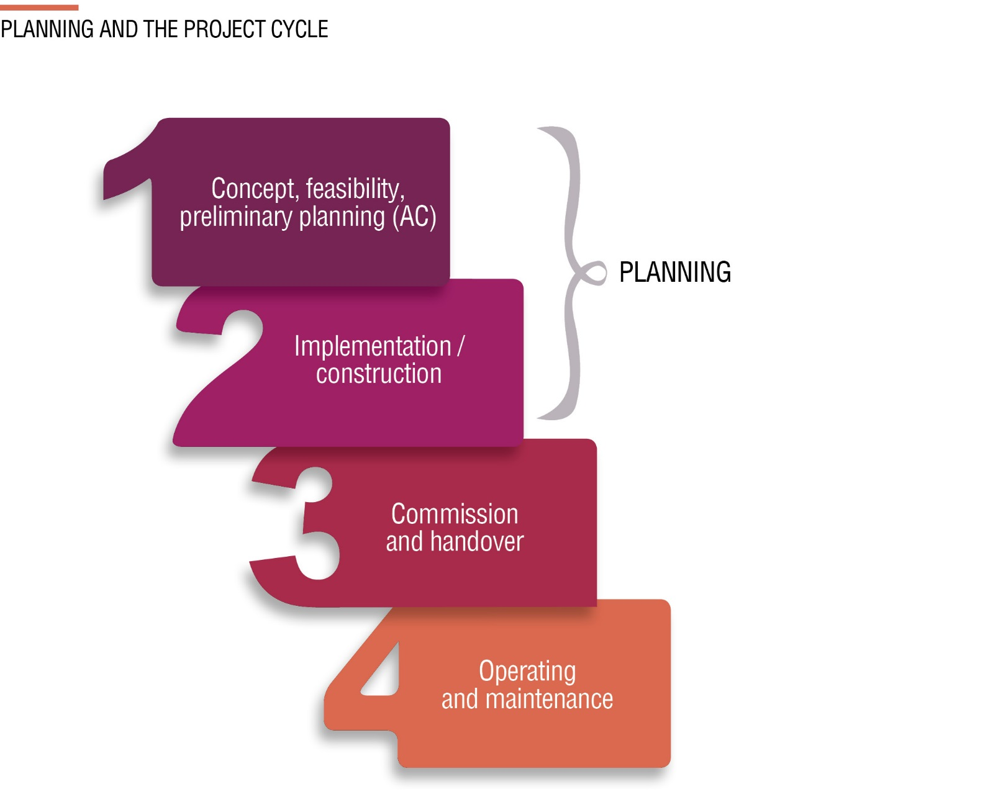
The Project Cycle

Slide 10
Examples of Types of Settlement Upgrading Plans
Short profile, developmental pathways,
Priorities and indicative costs
At AC Stage
Pre-feasibility
Stage
Technical studies
Project Cycle
At subsidy Application Stage
Full feasibility with specialist reports and business plan
At detailed design Stage
Detailed design reports and specifications, and accurate costings

Slide 11
Key Planning Success Factors – Project Fundamentals
A proven need for the project.
Available funds: Line it up early on and know the funders requirements! Make sure there is a source of funding that can most likely be secured or don’t proceed further.
A suitable site and location
Stakeholder support and involvement: Formulate a clear concept with community buy-in. The community should be involved in decision making and choices. This may be through a social compact which is a signed agreement between the community and the municipality.
A professional team (specialists) to do the work comprising planning and designing the settlement upgrade. This professional service is usually outsourced and procured.

Slide 12
2. Developing a Settlement Upgrading Plan
Activity 10.2: Factors that affect a settlement upgrading plan
Type of activity: Pair work
Timing: 5 minutes
Purpose: To identify the different factors that will affect the plan.
Instruction: In the space in the Participants Manual write down as many factors as you can think of that will make the informal settlement upgrading plan different from one settlement to another. Give examples where you can.

Slide 13
Key points that affect an upgrading plan
The type of the settlement
Target funder/grant mechanism
The density of the settlement
Scale of the project/settlement
Technical site suitability factors
Locational factors
The upgrading approach and housing delivery method

Slide 14
Content of a settlement upgrading plan
Background and assessment (Settlement profile, categorisation, status quo assessment, site development potential assessment and vulnerability assessment
The proposed settlement upgrading plan including:
  Details on:
    How imminent health and safety threats will be addressed
    How basic infrastructure will be provided
    How tenure will be addressed
    How communication and community participation will be achieved and sustained
    The plan for a long-term solution to housing, as well as interim arrangements.
  A relocation plan if required
  How social facilities including education and health care will be provided
  Annexures: The following annexures could be included:
    Locality plan;
    Aerial photograph showing settlement boundary;
    Available site developability plans;
    Any other technical studies, reports or plans (e.g. geotechnical reports, land legal investigations, planning layouts)

Slide 15
3. Planning for different informal settlement types
Activity 10.3: Revision of categories of informal settlements
Type of Activity: Triads
Timing: 15 minutes
Purpose: To revise what you learnt in Module 5 about settlement categories.
Instructions: Match the criteria listed in the Participants Manual to the settlement types. You can refer to the handout: Summary of NUSP Settlement Categories.
Complete the table. Note that the some criteria apply to more than one settlement type, and each settlement type will have more than one criterion.

Slide 16
Planning implications or priorities per settlement types - Conventional formal full upgrading (A)
Community workshops
Undertake full assessment of site development potential
Land acquisition.
Determine relocation implications
Commence with formal planning processes
Proactively manage further influx
Plan for key social facilities

Slide 17
Planning implications or priorities per settlement types – incremental full upgrading (B1 extended)
As for conventional formal full upgrading and interim arrangements EXCEPT that:
Alternative planning solutions to be explored
Land acquisition may not be immediately necessary
Support for housing consolidation

Slide 18
Planning implications or priorities per settlement types - Interim arrangements (B1)
As for conventional formal full upgrading and incremental full upgrading above EXCEPT that:
Prioritise planning and design for interim basic services, and
Determine likely timeframe for formalisation and housing delivery.
Note: Land acquisition is not required for interim services (especially when using USDG and MIG), but should be undertaken in advance of formalisation and housing delivery.

Slide 19
Planning implications or priorities per settlement types – Deferred relocation (B2)
Community workshops
Rapidly action key health and safety mitigation measures
Accelerate provision of basic services
Determine likely timeframes until eventual relocation
Start the process of identifying an eventual relocation site
Proactively manage further influx
Where necessary make interim social facility arrangements

Slide 20
Planning implications or priorities per settlement types – Relocation (C)
Community workshops
Confirm that the relocation is indeed imminent and that an alternative relocation site is available
Plan relocation process in close consultation with community
Prevent further settlement on the vacated unsafe site.
Understand and assess livelihood impacts
Ensure relocation is negotiated and visited
Assess and plan for key social facilities

Slide 21
Activity 10.4: Planning for different developmental pathways
Type of activity: Group work
Timing: 20 minutes
Purpose: To apply your knowledge of planning for different upgrading pathways and settlement conditions.
Instructions: Use the same four settlement profiles you used in activities 5.5 and 5.6 in Module 5. For each of the settlements answer the following:
  What category of settlement is it? (You can refer to Activity 5.5 in Module 5).
  What are the key vulnerabilities affecting residents? (You can refer to Activity 5.6 in Module 5).
  What are the constraints limiting the upgrading project?
  What actions must be included in the project plan to deal with these constraints and address the vulnerabilities?
  Write your answers in the Participants Manual

Slide 22
4.Planning when using the UISP
The UISP and the informal settlement types
The UISP applies to the following informal settlement types:
Conventional formal full upgrading (Category C) and incremental full upgrading (Category B1 extended): For services, land acquisition, and all necessary professional work including town planning, design and planning approvals. Final top-structure phase is funded as a final phase using a separate top-structure subsidy.
Interim arrangements (Category B1): For limited interim services and initial participative and preplanning work.

Slide 23
Activity 10.5: Revisiting the UISP
Type of Activity: Individual
Timing: 30 minutes
Purpose: To revise what you learnt about the UISP in Module 3.
Instructions: Refer to the notes in Module 3 , section 2 and answer the questions in the Participants Manual.

Slide 24
Timeframes within the UISP framework
The UISP planning framework is generally not flexible. The reasons for this are:
Formal top-structure provision (state-subsidised housing) only occurs at best from the middle of year five into year six.
Full engineering services are provided, at best, from mid-year four into year five.
Timeframes can be significantly improved if an alternative approach is assumed which relates to enabling a more informal upgrading approach, such as incremental full upgrading.

Slide 25
Activity 10.6: Reading a Gantt Chart
Type of activity: Triads
Timing: 30 minutes
Purpose: To practise reading a Gantt Chart
Instructions: Find the information in the Gantt timetable provided in the Participant Manual for a formal UISP upgrading project and answer the following questions.

Slide 26
Activity 10.7 Comparing timeframes using a Gantt chart
Type of activity: Triads
Timing: 20 minutes
Purpose: To use a Gantt chart to compare timeframes.
Instructions: Compare the timeframes for a non-formal UISP upgrading project in the Gantt chart in the Participants Manual, with the timeframes for a formal UISP project in the Gantt chart you used in the last activity. Answer the questions in the Participants Manual

Slide 27
Key points
In the second Gantt timetable flexibility is introduced so that housing improvements and more substantial engineering services can occur earlier.
Incremental top-structure improvements and consolidation could now start from the middle of year two (brought forward by three years) even if these might initially be largely owner-driven and not using the full state top-structure subsidy (but hopefully with some state support).
Full engineering services could now potentially be provided from mid year two into year three providing a much better platform for housing consolidation.
Both top-structure improvements and engineering services are now provided on the basis of site suitability studies and municipal categorisation for less formal, full upgrading. They are provided in parallel with land acquisition and are not put on hold until land is acquired.
Topographic and geotechnical surveys are moved earlier into Phase 1. This would also require greater flexibility in terms of usual regulations relating to town planning schemes, municipal by-laws and building regulations so that a less formal development area can be accommodated.

Slide 28
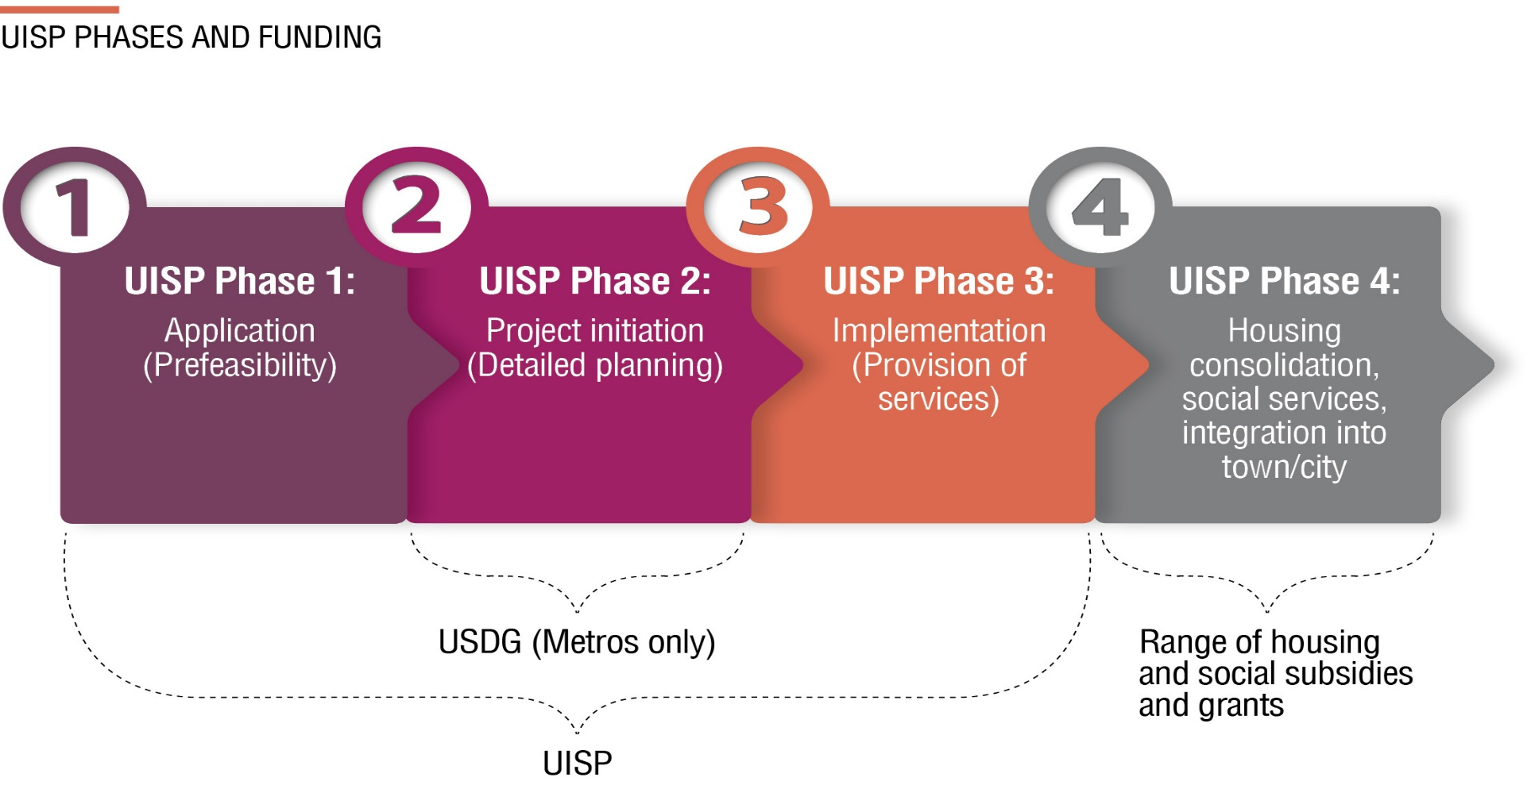
Summary — the UISP planning process

Slide 29
Activity 10.8 What did you gain?
Type of activity: Individual
Timing: 5 minutes
Instruction: Write down five important things you learnt from this module in the Participants Manual.

