Slide 1
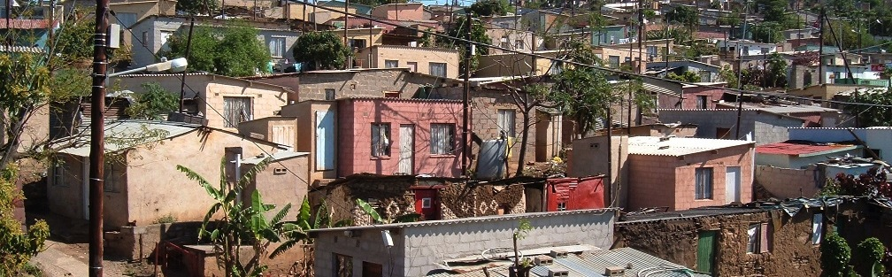


INTRODUCTION TO
INFORMAL SETTLEMENT
UPGRADING
MODULE 2: THE CASE FOR INCREMENTAL UPGRADING

Slide 2
Module purpose
To enable you to understand social conditions in informal settlements and
The importance of interventions that support livelihoods and strengthen social capital, so that you can contribute to including these initiatives in the design and implementation of upgrading projects.

Slide 3
Learning outcomes
After completing this module you should be able to:
Describe social conditions often found in informal settlements and why the situation in informal settlements may make them worse;
Explain what is meant by assets and livelihoods, and why livelihoods are so important;
Identify principles for strengthening assets and planning for livelihood support;
Give examples of support interventions that can link to informal settlement upgrading and strengthen assets and livelihoods.

Slide 4
What the module covers
Beyond poor shelter and services: the social dimensions of upgrading
Finding resources locally: assets and livelihoods
Strengthening social capital and livelihoods
Integrating with informal settlement upgrading
Summing up: The livelihood impacts of upgrading

Slide 5
1. Beyond poor shelter and services: the social dimensions of upgrading
Informal settlement upgrading is about more than the physical development of a settlement – it is also about improving people’s social and economic circumstances.
The overall upgrading process can be a platform for the improvement of the lives of the residents of an informal settlements.
The existing assets that residents draw on and the livelihood approaches they use provide opportunities to do this.
→ This means that life in these neighbourhoods can improve

Slide 6
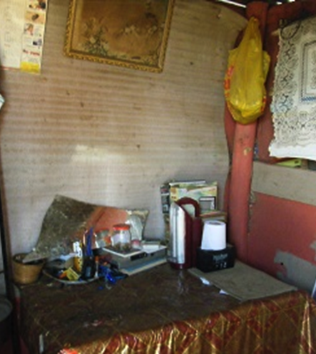
Social and economic problems in informal settlements
High unemployment rates (32% vs 25%)
Lower levels of formal employment (37% vs 53%)
Lower levels of education (2% post-matric vs 11%)
People with insufficient or insecure access to food
A significantly higher prevalence of HIV

Slide 7
Understanding vulnerability in addition to poverty
Physical weakness
Isolation
Power-lessness
Feeling inferior
Poverty is not just lack of money, it is also…

Slide 8
Multiple overlapping vulnerabilities
Vulnerability can be understood as the probability of being exposed to risk and includes…
Not having enough money
Not having a sure source of sufficient food.
Having inadequate access to water, sanitation and electricity.
Living far away from facilities and support programmes
Struggling to meet basic needs
Being female

Slide 9
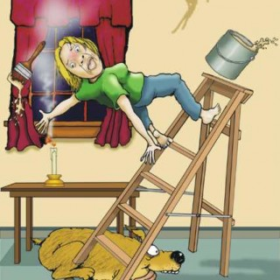
Understanding vulnerability in addition to poverty
Shocks: sudden events impacting negatively
  Human shocks (e.g. illness, accidents);

Slide 10
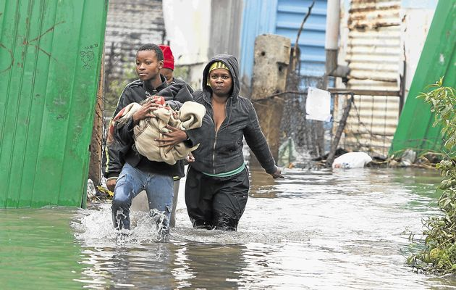
Natural shocks
  Natural shocks (e.g. floods, earthquakes);
Source: http://www.timeslive.co.za/Feeds/2013/04/22/1017922_839747.jpg/ALTERNATES/crop_630x400/1017922_839747.jpg

Slide 11
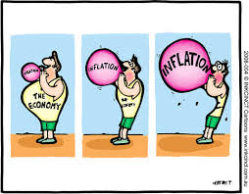
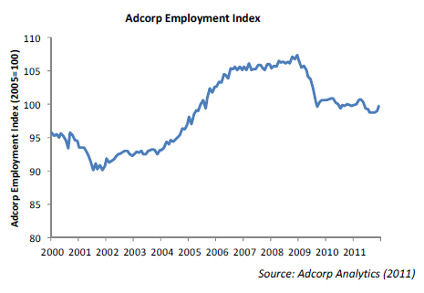
Economic shocks
Economic shocks (e.g. job losses, price increases);
Source: http://cpjohn.in/wp-content/uploads/inflation-cartoon.jpg and http://www.politicsweb.co.za/politicsweb/media_stream/politicsweb/1/274464/images/AdcorpGraph.png

Slide 12
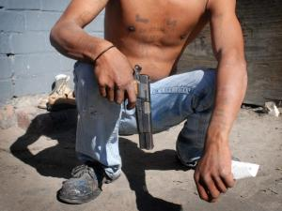
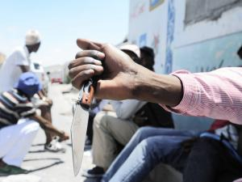
Shocks: Conflict
Conflict (e.g. gang wars; war)

Slide 13
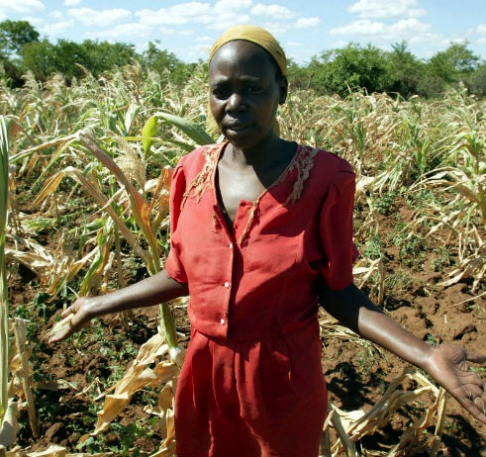
Shocks: Crops and Livestock
Crop/livestock health shocks
Source: http://blogs.cfr.org/campbell/2012/09/07/zimbabwe-crops-fail-hunger-looms/

Slide 14
Vulnerability and Shocks
A focus on vulnerability and shocks assists in understanding social and economic problems that affect informal settlements is useful for us because:
It highlights
  the varied forms of bad circumstances that people are facing simultaneously,
  how the combination of these factors make the prospects for achieving a better life very difficult.

Slide 15
Relationship between vulnerability, risks and shocks
Vulnerability
Risk
Shocks
Poverty

Slide 16
Activity 2.1Impact of informal settlement conditions
Type of activity: Small group work (triads)
Timing: 10 minutes + 20 minutes de-brief
Purpose: In this activity you will consider how the conditions in informal settlements increase vulnerability.
Instruction: The article in the Participant Manual “A big devil in the shacks” describes how the conditions found in informal settlements heighten the risk of fire, as well as the impact of the fire.
Using the article as an example, discuss how the conditions found in informal settlements might make each of the social or economic conditions listed in the Participant Manual worse.

Slide 17
Activity 2.2: Analysing risk
Type of activity: Group work
Timing: 20 minutes + 15 minutes
Purpose: To describe and assess risk in your settlement, using a mapping technique.
Instruction: The facilitator will provide you with a sheet of flipchart paper and a set of coloured pens.
Choose a settlement that you know.
Draw a rough sketch map of the settlement that shows the hazards and risks such as dongas, rubbish piles, unsanitary areas and dangers from cars or trains. Use different colours or symbols for different types of hazard. Identify whether the hazard is there at any time of day, week, month, year when the hazards are better or worse.
After 20 minutes, you will stick your maps onto the wall and walk around to view the maps of the other groups. Each group should identify someone to act as a guide and explain their map to the other groups.

Slide 18
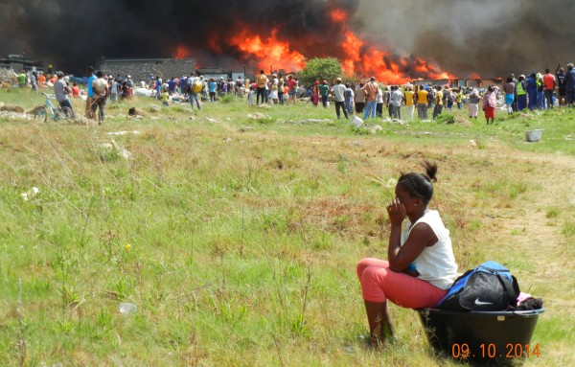

Slide 19
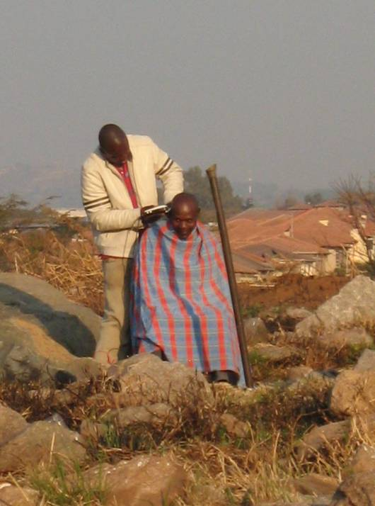
2. Finding resources locally: assets and livelihoods
Assets are:
the resources people are able to draw on
they are the ‘building blocks’ which make people stronger in their life strategies
There are:
Material/ physical resources
Non-material/ social resources

Slide 20
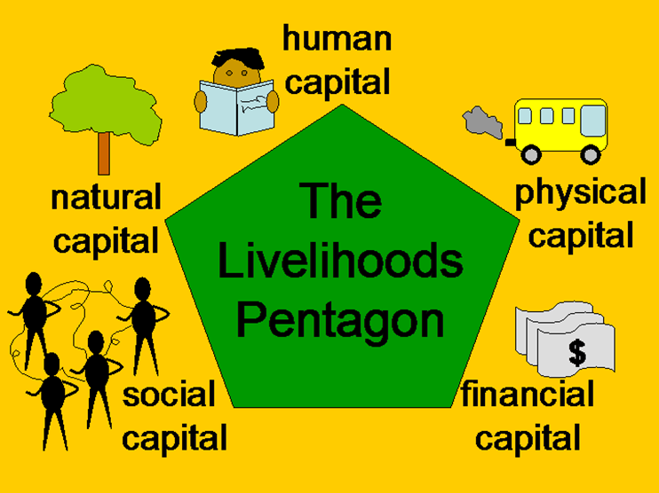
Five Types of Capital or Assets
  Trees, land and water
Skills, knowledge, good health and ability to work
  Affordable transport; shelter; water and sanitation
  Groups, networks, relationships
Savings, loans, grants remittances

Slide 21
Activity 2.3: Assets as Resources
Type of activity: Individual
Timing: 10 minutes
Purpose: To apply the concept of assets as resources to draw on to your own life.
Instruction:
  Imagine that you suffered a shock to your livelihood for example, you lost your job, or broke both your legs in an accident.
  List as many assets as you can, in each of the categories described in the previous slide, which you would be able to draw on to survive

Slide 22
Activity 2.4: Social Capital
Type of activity: Individual & Facilitated Group Discussion
Timing: 5 minutes
Purpose: To identify examples of social capital in the informal settlement you know.
Instruction:
  List as many groups as you can that operate in the informal settlement you know, where people are already joining together to help address a social or economic problem or to gain greater benefit from working as a group.

Slide 23
  Livelihoods and sustainable livelihoods
Resources used + the activities undertaken in order to live = livelihood
People combine activities in different ways to meet their various needs at different times
Livelihood strategy = the range and combination of activities and choices
People require a range of assets to achieve positive livelihood outcomes. No single category of assets on its own is sufficient to yield all the many and varied livelihood outcomes that people seek.
This is particularly true for poor people whose access to any given category of assets tends to be very limited. They have to seek ways of nurturing and combining what assets they do have in innovative ways to ensure survival.

Slide 24
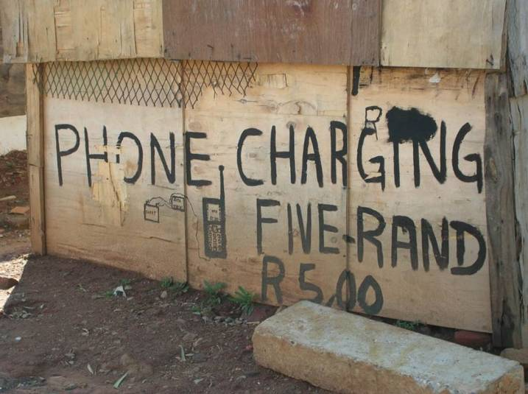
  How to support livelihoods
Focus on people’s strengths and assets
An expanding range of assets strengthens opportunity
Promote choice, opportunity and diversity
Build up the ability to take advantage of these opportunities

Slide 25
Sustainable livelihoods
Are able to cope with and recover from shocks
Maintain or enhance its capabilities and assets now and in the future
Improving people’s livelihoods is about improving their living conditions, quality of life and prospects for the future.
The objective is to increase resilience or the ability to recover from negative events, and to reduce dependency on outside support
BUT:
Be aware there is competition for resources
Interventions can favour some and disadvantage others
‘Safety nets’ might be needed for those that are marginalized and most vulnerable

Slide 26
Activity 2.5: Livelihoods
Type of activity: Group work
Timing: 15 minutes
Purpose: To build understanding of shocks, assets and livelihood strategies.
Instruction: Read the case study about Vuyiswa Magadla in the Participants Manual and identify the shocks she experienced and the livelihood strategies she used.

Slide 27
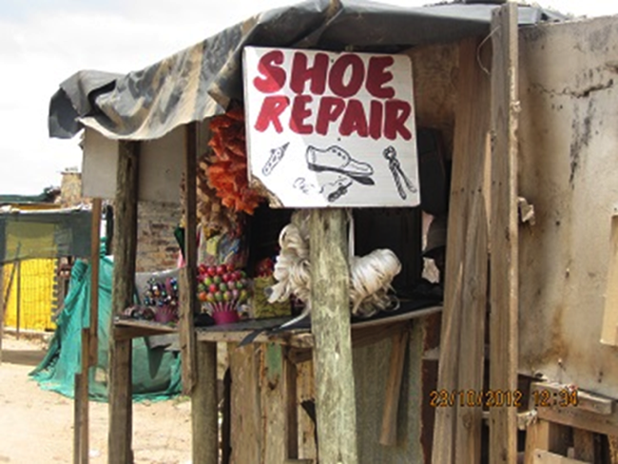
3. Strengthening social capital and livelihoods
What to strengthen and how to do so
Adopt a participatory approach
Scan widely, then focus
Recognise difference in the community: differentiate need and responses
Build on strengths: existing talents, skills, activities, opportunities and features
Identify external support

Slide 28
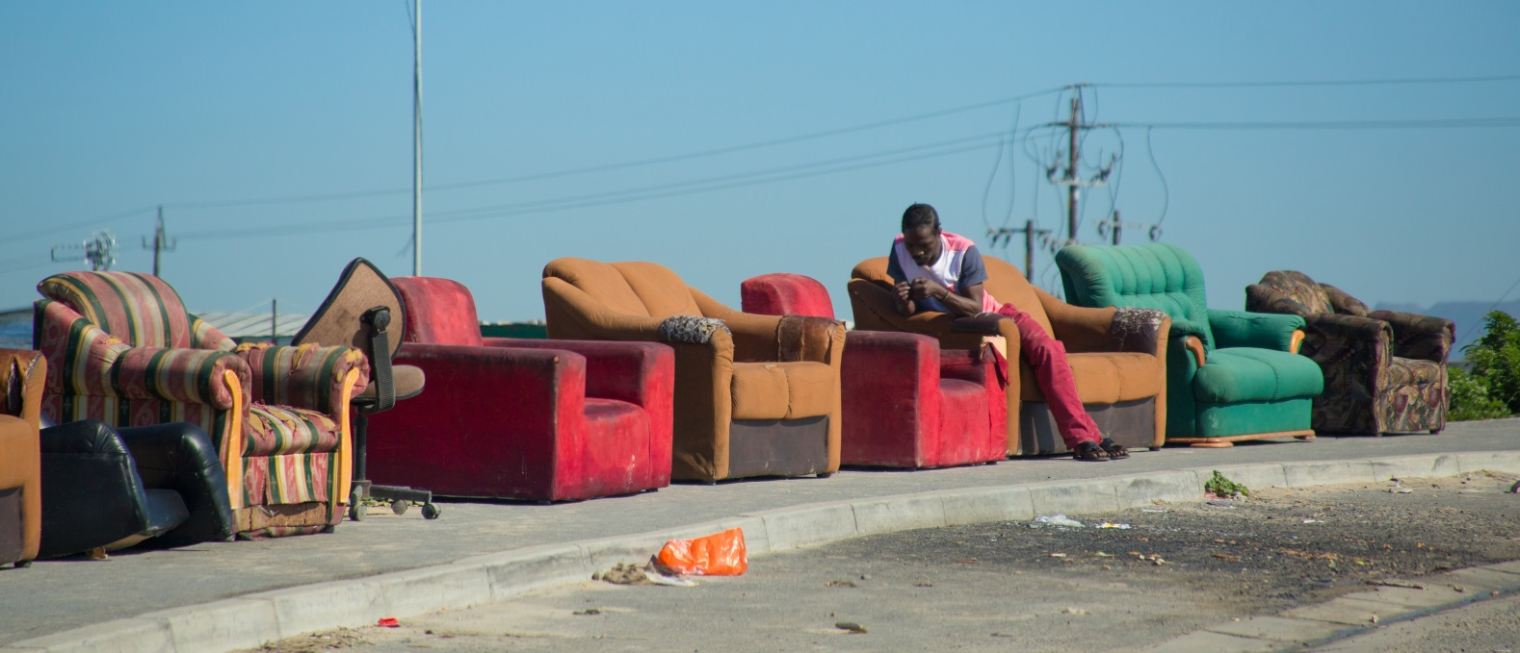
Strengthening social capital and livelihoods
Informal settlements offer livelihoods opportunities to residents. Informal economic activity is vital:
  A platform for more inclusive and sustained economic growth
  To meet immediate household needs and improve livelihoods.

Slide 29
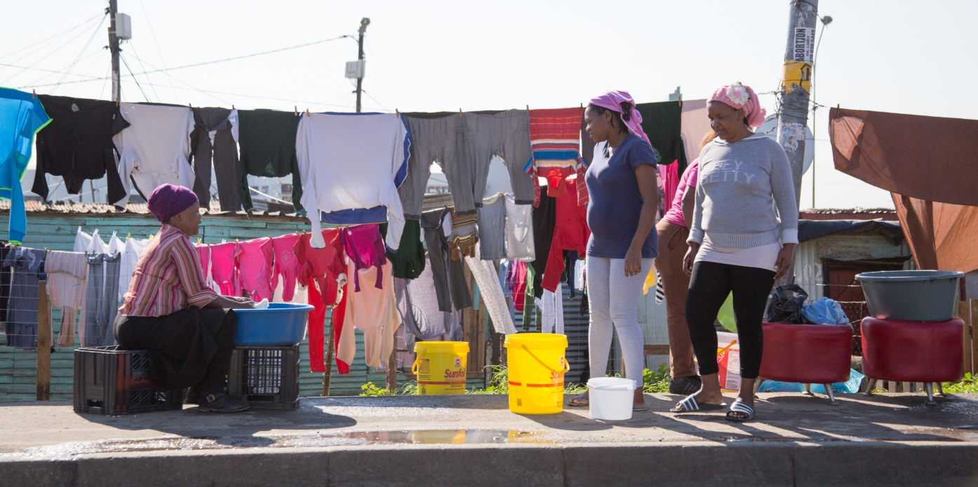
Strengthening social capital and livelihoods
Various methods and tools
  Identify existing characteristics, patterns, issues and circumstances
  Identify and agree on how to improve things, what to prioritise and how to get support with these

Slide 30
4. Integrating with informal settlement upgrading
How government sees the social dimensions of upgrading:
Emphasises the importance of improving socio-economic conditions
Outcome 8
UISP (Housing Code)
National Development Plan
UISP requires a settlement-level response plan
  a plan for the transformation of the target community into a sustainable human settlement.
  tied into municipal planning and budgeting processes

Slide 31
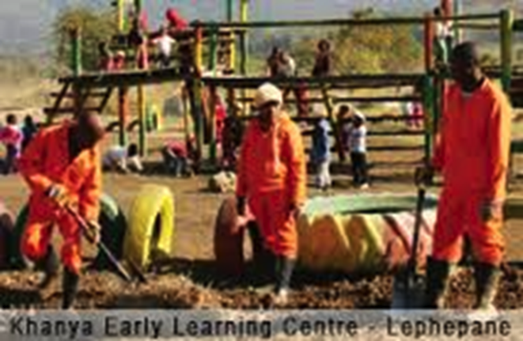
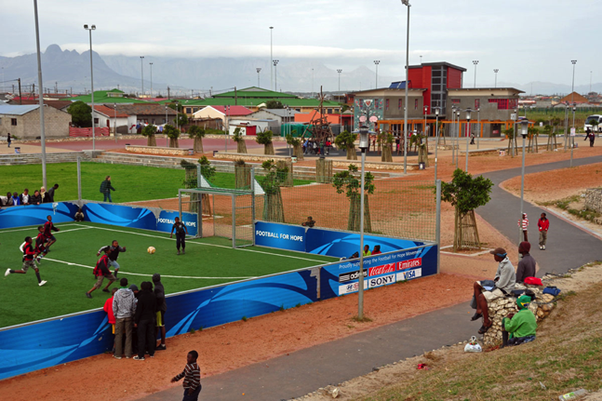
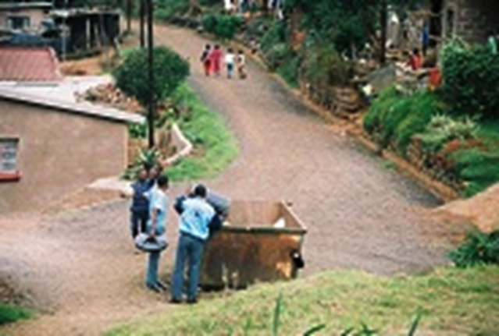
Examples of activities, interventions and partners
Community Works Programme.
Active boxes built in Khayelitsha through the VPUU
Community based maintenance in Msunduzi

Slide 32
Activity 2.6: Proposing a CWP Project
Type of activity: Group Work
Timing: 15 minutes
Purpose: To link a problem in the informal settlement you know to an idea for a work and infrastructure initiative.
Instruction: Refer to the map you drew earlier of the risks in the settlement you know.
  Identify a possible CWP initiative that could be integrated with an upgrading project to improve socio-economic conditions.
  Describe the initiative by responding to the questions in the Participants Manual.

Slide 33
5. Summing up: The livelihood impacts of upgrading
Informal settlements can improve access to livelihoods by strengthening ‘capital’:
Human capital - Health improvements and reduced health risks (e.g. water and sanitation provision). Increased skills and knowledge through participatory processes
Social capital - Sense of permanent community through secure tenure; improved access to support services; network building through community participation and empowerment

Slide 34
The livelihood impacts of upgrading cont.
Natural capital - Improved natural environment through the provision of water and sanitation services, storm-water drains and electrification
Physical capital - Provision of basic services: water, sanitation, drainage, access to public transport, area lighting, electrification
Financial capital - Secure tenure as a focus for investment; a fixed address improves access to banking facilities; improved employment opportunities through provision of transport, local economic amenities, and participatory processes

Slide 35
The livelihood impacts of upgrading
Reduced vulnerability to external shocks through
Security of tenure
Greater social cohesion
Pro-poor attitudes from officials, professionals and politicians engaging in the upgrading process (but can take time for attitudes to change)

Slide 36
Activity 2.7: What Did You Gain?
Type of activity: Individual
Timing: 5 minutes
Instruction: Write down at least three important things you learnt from this module, and at least one thing that you will do differently when working in informal settlement upgrading.

